Slide 1

P
Data Protection Operations – Planning a Programme
May 5th, 2022 compliance.ie

Slide 2

Welcome & Introduction
Thank you for registering
Questions
  Please use the question box on the right of your screen to send the questions for our speaker
Today’s session will be recorded and will be on our website later today
The CPD code is noted below and will be sent out directly after this session has concluded
CPD CODE: 2022-1195

Slide 3
What we will cover?
Why Privacy, Security and Data Protection is so important in financial services
Back to basics: know your client, know your data!
What is involved in a core program?
Low hanging fruit and common pinch points:
Communication and Training
3rd party and the supply chain: how risk gets outsourced
Looking to Europe and the US
Organisational resilience
Notes:
3

Slide 4
Poll Question #1
Are Security and Privacy working closely together in your organisation?
A. Always work together
B. Often work together
D. Rarely work together
E. Never work together
Notes:
4

Slide 5

1. Why Privacy , Security and Data Protection are so important in financial services

Slide 6
1. Why Privacy , Security and Data Protection are so important in financial services
Outsourcing requirements
“Ensure adherence with the requirements of
any data protection legislation, including GDPR which apply to the operations of the Firm”
CBI cross industry guidance on outsourcing – December 2021
European Bank Authority updated guidelines on outsourcing 2019
CBI discussion paper: outsourcing: findings and issues for discussion 2018
CBI Investment Firms Regulations 2017
“These considerations are particularly important when assessing the risks
associated with offshoring especially
outside the EU/EEA”
EU and Irish regulatory framework but what about other non EU regimes?
Cyber security requirements
Data protection requirements
CBI Securities Markets Risk Outlook Report February 2022
24 February 2022: Russia invades Ukraine
GDPR but only?
Schrems II decision of July 2020

Slide 7
1. Why Privacy , Security and Data Protection are so important in financial services
December 2021: CBI cross industry guidance on outsourcing
Must ensure outsourcing risk assessments are tailored to take account of specific risks associated with outsourcing, including cyber risk
When conducting due diligence review of outsourced service providers, Firms must consider effectiveness of risk management and internal controls, including IT and cybersecurity in providing appropriate technical and organisational measures to protect data
Where relevant, carry out security penetration testing to assess effectiveness of implemented cyber and internal security measures and processes

Slide 8
1. Why Privacy , Security and Data Protection are so important in financial services
8 February 2022: CBI Securities Markets Risk Outlook Report
With digital transformation increasing risk of cyber attacks, Firms expected to take steps to understand critical business services and ensure they are more resilient to disruption from operational and cyber risk
Steps expected to be undertaken by Firms include:
  regular staff training on all aspects of cyber security, with regard to international best practice in this area, including, for example, simulated phishing emails
  have a program of risk analysis and oversight to identify and minimise sources of cyber security risk
  have emergency procedures, backup facilities, and plan for disaster recovery that allow for timely recovery and resumption of operations
  have automated systems that are reliable, secure and have adequate scalable capacity

Slide 9


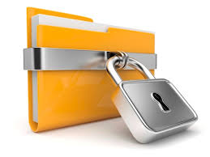
2. Back to Basics: Know You Client, Know Your Data
If you collect it, protect it: Art 32
Notes:
9

Slide 10
2. Back to Basics: Know You Client, Know Your Data
Map data flows both within your organisation and with your vendors / sub-processors
Assess data transfer impacts and related risks outside your organisation (Schrems II decision and Ukraine situation)
Refresh at least on annual basis all relevant documentation:
    Policies and procedures
    Data protection terms with clients and vendors / sub-processors as need be (CNIL decision of 15 April 2022)
    Training documentation (taking into account emerging risks)
    Personal data / cyber security incident response plan
Accountability: training and awareness throughout entire organisation
Document, document and document!

Slide 11
3. What is involved in a core program?
Evidence ID and topic | Regular/ on-going action | Deadline
1. Respond to Requests and Complaints from Individuals | Capture detail of subject rights requests | Ongoing
2. Conduct PIAs/DPIAs for new programs, systems, processes | Capture all DPIAs conducted in an internal DPIA folder. | Ongoing
3. Maintain a log to track data privacy incidents/breaches | Capture and manage all personal data breaches as required by any Breach Notification & Response Policy | Ongoing
4. Contact point for and cooperates with any Supervisory Authority on data protection/ privacy topics | Capture correspondence with DPC | Ongoing

Slide 12
3. What is involved in a core program?
GDPR topic | Detailed action (annual) | Deadline
1. Responsibility for data privacy has been assigned to an individual | Update the evidence repository with any changes to DPOs | Month
2. Appoint a Data Protection Officer (DPO) in an independent oversight role | Provide confirmation that the privacy notice contains the details of how to contact the DPO | Month
 | Update the evidence repository with any changes to DPOs showing that the Supervisory Authority has also been made aware | Month
 | Provide a organisation chart showing where in the the DPO/ Privacy Officer | Month
3. Data privacy requirements for third parties | Update Data Processing Agreement / Joint controller language incl 3rd party DD, risk assessments & SCC | Month
4. DPO details in the Data Privacy Notice | Maintain privacy notice template with up to date DPO information and accurate LIA information | Month
5. Data Privacy Notice | Maintain a repository of privacy notices used and the period they were used. | Month
6. Data transfer mechanisms | If used, capture details of new Standard Contractual Clauses, IDTA, Regulator Approval, Derogations | Month
7. Maintaining and updating the Country personal data processing inventory | Review the 'processing inventory' (Art 30 records) and reach out to process owners to confirm the details are accurate. Do LIA for new elements | Month
8 Legal basis for processing | Review the Legal basis (art. 30) documented ROPA and ensure embedded in Privacy Notice | Month
9. Policies/procedures for obtaining valid consent | Review any changes to the use of consent by the business to ensure it is compliant with the GDPR. Record consents. *especially cookie consent | Month
10. Conduct self–assessments of privacy management | Support an internal audit to assess compliance 12 months annually from GDPR. | Month

Slide 13
3. What is involved in a core program?
11. Maintain policies/ procedures for integrating data privacy into records retention practices | Review and update company data retention policy and update the evidence repository as required | Month
12. Maintain policies/ procedures for the de-identification of personal data | Review your deletion practices and ensure validity. Capture the details of the processes reviewed and the actions taken | Month
13. Integrate data privacy into the organization’s use of social media practices | Review your company use of social media (marketing) practices to determine whether they are compliance. Capture the details of the processes reviewed and the actions taken | Month
14. Maintain policies/procedures for use of sensitive personal data; secondary uses of personal data; maintaining data quality; Integrating data privacy into research practices (e.g., scientific and historical research) | Review your country use of sensitive personal data, secondary use of data, personal data for research purposes and how you maintain data quality Capture the details of the review and the proposed actions | Month
15. Budget and resources allocated for the DPO role | Provide an email/document that shows the DPO budget and resources that have been/ will be allocated for the financial year | Month
16. Privacy by Design | Provide or update a document indicating which business processes have included a step to consider data privacy and guidelines on when to conduct a Data Protection Impact Assessment (DPIA) | Month
17. Appoint a Data Protection Officer (DPO) in an independent oversight role | Store proof of attendance and achievement of qualification for the DPO and / or other relevant privacy officers | Month
18. Identify ongoing privacy compliance requirements, e.g., law, case law, codes, etc | Document the use of software, resources; conferences attended and; use of law firms | Month

Slide 14
Poll Question #2
What are the common pinch points ?
A. Communication
B. Buy in from the business
C. Buy in from the board
D. Budget
E. Other
Notes:
14

Slide 15
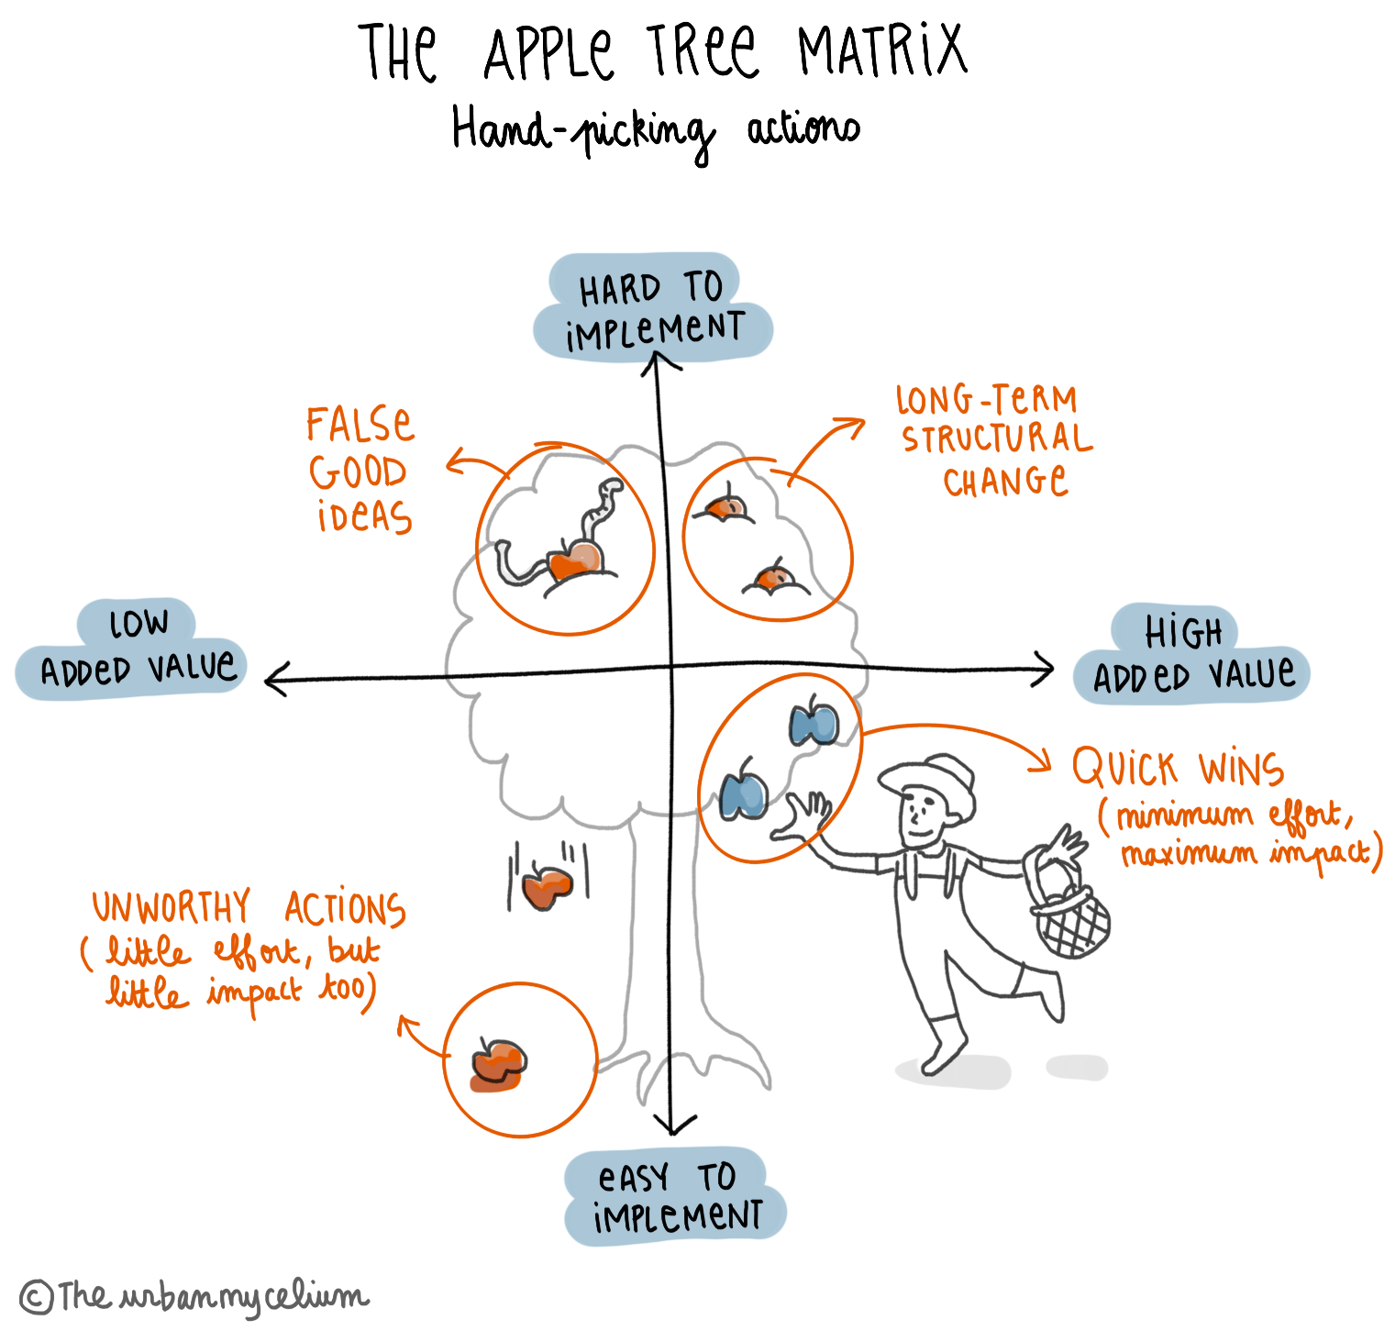
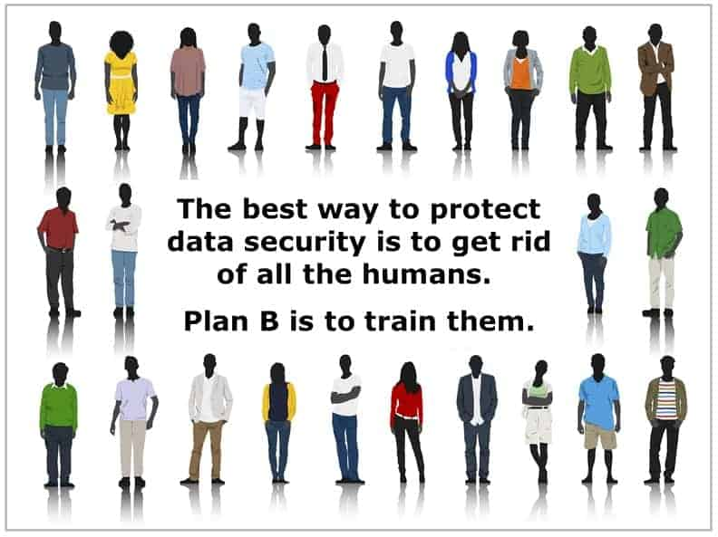
4. Low hanging fruit and common pinch points:
Communication and Training

Slide 16
4. Low hanging fruit and common pinch points:
Communication and Training
24 February 2022: Russia invades Ukraine
CBI correspondence with Firms of 25 February 2022 : a reminder to Firms that they need to:
  be aware of significantly increased cyber threat landscape resulting from Russia's invasion into Ukraine
  be on heightened alert for cyber-attack and have measures in place to detect, defend and recover as needed, to both protect and ensure continuity of their operations
  assess their exposure to cyber risks, including indirect exposures via third parties
  monitor notifications from National Cyber Security Centre (NCSC) and review NCSC recommendations on actions firms should be already taking

Slide 17

5. 3rd party and the supply chain: how risk gets outsourced
Maintain oversight of partners & vendors.
Schrems II
3rd party due diligence
3rd party regulatory risk
This Photo by Unknown Author is licensed under CC BY-NC

Slide 18
5. 3rd party and the supply chain: how risk gets outsourced
GDPR: both controllers (clients) and processors (delegates) are subject to EU statutory duties and obligations and corresponding increased fines and administrative sanctions (Art. 82 and 83 of GDPR) (up to 20 million euros, or, in case of undertaking, up to 4% of entire global turnover of preceding fiscal year, whichever is higher)
CBI focus on data protection compliance in outsourcing guidance:
  “Must assess the risks associated with offshoring especially outside the EU/EEA”

Slide 19

6. Looking to Europe and the US
and where might other privacy laws be relevant to my organisation

Slide 20
6. Looking to Europe and the US
From an EU / UK perspective
New EU data protection regime (General Data Protection Regulation or “GDPR”) in effect since 25 May 2018
New EU framework on data transfer to third countries (Standard Contractual Clauses of 4 June 2021 with supplementary measures obligations)
New UK framework on data transfer to third countries (International Data Transfer Agreement and UK addendum to EU Standard Contractual Clauses of 21 March 2022) for compliance with UK-GDPR

Slide 21
6. Looking to Europe and the US
From an non EU perspective - emerging privacy markets include:
Cayman Islands Data Protection Act (2021 Revision (in effect since September 2019)
California Consumer Privacy Act of 2018, California Civil Code § 1798.100 to 1798.199 and regulated regulations (in effect since 1 January 2020)
China Personal Information Protection Law 2021 (in effect since 1 November 2021) with extra territoriality application

Slide 22
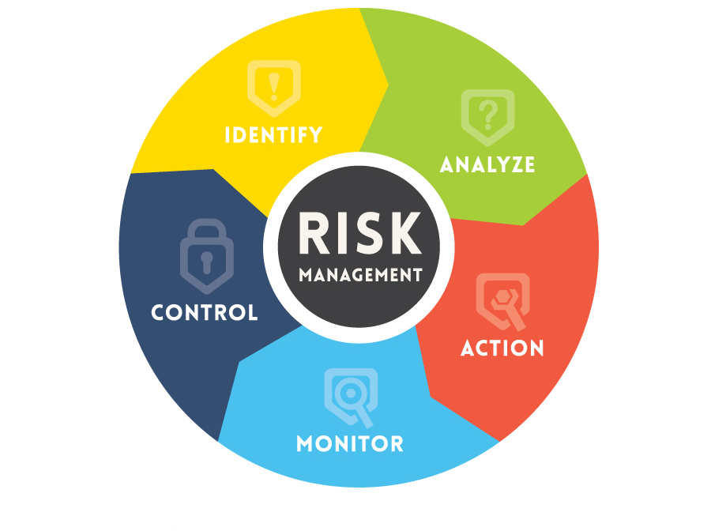
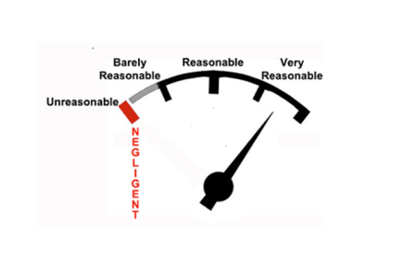
7. Organisational resilience
and why it should be the baseline of any program
Confidentiality
Integrity
Availability
Resilience

Slide 23
7. Organisational resilience
December 2021: CBI Cross Industry Guidance on Operational Resilience (Guidance)
Guidance built around three pillars of Operational Resilience:
Identify and Prepare
Respond and Adapt
Recover and Learn
“Operational resilience is the ability of a firm, and the financial services sector as a whole, to identify and prepare for, respond and adapt to, recover and learn from an operational disruption”

Slide 24
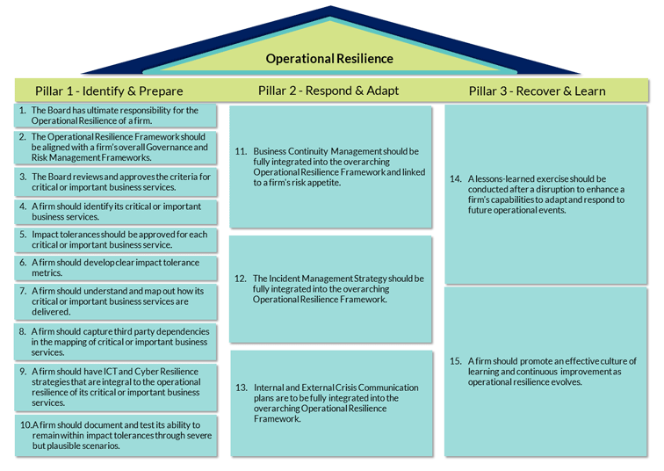
7. Organisational resilience

Slide 25
P
Questions & Answers
CPD CODE: 2022-1195

Slide 26

Thank You For Attending Data Protection Operations – Planning a Programme
A recoding of this webinar and the CPD code will be available on our website later today.
CPD CODE – 2022-1195
compliance.ie

