Slide 1
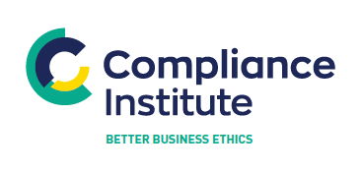
P
Risk Maturity Model –
How to improve risk embeddedness
21 September, 2022 compliance.ie

Slide 2

Welcome & Introduction
Thank you for registering
Questions
  Please use the question box on the right of your screen to send the questions for our
  speaker
Today’s session will be recorded and will be on our website later today
The CPD code is noted below and will be sent out directly after this session has
concluded
CPD CODE: 2022 - 2195

Slide 3



The Dark Arts Of Risk Management

Slide 4
Approach for today
  Understanding Where You Are
  Risk Maturity vs Risk Embeddedness
  Risk Identification & Risk Registers
  Risk Management
    Risk Controls
    Risk Reporting & Monitoring
    Risk Appetite, Tolerance & Capacity
    Setting Risk Appetite
  Governance Risk
  Operational Considerations
  Risk Management & Technology
  Risk Training
  Regulators View

Slide 5
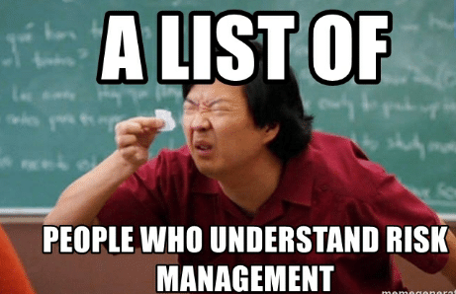

Slide 6

Question:
Where are we on our Risk Management Journey?

Slide 7
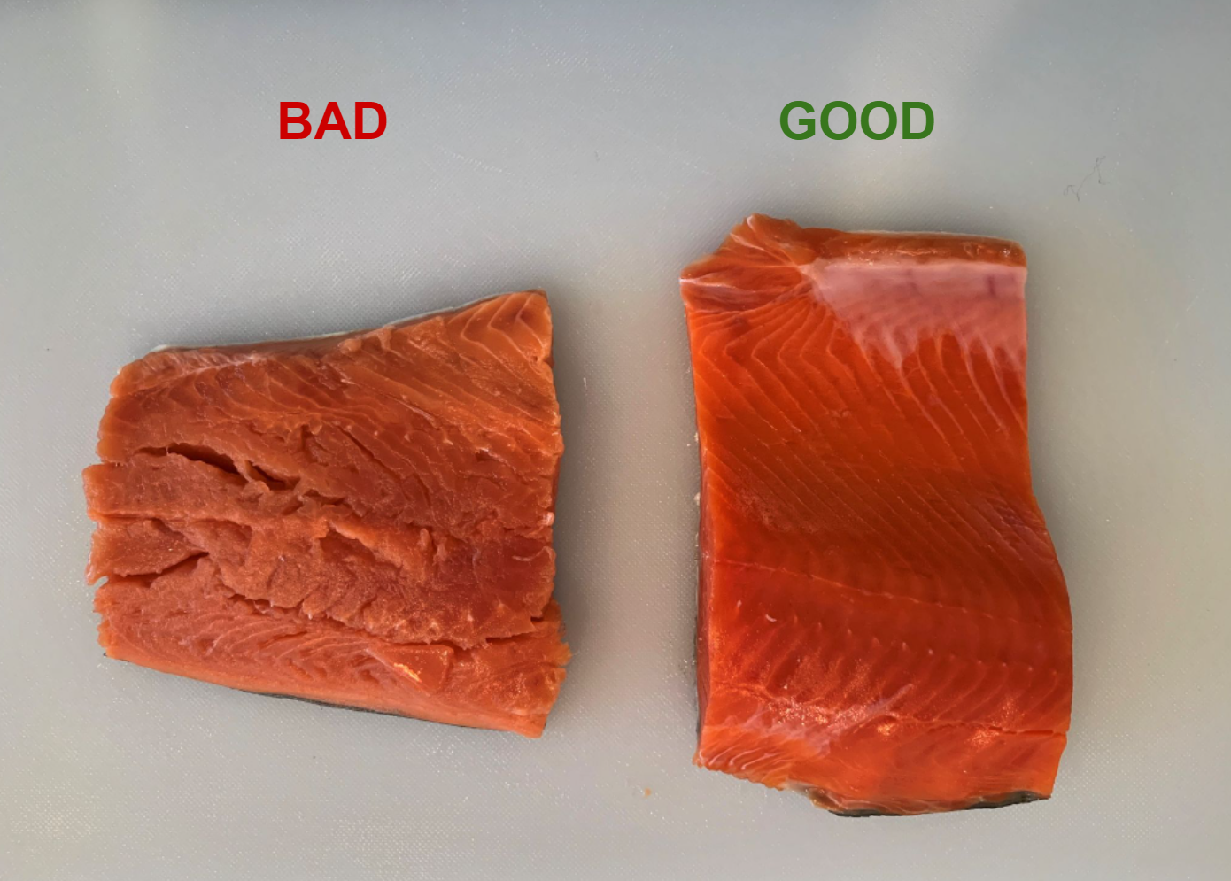
Question:
Do You Know What Good vs. Bad Risk Management Looks Like?

Slide 8

Develop Risk Management Plan and Checklist

Slide 9
Risk Management Plan – Suggested Sections
  Risk Identification
  Risk Assessment
  Risk Controls
  Risk Reporting
  Risk Recommendation
  Risk Management Policy
  Risk Appetite Statement
  Risk Maturity Assessment
  Risk Management System
  Risk Reserve
  Risk Culture
  Risk Management Officer
  Risk Events / Loss Events
  Risk Governance
  Risk Training

Slide 10
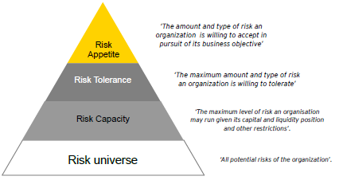
Risk Framework – Bottom Up vs Top Down. Which One Are You?

Slide 11

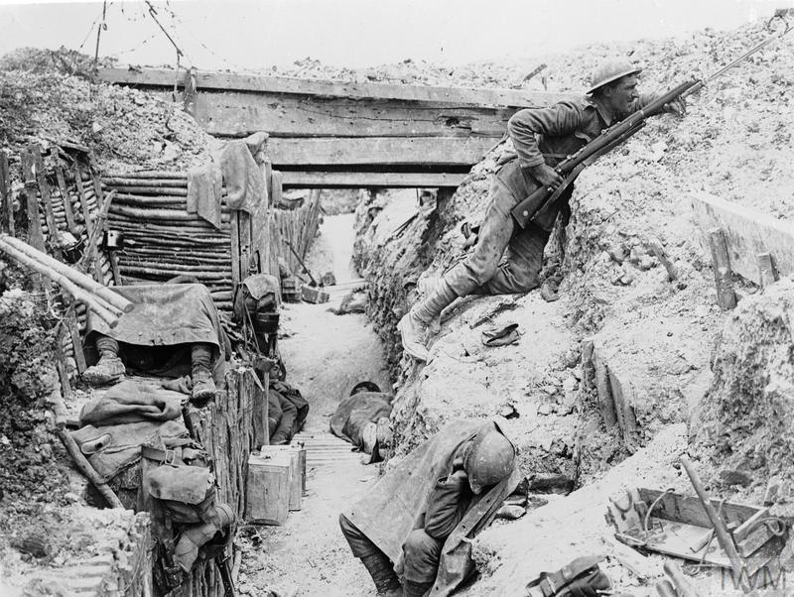
Risk Maturity and Risk Embeddedness

Slide 12

Risk Maturity and Risk Embeddedness

Slide 13
Risk Maturity and Risk Embeddedness
Embedded risk management is where the right techniques are applied where appropriate, in the right strength, and in a way that generates evidence of operation and effectiveness. How do we achieve effective risk management?
The concept of risk maturity is one that has largely developed outside of the academic realm. It has come to be understood as the measure adopted by organisations to help them better understand their overall risk position including the value created from risk management initiatives. Despite lacking a clear or universal definition, risk maturity is a concept that is becoming better understood amongst senior management.

Slide 14
Risk Embeddedness
How do we achieve effective risk management?
Effective risk management within organisations can only be achieved when staff are willing to engage in risk management activities. Only then can the board’s risk taking and control objectives be achieved. In short, risk management cannot be effective if it is not embedded.
To be able to do this, we need to understand how board-level risk taking and control objectives translate into the risk management activities. That includes recognising how these activities are performed within organisations.
Organisations are taking different paths to embedding risk management depending on the external environment in which they operate. A range of internal factors, such as leadership tone and the success or failure of past risk management initiatives, also contribute to the varied approach to risk management.
Key findings
Communication is vital (Casual, Informal and Structured). This includes communication between business units and functions, as well as communication to/from the risk management function and internal audit function.
The risk management function has a pivotal role in communication and building risk management relationships.
The risk management function does not only design and implement risk identification, assessment and reporting tools; it must also work hard to explain and even sell the benefits of risk management to the wider organisation.
The mix of formal and informal is key
There are no easy answers or quick fixes when embedding risk management. What works differs from one organisation to the next. Nevertheless, it is possible to identify common challenges and good practices to overcome these challenges.

Slide 15
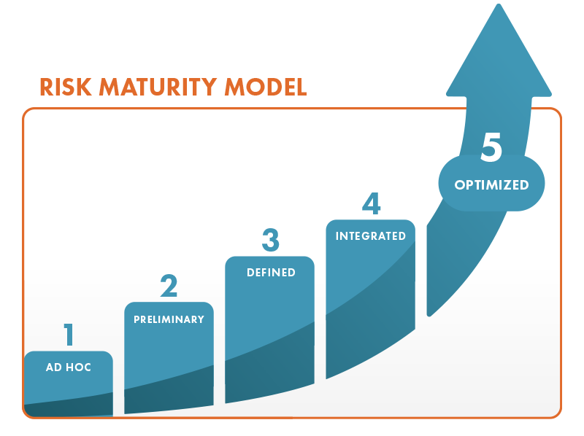
Risk Maturity

Slide 16
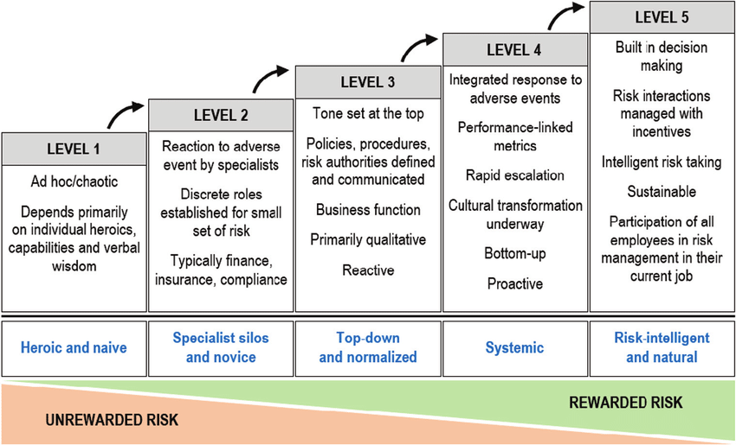
Risk Maturity Model

Slide 17
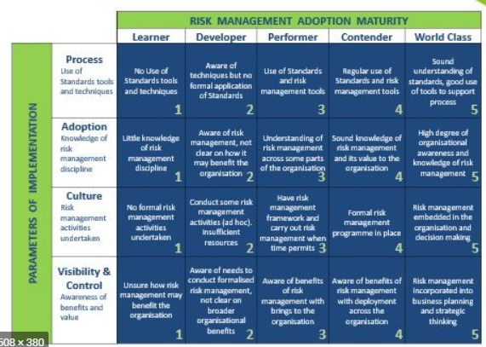
Risk Maturity Assessment

Slide 18
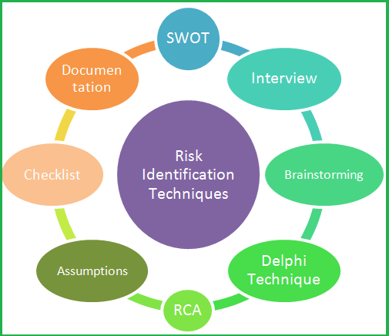
Risk Identification

Slide 19
Risk Management and Strategic Planning

Slide 20
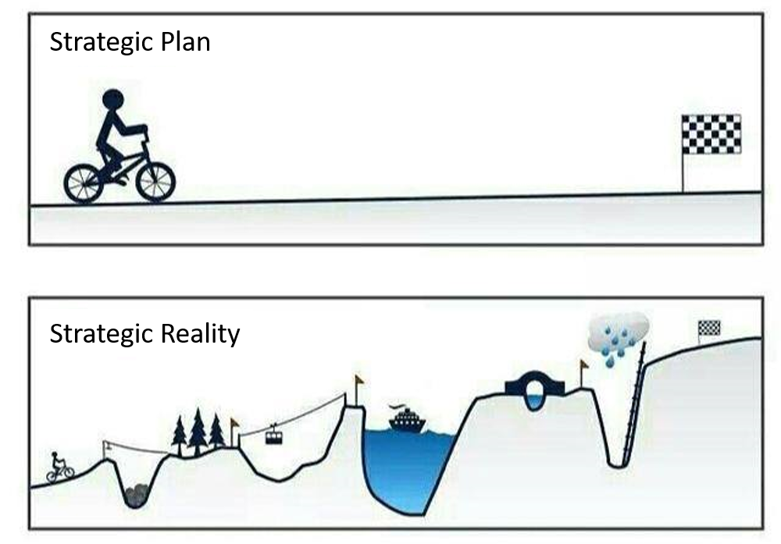
Strategic Plan and Risk Management

Slide 21
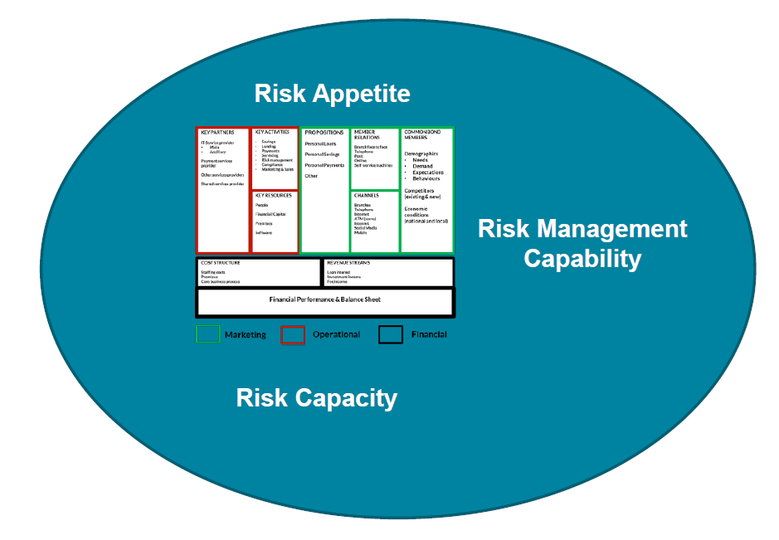
Strategic Plan & Risk Management

Slide 22
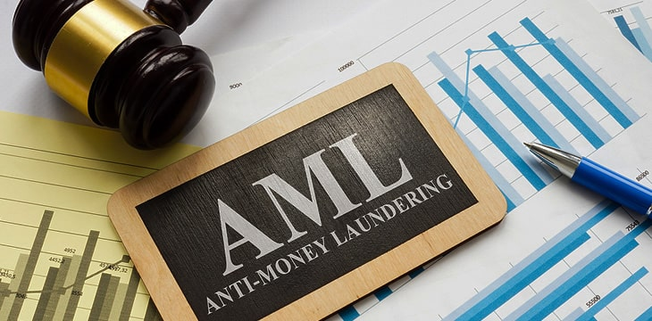





Risk Hierarchy - Develop Corporate, Sub and Standalone Risk Registers

Slide 23
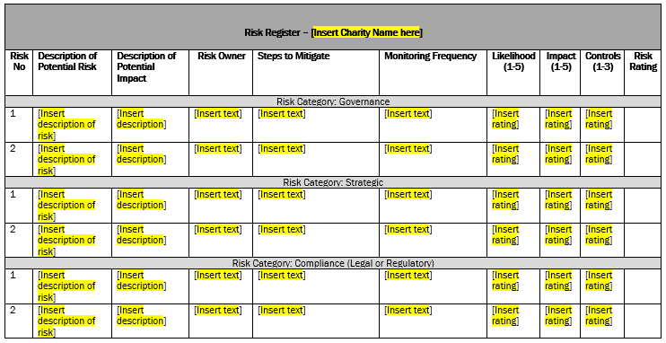
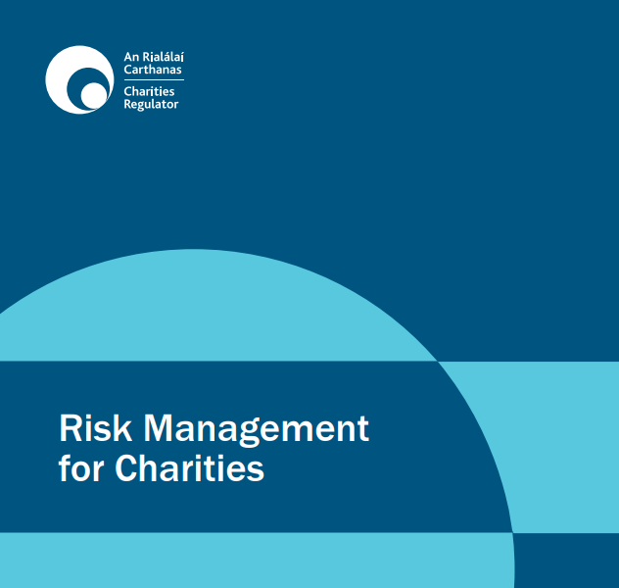
Charities Regulator Sample Risk Register
In Word Document instead of Excel

Slide 24
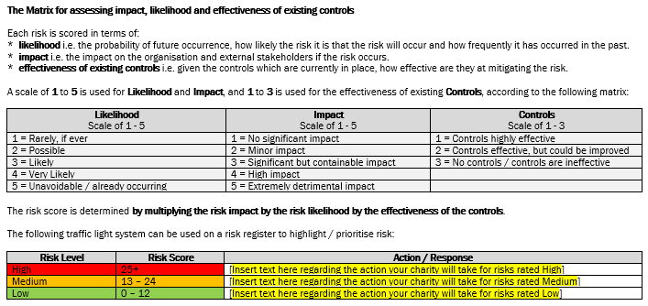
Regulator Sample Risk Register

Slide 25
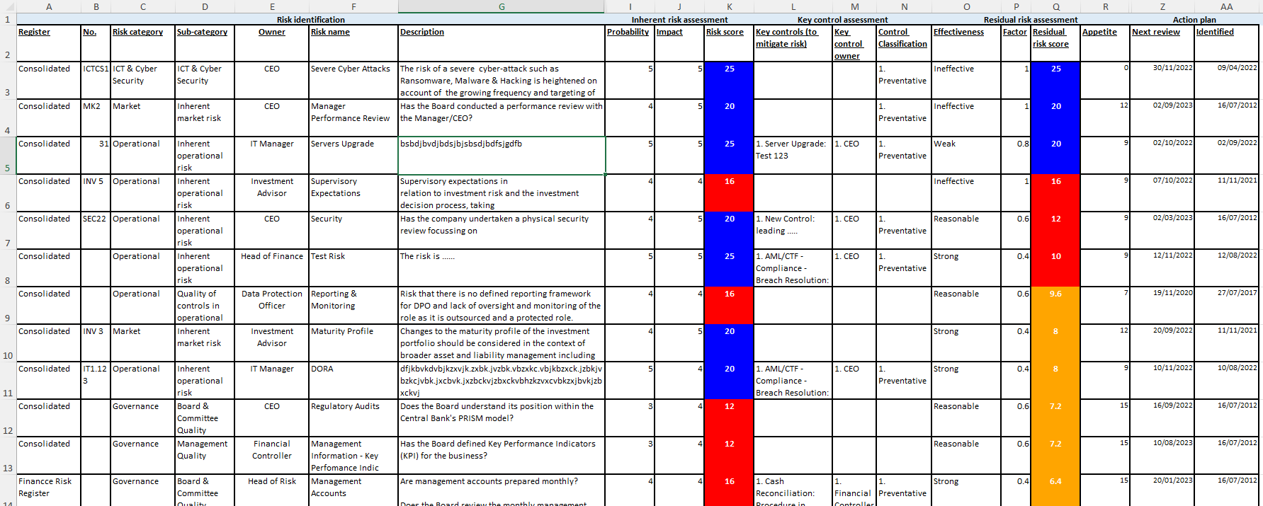
Risk Identification – Risk Register

Slide 26

Risk Management In Excel

Slide 27

Risk Management In Excel

Slide 28
Problems With Risk Registers In Excel !!
  Tells you the score you expect
  Reporting is extremely difficult
  Version Control after changes are made
  Integration with other systems and API’s Poor
  Integration with Control Framework is Poor
  Integration with Key Risk Indicators / Trigger Events
  History of risk and trend analysis difficult to record
  Embeddedness across the organisation
  Subject to Human Error

Slide 29
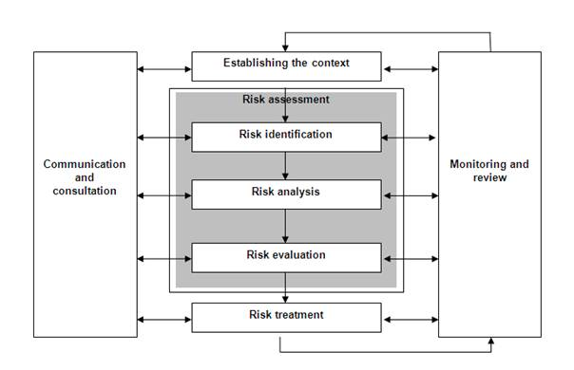
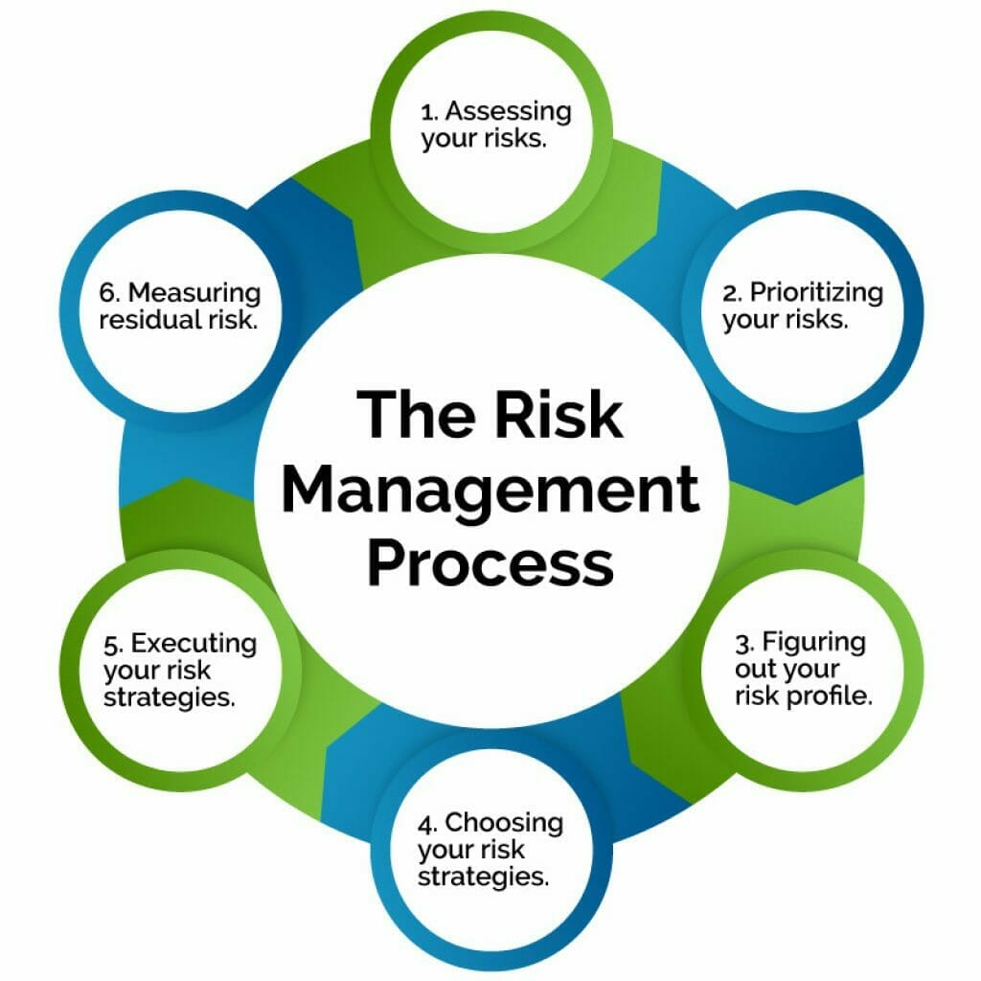
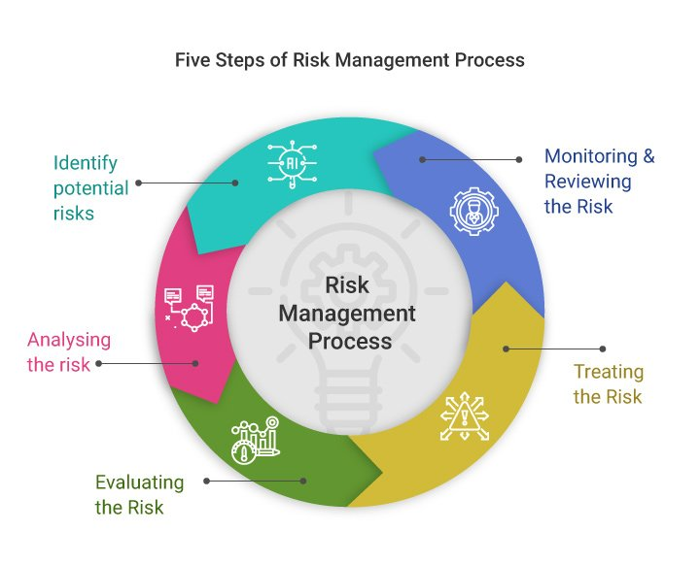
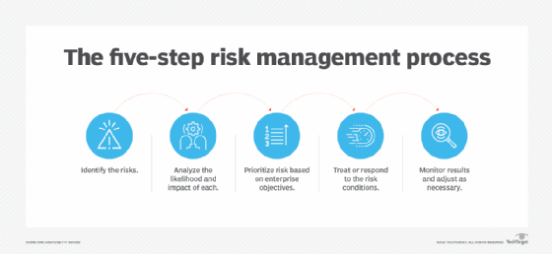
Risk Management

Slide 30
Risk Management
  Risk Controls
  Risk Evaluation
  Risk Reporting
  Risk Monitoring
  Risk Appetite, Tolerance & Capacity
  Setting Risk Appetite

Slide 31
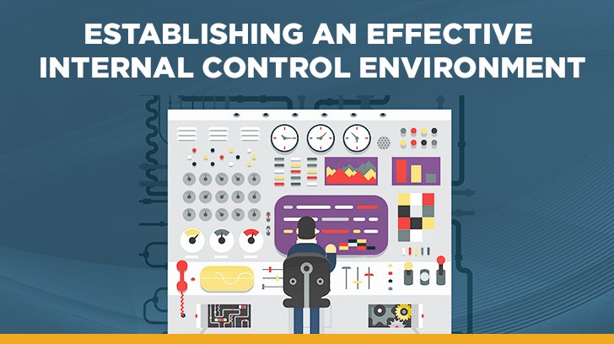
Risk Controls

Slide 32
Risk Controls Definition
  Risk control, also known as hazard control, is a part of the risk management process in which methods for neutralising or reduction of identified risks are implemented. Controlled risks remain potential threats, but the probability of an associated incident or the consequences thereof have been significantly reduced
  Risk control is the set of methods by which firms evaluate potential losses and take action to reduce or eliminate such threats. It is a technique that utilizes findings from risk assessments, which involve identifying potential risk factors in a company's operations, such as technical and non-technical aspects of the business, financial policies and other issues that may affect the well-being of the firm.
  Risk control also implements proactive changes to reduce risk in these areas. Risk control thus helps companies limit lost assets and income. Risk control is a key component of a company's enterprise risk management (ERM) protocol.

Slide 33
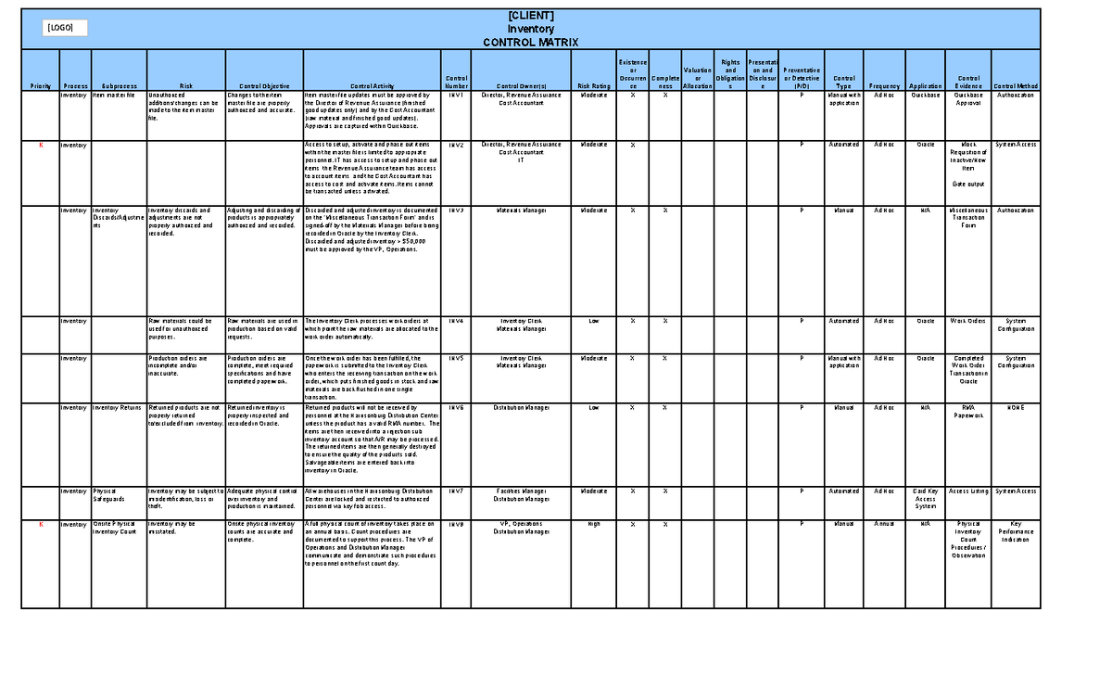
Risk Controls

Slide 34
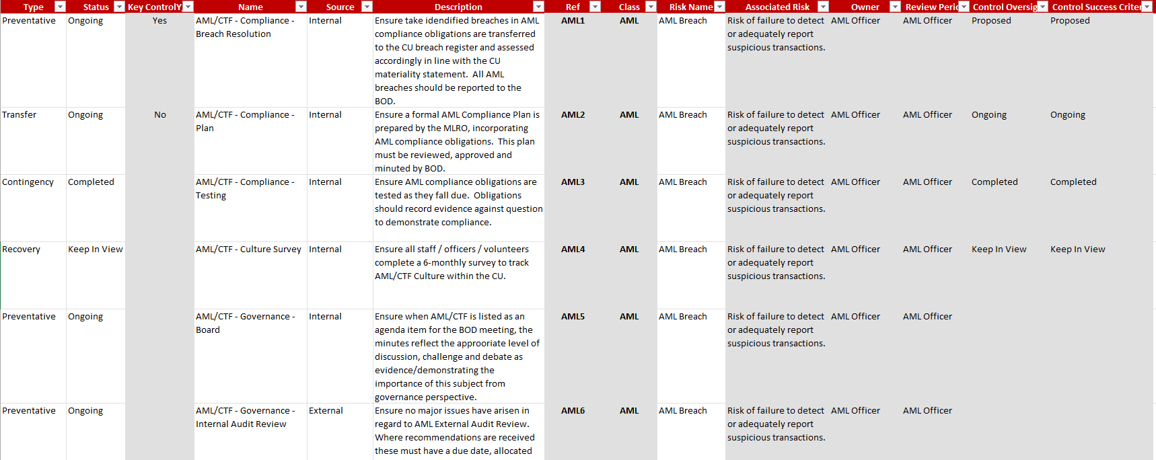
Risk Controls

Slide 35
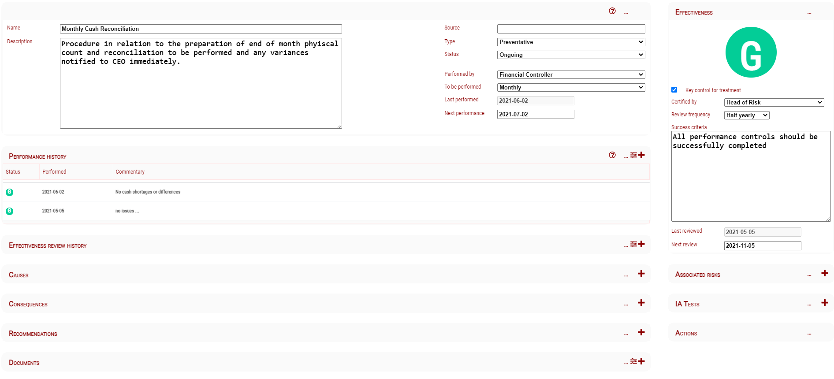
Document Internal Controls

Slide 36
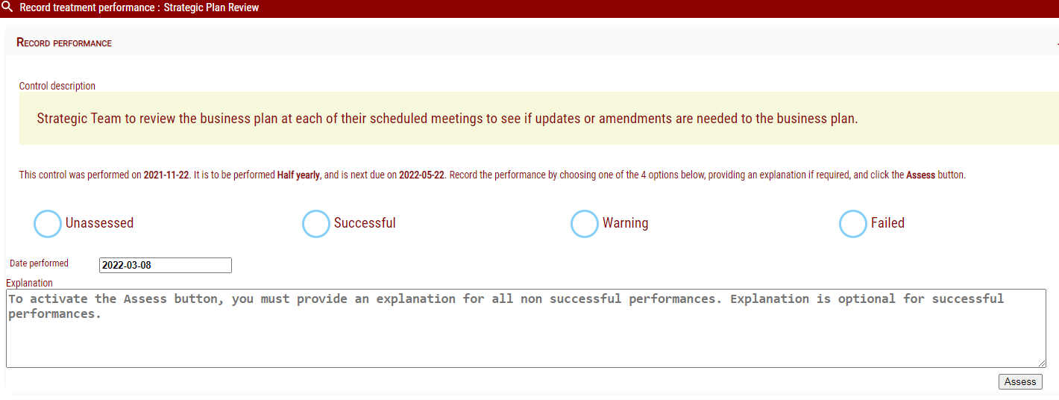
Record Internal Control Performance – “FLOD”

Slide 37
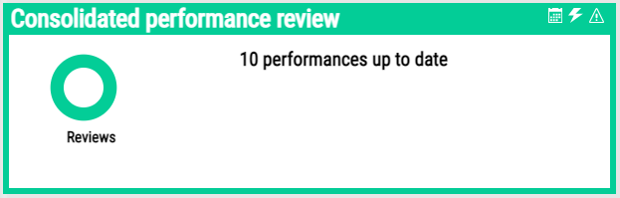
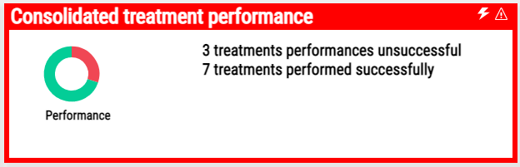
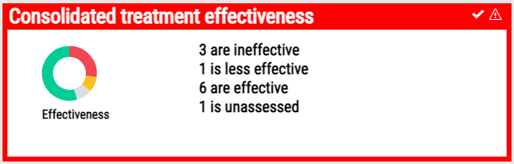
Risk Control Performance Review

Slide 38
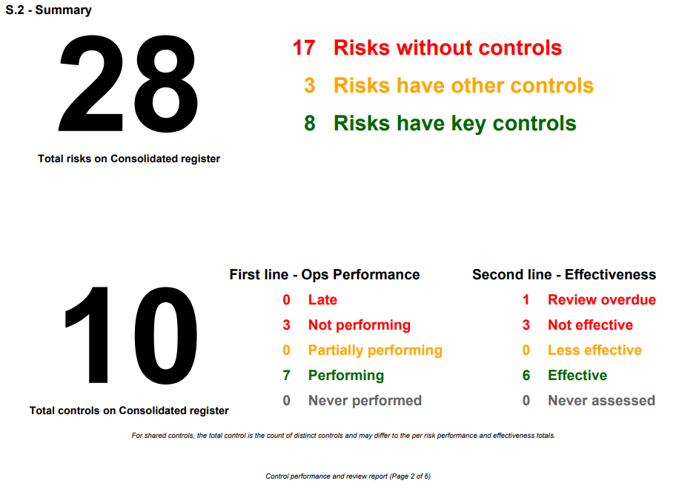
Internal Control Reporting

Slide 39
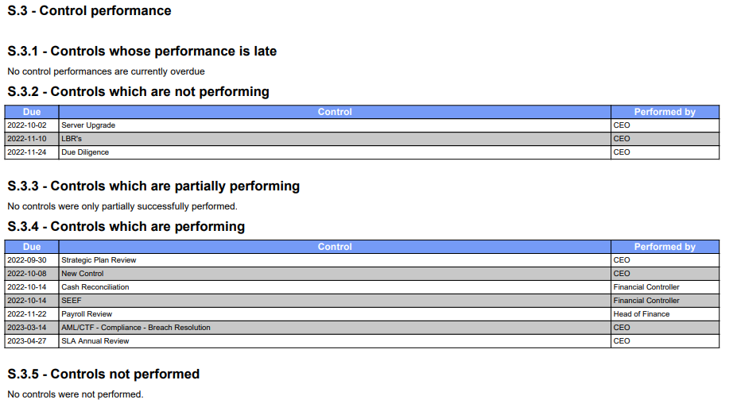
Internal Control Reporting

Slide 40

Risk Reporting

Slide 41
Risk Reporting
Reports should cover the following at a minimum on 2 – 3 pages:
significant risks and the effectiveness of systems and controls;
any risk events that have occurred and the actions taken or proposed to mitigate the risk;
likely or actual deviations from risk tolerance levels or established systems and controls and should include the timeframe and status of any activities that are proposed to address these;
any negative trends in higher risk areas and any recommended changes to risk management activities;
any new risks including their risk assessment, risk rating and systems and controls;
any material emerging risks and recommended course of action;
updates on risk management recommendations / actions arising from previous reports

Slide 42
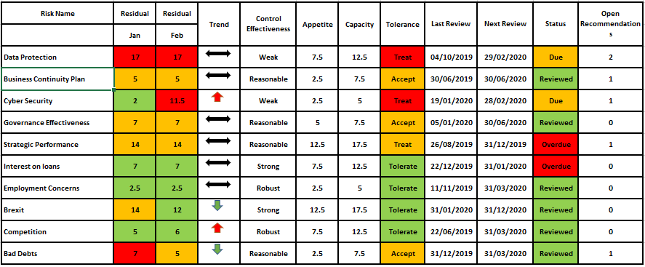
Risk Reporting – Top 10 Residual Risks

Slide 43
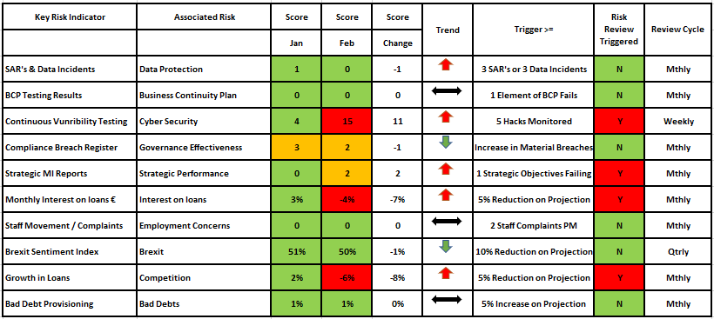
Risk Reporting –Key Risk Indicators

Slide 44
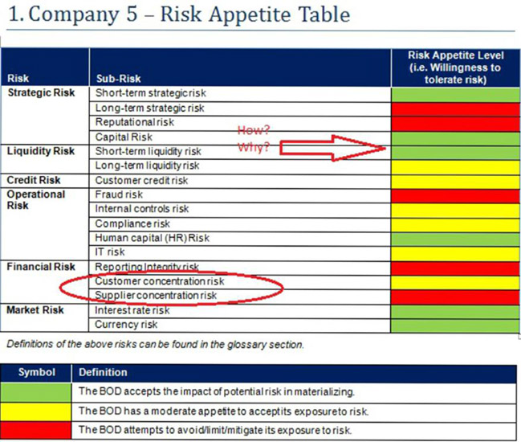
Risk Reporting

Slide 45
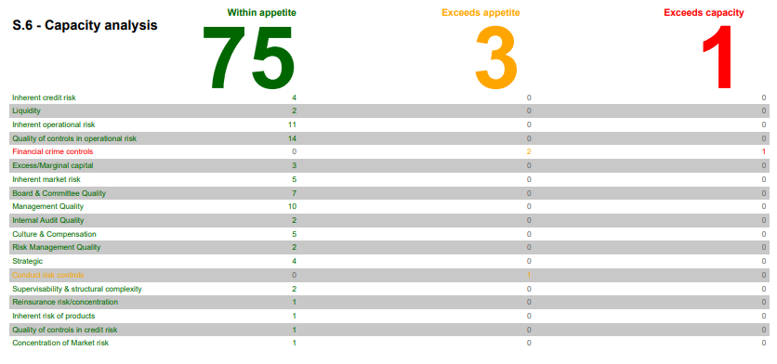
Risk Reporting

Slide 46
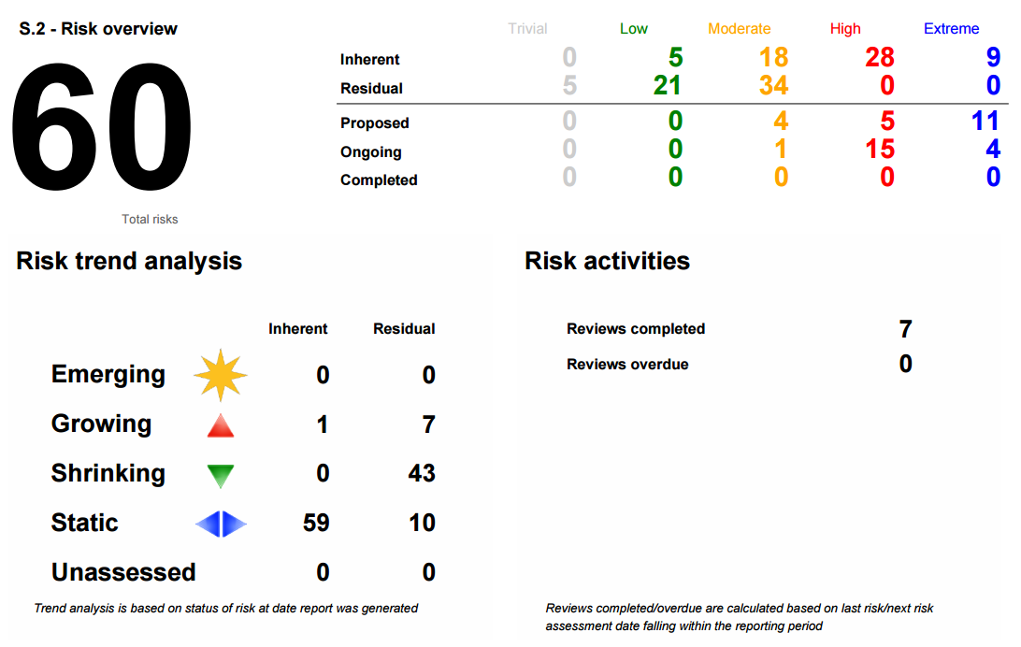
Risk Reporting

Slide 47
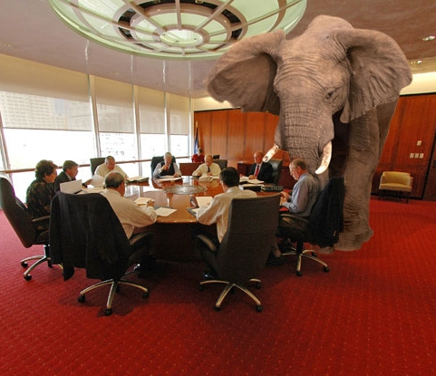
Risk Appetite & Capacity is Set By the Board!!

Slide 48

Risk Appetite – Rules of Play

Slide 49
What is Risk Appetite Statement?
  Clear & Concise Statement
  Accepted risk in pursuit of business & strategic objectives
  Articulation of type & degree of risk
  Embracing risk in areas of skills, experience, knowledge
  Limiting areas of risk, skill shortage, experience, knowledge
  What we do, what we don’t do and shouldn’t do
  Calculated risks in pursuit of long-term strategy
  Places constraints on activities
  RAS is a positive and dynamic document

Slide 50
Top of the Pyramid
- Risk Appetite
The UK’s Financial Services Authority (FSA) states:
  “Risk appetite is the amount of risk that one is prepared to accept, tolerate, or be exposed to at any point in time.”

Slide 51
Understanding Risk Capacity
Risk Capacity - The maximum amount of risk an entity is able to support within its available financial resources
Versus
Risk Tolerance - The maximum amount or type of risk the entity is prepared to tolerate above risk appetite.

Slide 52
Top of the Pyramid - Risk Appetite
Would you ever take up hang gliding? What about base jumping?
Would you drive a car if the seat belt was broken? To get to an important meeting or catch a flight … maybe?
If you were down to your last €100, would you bet €10 on a horse after a hot tip? €20? Your whole €100?
Would to break COVID19 restrictions / advice, for a pint, to travel to visit a friend? Spanish Holiday vrs Staycation?
Would you cross in the middle of a busy main road to save a minute, instead walking to the pedestrian crossing?

Slide 53
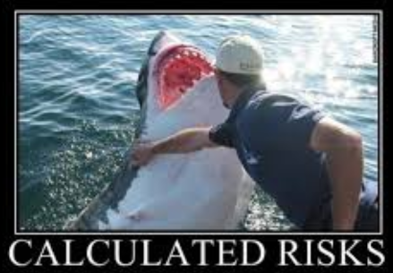

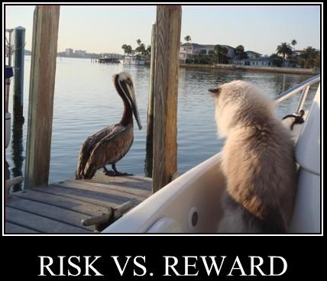
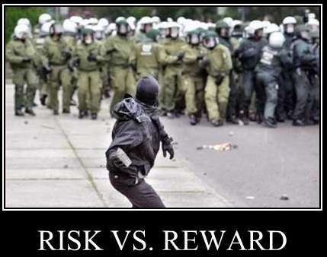
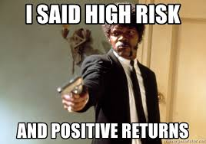
How Much Risk Are You Prepared to Take?

Slide 54
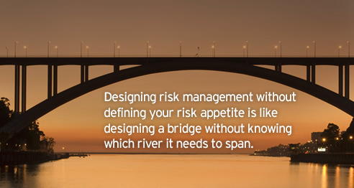
Top of the Pyramid - Risk Appetite

Slide 55
Risk Framework – Appetite Is At The Top!

Slide 56
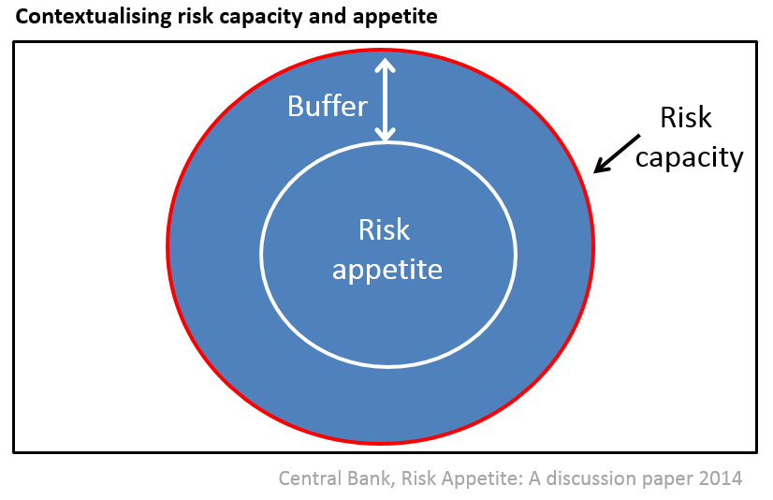
Understanding Risk Capacity

Slide 57
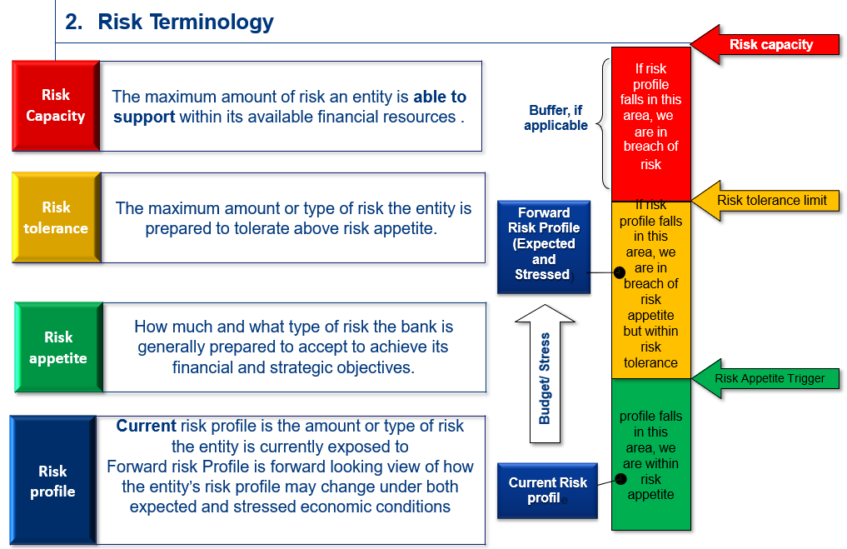

Slide 58
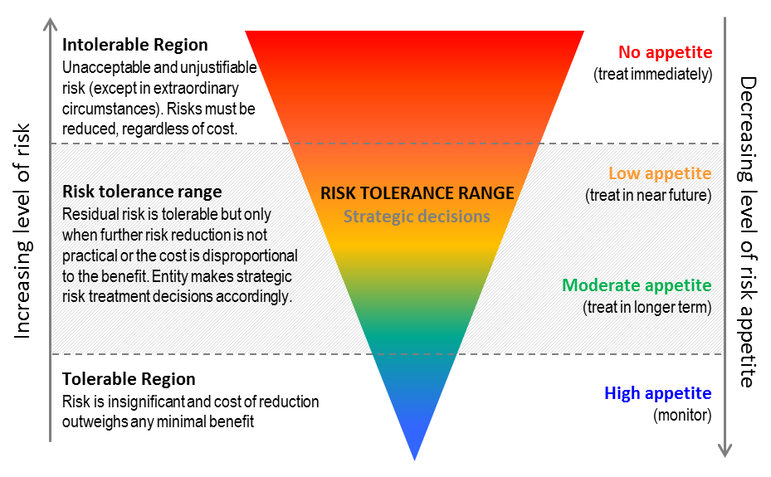
Understanding Risk Tolerance

Slide 59
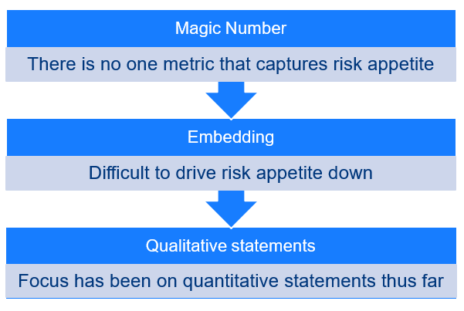
Mapping Risk Appetite to Scoring Matrix

Slide 60
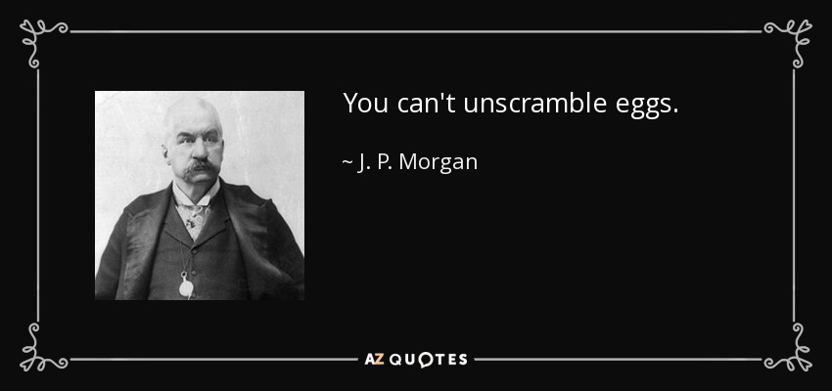

Breaching Your Risk Capacity

Slide 61
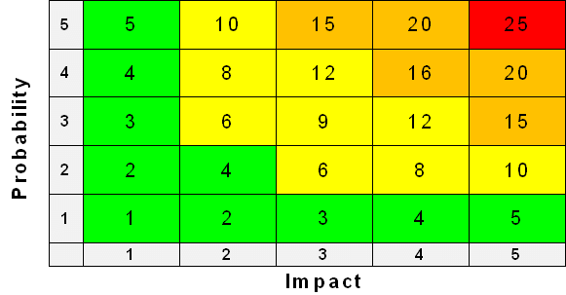
Matching Score to Appetite

Slide 62
Mapping Risk Appetite to Scoring Matrix

Slide 63
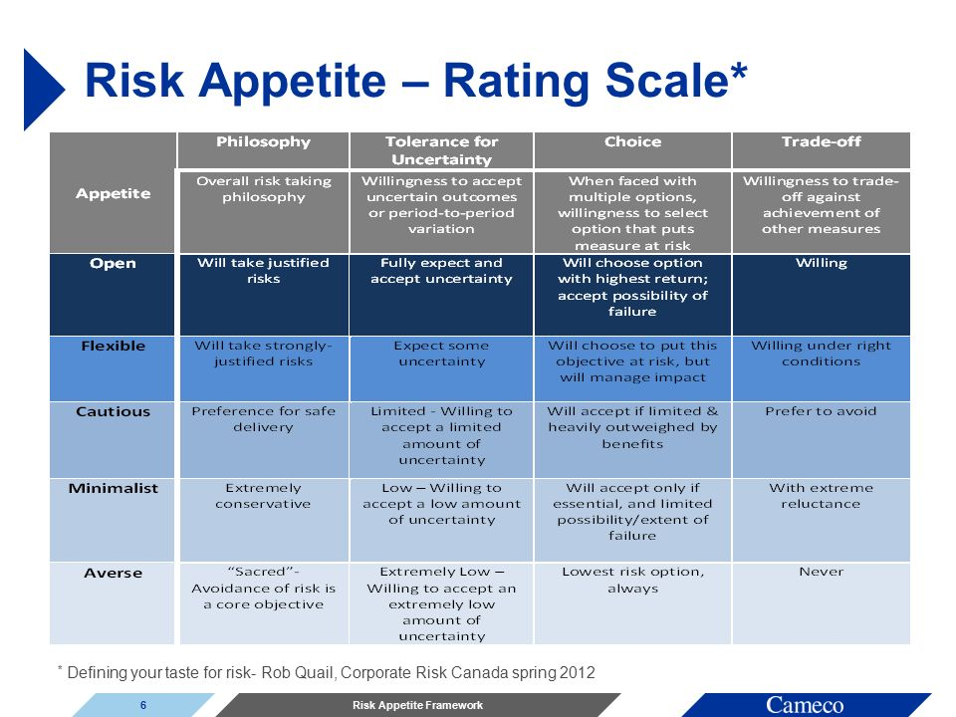
Apply Inline With Strategy

Slide 64
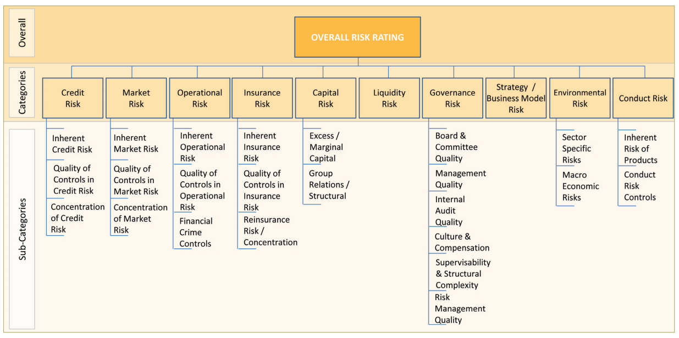
You Need To Define Individual Scores and relate back to appetite.

Slide 65
Risk Appetite Calculation Table
Colour Code | Risk Appetite | Description – Philosophy & Tolerance
Zero | Averse – 0.1 – 5 | Averse - Avoidance of risk is the core objective, unwilling to accept any extremely low amount of uncertainty
Low | Minimalist – 5.1 – 10 | Minimalist - Extremely conservative, willing to accept a low amount of uncertainty
Medium | Cautious – 10.1 – 15 | Cautious - Preference for safe delivery, willing to accept a certain amount of uncertainty
High | Flexible – 15.1 – 20 | Flexible - Will take strongly justified risks and expect some uncertainty
Extreme | Open – 20.1 - 25 | Open - Will take justified risks and fully expect and accept uncertainty

Slide 66
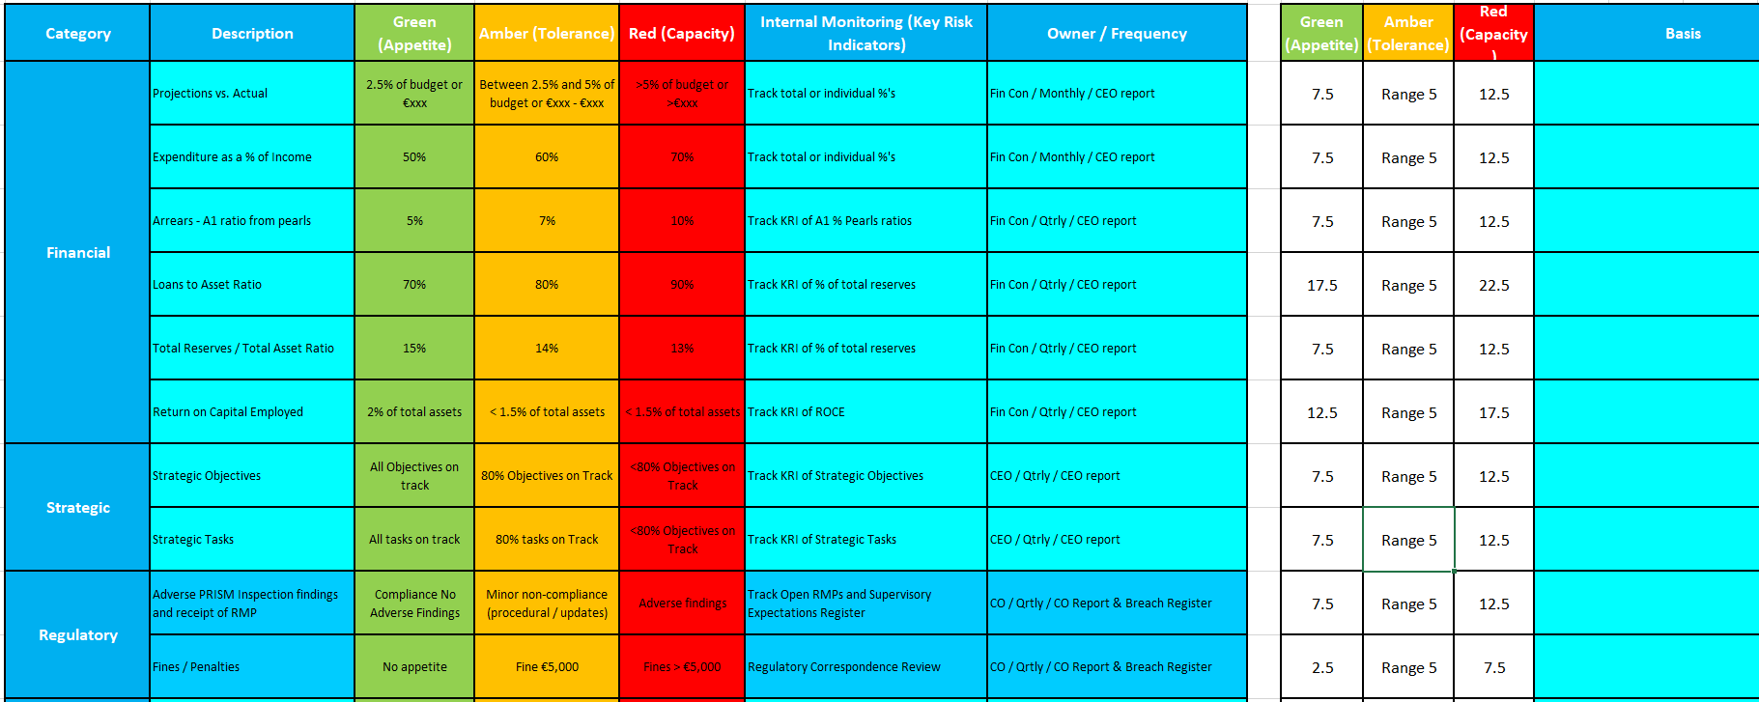
Worked Example Risk Appetite Table – Aligned to Strategic Plan

Slide 67

Governance Risk

Slide 68

Governance Risk –
What Kind of Board are You ?

Slide 69

Governance Risk –
Is Your Board Operationally or Strategically Focused?

Slide 70

Board of Directors

Slide 71

Thou Shalt Obey Your Prescribed Legislation
Not Maybe or Might!!

Slide 72

Risk Structure for Directors Meetings

Slide 73

Preparation For Board Meetings
Reduces Governance Risk
Limit Meetings to Under 2 Hrs !!

Slide 74

Operational Considerations

Slide 75
Operational Considerations
  Set Risk Appetite Within Risk Management System
  Develop Multiple Risk Registers
  Create Contingent Risk Registers
  Development an Annual Risk Plan
  Document Internal Controls Allocated To Risk
  Document Key Risk Indicators
  Record Performance Controls – Key and Other
  Oversight of Performance Controls
  Residual Risk Rating based upon control effectiveness
  Create Mitigants if controls are ineffective
  Create Risk Recommendations Register
  Allocate Owner, Review Period, Type, Tasks, Notifications
  BOD Discussion and Challenge – Controls and Appetite

Slide 76

Risk Management Officer (RMO)

Slide 77
Role of the Risk Management Officer
Ensuring each internal/external risk of the organisation is identified, assessed, reported and monitored and assisting the manager with managing and mitigating those risks
Advising the board of directors on the risk management policy and process and any deviations from the risk management policy
Reporting on any significant risk event to the board of directors in a timely manner
Implementing the risk management system approved by the board of directors
Maintaining the risk register
Making monthly (quarterly) reports to the board of directors
Communicating the risk management policy, process and roles and responsibilities relating to officers of the organisation
Providing training and support in the area of risk management to officers of the organisation
Making the necessary information available to the internal audit function to facilitate independent review of the risk management system
Supporting the board of directors in promoting a culture of risk awareness, identification and management at every level within the organisation

Slide 78




Key Risk Indicators – KRI’s

Slide 79

Key Risk Indicators Register

Slide 80

Key Risk Indicator Design & Assessement Register

Slide 81

Risk Management & Technology

Slide 82
Considerations Risk Systems
  Excel Spreadsheets – Size, Version Control, Embedding
  Integrated API’s in Risk Systems
  Automatic Notifications
  Audit Trail
  Realtime Reporting – Filters, Historic Reporting
  Internal Control Framework
  Cloud vs Prem
  Loss events / incidents / leading indicators
  Bow Tie Risk Management – Cause & Consequences
  Risk reporting and documentation
  Value Add – Makes Life Easier
  Shameless Plug – Consider Red Flare

Slide 83

Risk Training

Slide 84





Risk Training

Slide 85
Risk Terminology
  Risk framework
  Risk appetite
  Risk tolerance
  Risk capacity
  Risk universe
  Risk indicators / Key Risk Indicator’s
  Loss events / incidents
  Risk reporting and documentation
  Quantitative and Qualitative risk analysis
  Risk causes
  Risk consequences
  Risk mitigation
  Risk controls
  Risk assessment
  Risk root cause analysis
  Inherent Risk & Residual Risk
  Impact & Probability - Matrix
  Emerging risks

Slide 86

What Does the Regulator Think?

Slide 87


What Does the Regulator Think?

Slide 88
Regulator Guidance on Risk

Slide 89
Review of Guidance & Sample Risk Register
  7 pages of which 2 are filler (cover pages)
  No mention of Risk Appetite Statement
  No mention of Risk Capacity, Tolerance or Limits
  Limited guidance on reporting
  No sample Risks or worked risk scoring example
  Provides some guidance on 7 risk categories
  No discussion of risk events, leading indicators, near misses, loss events, etc
  No mention Internal Controls and Effectiveness Review
  No discussion of the alignment of Risk and Strategy

Slide 90

Risk Maturity Model

Slide 91
Summary of Speech Risk Element
“In the face of the uncertainty and given the key commercial challenges affecting so many in the sector, credit unions will need to continue to strengthen their operational and financial resilience, supported by robust risk management”
“underpinned by effective governance, risk management and operational frameworks,
when they are effectively governed, professionally managed and staffed by competent, capable people, who take ownership of and prudently manage current and emerging risks.”
“our focus in 2021 will be more on the effective implementation of recent regulatory framework enhancements”
“we expect credit unions to have core prudential foundations including strong governance and robust risk management
Greater ownership by boards of risk management is critical to overcome the recurring risk issues identified in our 2020 PRISM Supervisory Commentary.
Enhanced data and reporting capabilities are essential to facilitate continual assessment of the range of credit union risk considerations.
using key performance and risk indicators”
“The overall picture however in this area is not so positive. We continued to identify examples of fundamental governance and risk management weaknesses in many credit unions. Recurring risk issues here are a prudential concern. They evidence a lack of maturity in the credit union risk management process.”
“what we want is credit union boards to translate our findings into actions. Accordingly, enhanced risk management by credit unions is a key feature of our 2021 supervisory strategy.”

Slide 92

% of risk issues identified by risk category 2019

Slide 93

% of risk issues identified by risk category 2020

Slide 94

Governance Risks 2020
Of the 57 credit unions with assets of less than €100m that received an RMP during the review period, 42 (74%) were found to have governance risk issues.

Slide 95
Governance Risks – CBI Findings
Risk & Compliance
Weaknesses in the risk management and compliance functions
Weaknesses in risk and compliance reports
Inconsistencies between documented Risk Appetite and policies
The top risks, as documented by the credit union, not being reflective of the risk profile of the credit union
Board Procedures and Performance Management
Failure by the board to formally respond to issues raised in the Risk Management, Internal Audit and Compliance reports
Lack of dedicated resources focused on key challenges facing the credit union
Poor attendance at board of directors meetings
Internal Audit
Weaknesses in Internal Audit reports being presented to boards

Slide 96

Governance Risks – CBI Expectations

Slide 97

Governance Risks – CBI Expectations

Slide 98


Governance Risks – CBI Expectations

Slide 99

TAKEAWAYS

Slide 100
Takeaways
  Develop a Comprehensive Risk Management Plan
  Develop Comprehensive Risk Appetite Statement
  Develop Multiple Risk Registers
  Create Contingent Risk Registers
  Document, Record & Embed Internal Controls
  Create & Track Key Risk Indicators
  Embed Performance Controls – 1st Line (Staff “FLOD”)
  Oversight of Performance Controls - RMO
  Thematic Board Meetings – Risk Centric (Quarterly)
  Align Risk Management to Supervisory Expectations (PRISM Findings)
  Embrace Technology (Red Flare GRC)
  Risk Culture Comes From The Top
  Allocate Owner, Review Period, Type, Tasks, Notifications
  Record BOD Risk Discussion and Challenge
  What Gets Measured Gets Done!!!

Slide 101

Final Thoughts

Slide 102

QUESTIONS?

Slide 103
Contact details
Jason Dowling CPA
jdowling@wda.ie
Jason.dowling@redflare.co
www.redflare.co
01-6771411
Thank you for your time!

Slide 104

Thank You For Attending Risk Maturity Model – How to improve risk embeddedness
A recoding of this webinar and the CPD code will be available on our website later today.
CPD CODE – 2022 - 2195
compliance.ie

