Slide 1
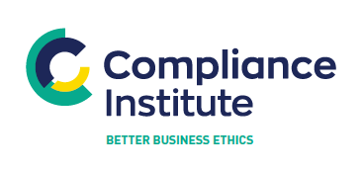
P
Preparing for the Senior Executive Accountability Regime
May 12th, 2022 compliance.ie

Slide 2

Welcome & Introduction
Thank you for registering
Questions
  Please use the question box on the right of your screen to send the questions for our speaker
Today’s session will be recorded and will be on our website later today
The CPD code is noted below and will be sent out directly after this session has concluded
CPD CODE: 2022-1036

Slide 3
Contents
01
02
03
04
05
06
07
08
Introduction
What is an Accountability Framework?
Developing an Accountability Framework Plan
Developing Your Management Responsibilities Map
Defining Reasonable Steps
Impact on the Staff Lifecycle
Questions & Answers
Our Experience

Slide 4
01
Introduction

Slide 5
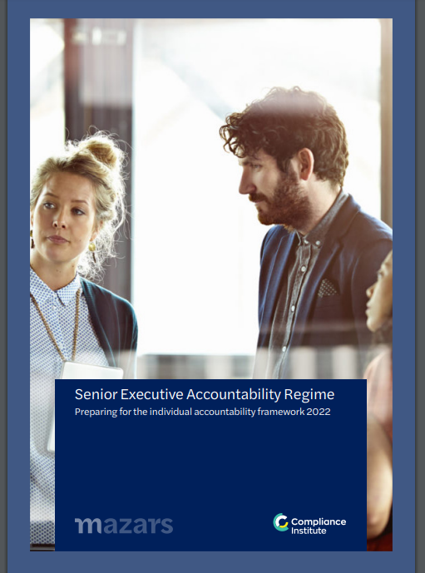
Introduction
Background
During Q1 2022, Compliance Institute and Mazars undertook our first industry survey to:
Assess the level of preparedness within the industry for the proposed Individual Accountability Framework (IAF); and
Understand the key aspects of the proposals that is concerning Compliance Institute Members.
Our research reflected that:
Members view the proposed IAF positively;
Many firms have taken some initial steps in preparation for the IAF. However, few had established formal implementation project;
Members were most concerned about:
Documenting and evidencing reasonable steps; and
Developing a management responsibilities map (MRM) and allocating prescribed responsibilities.

Slide 6
Introduction
Purpose
The purpose of today’s seminar is to build on the findings from industry survey and provide clarity and guidance on the actions you can take now in preparation for the IAF. Specifically, we are going to focus on the following:
An overview of what a firm Accountability Framework looks like
Developing an initial Accountability Framework implementation plan and key considerations
Developing a firm specific Management Responsibilities Map and allocating prescribed responsibilities
Developing an approach to defining reasonable steps
Key impacts an IAF may have on a firm’s staff lifecycle and compliance input.

Slide 7
02
What is an Accountability Framework?

Slide 8
Developing an Accountability Framework
It is expected that the implementation of the IAF legislation and supporting CBI requirements, will generate significant attention with firms. Including, providing the Board of Directors and senior management, with robust assurance and demonstrable evidence the firm has adequately implemented the requirements.
Experience dictates that firms, who develop a formal framework supported existing and/or new documents achieve successful implementation.
Outlined below is an overview of an indicative Accountability Framework.
Board of Directors and Senior Management Oversight
Accountability Policy
(Governance, SEAR, Conduct Standards)
Key Supporting Corporate Documentation
Management Responsibilities Map
Statement of Responsibilities
Reasonable Steps Policy
Fitness and Probity Policy and Procedures
Conduct Standards Breach Reporting Procedures
Handover Material
Staff Job Descriptions and Contracts
Management Information
Staff Handbook
Code of Conduct
Training and Competence Scheme
Performance Management and HR Procedures
Record Keeping Policy
Protected Disclosure Policy
Denotes documents to be created/significantly enhanced

Slide 9
03
Developing an Accountability Framework Plan

Slide 10
Developing an Accountability Framework Plan
When developing your multi-phase project plan, consider the following critical success factors:
Demonstrable buy-in and engagement at a Board of Director and Executive Committee level, accompanied by Executive Director Sponsorship for the Project.
Allocating dedicated project management resource(s) supported by first and second line of defence presentation, including clear action ownership.
Identifying specific milestones for performing iterative assurance reviews throughout implementation to allow management provide the Board with assurance that adequate systems and controls are in place at go-live.
Phase
Programme Governance and Overarching Actions
Senior Executive Accountability Regime
Key Workstreams
Design and implement programme governance, sponsorship and reporting
Enhance existing fitness and probity systems and controls
Agree the allocation of prescribed regulatory responsibilities and individual statements of responsibilities
Design and implement corporate documentation approval schedule
Review existing governance framework at a Board of Directors and senior management committee level
Design and approval of Management Responsibilities Map
Perform review of existing fitness and probity arrangements and allocate actions to relevant workstreams
Review existing job descriptions and staff contracts and identify enhancements
Design and implementation of SEAR policy and supporting procedures
On-going assurance throughout project to assess and report the adequacy of actions being taken
Design and delivery of SEAR training to identified Senior Executive Functions
Design and delivery reasonable steps training
Consideration and/or development of IAF tools for maintaining up to date records

Slide 11
Developing an Accountability Framework Plan
Phase
Certification Regime
Conduct Standards
Human Resource Processes
Key Workstreams
Enhance existing fitness and probity systems and controls
Standards for Businesses – Review and enhance key strategic and customer impacting processes to assess alignment with Standards for Businesses
Review an update employment contracts template and current employment contracts
Identification of all certification staff (controlled function)
Common Conduct Standards – Design and implement conduct standards (common an additional) policies and procedures
Review the current performance management and remuneration policies and processes to ensure aligned with SEAR Certification and Conduct Standards
Review and update job descriptions for certified staff
Design and delivery of conduct standard training
Review and update recruitment and onboarding policy and procedures
Review and enhance existing due diligence check processes
Design and implement conduct rule breach investigation and reporting processes
Review and update staff relations, investigation and disciplinary policies and procedures to consider the IAF/requirements but specifically, dealing with:
Adverse information about staff
Ongoing competency issues with staff at implementation
Staff investigations and disciplinary actions
Staff exits an and termination.
Design process, systems and controls to allow the firm/management evidence its assessment of staff fitness and probity and certification (at onboarding and annually)
Develop conduct rule breach scenarios specific to different controlled functions and SEFs
Design and deliver certified individuals training

Slide 12
04
Developing Your Management Responsibilities Map

Slide 13
Developing Your Management Responsibilities Map (MRM)
What is it?
Central Bank (Individual Accountability Framework) Bill 2021 (the Bill)
The Bill notes the following with respect to the MRM:
The purpose of the management responsibility map is to describe the management, governance and reporting arrangements of the RFSP in a clear single source of reference to include governance arrangements for the board, board committees and other decision making committees or groups, reporting lines of SEFs, including within the wider RFSP group, and, if relevant, the interaction between the RFSP’s and the RFSP group’s governance and management arrangements.”
Documenting key management and governance arrangements in a comprehensive and accessible way within a single source of reference.
Senior Managers Regime
SYSC 25.2, with the FCA’s Handbook sets out the main rules
A management responsibilities map must include:
(a) Details of the reporting lines and the lines of responsibility; and
(b) Reasonable details about:
(i) The persons who are part of those arrangements; and
(ii) Their responsibilities.
The firm’s management responsibilities map must show clearly how any responsibilities covered by a firm’s management responsibilities map are shared or divided between different persons.
A firm's management responsibilities map should demonstrate that there are no gaps in the allocation of responsibilities among its management.
A management responsibilities map should include a checklist confirming that all FCA-prescribed senior management responsibilities have been allocated
The objectives and the purpose of the MRM in both jurisdictions is near identical. Furthermore, what has been published to date it appears both will be similar in practice. What does this mean in practice?

Slide 14
Developing Your Management Responsibilities Map (MRM)
What is it?
Additional Expectations
The MRM must always be kept up to date and be a current reflection of the firm’s governance arrangements, appointed SEFs and allocation of prescribed regulatory responsibilities.
The Board is the owner of the MRM, as a result it must review and approve the MRM every time amendments are required. If the MRM is structured incorrectly, this will result in some or all of the following occurring:
The Board becoming frustrated with having to re-approve the MRM multiple times during the year due to changes in staff resourcing that are strictly outside the scope of the MRM; and
The MRM becoming out of date due to management not wanting to put forward what it believes are immaterial amendments to the Board. It is expected that there will not be a materiality threshold with respect the MRM being up to date or not. Especially where a firm broadens the remit of the MRM beyond the regulatory requirements.

Slide 15
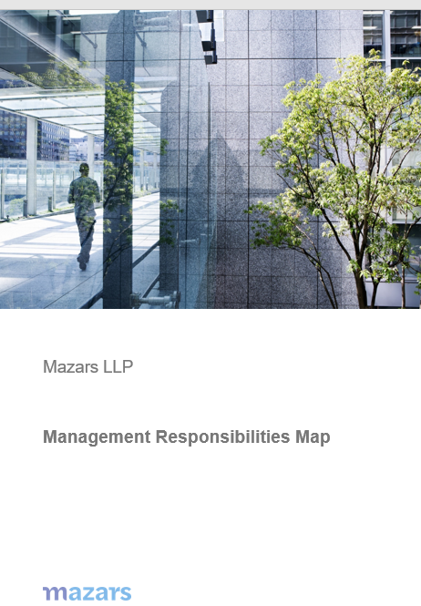
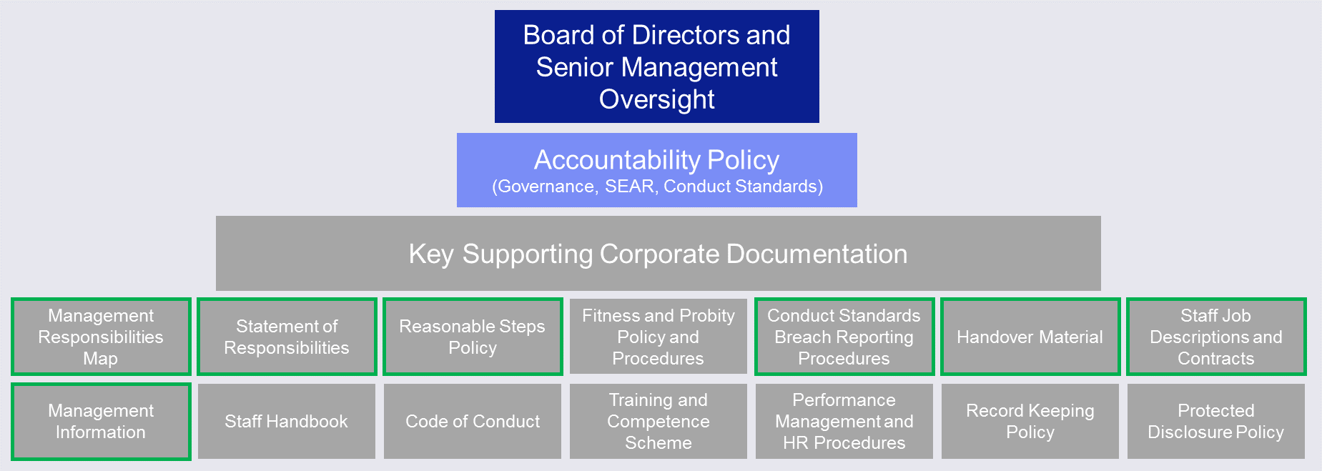
Developing Your Management Responsibilities Map (MRM)
What Does Good Look Like?
Consider the MRM as significant to effective corporate governance as the Internal Capital Adequacy Assessment Process (ICAAP) is to effective capital management. Outlined below is a brief overview of what a MRM should look like in practice.
Overview of Accountability Framework
Corporate Governance Structure and Terms of Reference
Circa 1-2 pages
Circa 2-4 pages, excluding committee terms of reference
Group Board of Directors
Terms of Reference for each committee
Membership of each committee
Reporting lines
Regulatory responsibilities
Involvement of any related/third parties e.g. Parent Group
Board of Directors
Sub-Committees of the Board of Directors
Management Decision Making Committees
Actions you can undertake now – Review your corporate governance structure (including terms of reference (ToR)) and benchmark against the relevant publications of the Central Bank of Ireland, relevant European institutions e.g. the Financial Reporting Council.
Also assess the effectiveness of your ToRs can you evidence that each committee demonstrably adheres to its ToR.

Slide 16
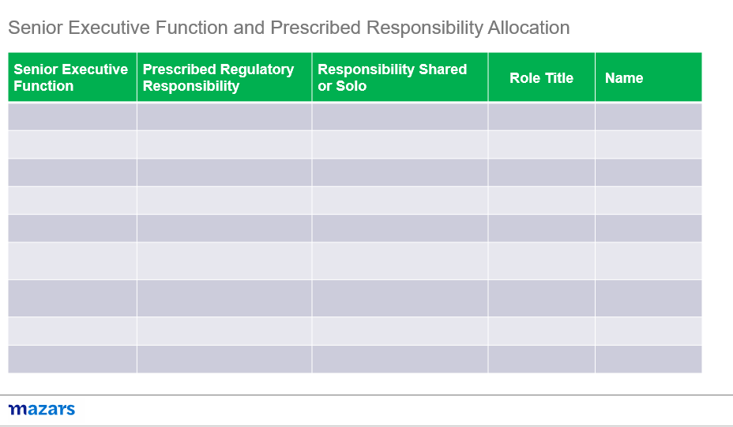
Developing Your Management Responsibilities Map (MRM)
What Does Good Look Like?
Assignment of SEF and Allocation of Prescribed Regulatory Responsibilities
Circa 2-4+ pages, contingent on the complexity of the firm and allocation arrangements
Each firm must allocate all relevant prescribed responsibilities to SEFs
Where a responsibility is shared this must be highlighted
The contents of the MRM must be consistent with each Statement of Responsibility
Where a responsibility is shared it is expected the Statement of Responsibility will outline the key actions each individual undertakes when discharging this responsibility
The list of the FCA and PRA’s prescribed responsibilities are outlined in the respective rule books. In addition, we have included these in the appendix to this presentation.
Actions you can undertake now – Review the FCA and PRA prescribed responsibilities and consider to what members of your Board of Directors or Executive Committee you would allocate these responsibilities to. The current list of prescribed responsibilities are provided in Section 5

Slide 17
05
Defining Reasonable Steps

Slide 18
Defining Reasonable Steps
Reasonable steps will vary across firms and across roles, before defining and implementing your firm’s approach to reasonable steps it is important to understand the different factors at play that will inform your policy. These are also the same factors that will be relevant to individuals as they consider their own reasonable steps.
Duty of Responsibility & Regulatory Requirements
Conduct Standards
Reasonable Steps Policy
Accountability Framework
Senior Executive Function (s) & Prescribed Responsibilities
Performance Management Process

Slide 19
Defining Reasonable Steps
Duty of Responsibility
When considering the design of a Reasonable Steps Policy, it is important to understand what the proposed legislative requirements and expectations are in relation to reasonable steps.
As outlined in the Central Bank (Individual Accountability Framework) Bill 2021 (Bill) “a legal duty is imposed on individuals performing “senior executive functions” in regulated financial service providers (RFSPs) within the scope of the Central Bank’s senior executive accountability regime to take reasonable steps to avoid their firm committing or continuing to commit a “prescribed contravention” in relation to the areas of the business for which they are individually responsible.”
“An individual will breach this legal duty where:
At a time when the individual was performing a senior executive function, the RFSP committed or continued to commit a prescribed contravention;
The individual was, at that time, responsible for the business area relevant to that prescribed contravention; and
The individual did not take reasonable steps to avoid the prescribed contravention occurring or continuing.“

Slide 20
Defining Reasonable Steps
Conduct Standards
Conduct standards play a key role in understanding the standards the Central Bank expects individuals to adhere to and incorporated within corporate documentation (e.g. job descriptions, objectives). They should also be used as key guiding principles when designing a reasonable steps policy and when individuals are articulating their own reasonable steps. As outlined in the Bill, the conduct standards are listed below.
Standards for Businesses
Common Conduct Standards
Additional Conduct Standards
Conduct its business professionally, honestly, ethically and with integrity
Conduct its business with due skill, care and diligence, and take appropriate steps to prevent or effectively manage conflicts of interest
Act in the best interests of its customers and treat them fairly and professionally
Maintain adequate financial resources and control and manage its affairs and systems sustainably, responsibly, and in a sound and prudent manner
Arrange adequate protection for clients’ assets when it is responsible for them
Deal with its regulators in good faith and in an open and cooperative way and shall disclose to the Central Bank promptly, proactively and appropriately anything relating to the firm of which the Central Bank would reasonably expect notice.
Act honestly, ethically and with integrity
Act with due skill, care and diligence
Be cooperative with the Central Bank and other regulators or authorities and deal with them in good faith and without delay
Act in the best interests of customers and treat them fairly and professionally
Act in the best interests of customers and treat them fairly and professionally
To ensure that the business of the RFSP for which the person is responsible is controlled effectively
To ensure that the business of the RFSP for which the person is responsible complies with relevant regulatory requirements
To ensure that any delegation of tasks for which they are responsible is to an appropriate person and that they oversee the discharge of the delegated task effectively
To disclose promptly, proactively and appropriately to the Central Bank any information of which the Central Bank would reasonably expect notice

Slide 21
Defining Reasonable Steps
Sample Prescribed Regulatory Responsibilities
Outlined below and on the following pages is the complete list of the Prescribed Regulatory Responsibilities (PR) as defined by the Prudential Regulation Authority (PRA) and the Financial Conduct Authority (FCA).
As part of your initial planning for SEAR and consideration of your MRM, consider these PRs in the context of your firm, existing PCFs, and allocate these PRs based on your type of firm.
FCA/PRA/ Dual PR | Ref | Prescribed Responsibility | Large CRR firms | Small CRR Firms | Third Country Firms | Credit Unions | Solvency II firms & Large NDFs | Small NDFs & Small run off firms | Third Country branches of insurers
Dual | A | Responsibility for the firm's performance of its obligations under the senior managers regime | ü | ü | ü | ü | ü | ü | ü
Dual | B | Responsibility for the firm's performance of its obligations under the staff certification regime | ü | ü | ü | ü | ü | ü | ü
FCA | B1 | Responsibility for the firm's obligations in relation to the conduct rules, including training and reporting | ü | ü | ü | ü | ü | ü | ü
Dual | C | Responsibility for compliance with the requirements of the regulatory system about the management responsibilities map | ü | ü | ü | ü | ü |  | ü

Slide 22
Defining Reasonable Steps
Sample Prescribed Regulatory Responsibilities
FCA/PRA/Dual PR | Ref | Prescribed Responsibility (PR) | Large CRR firms | Small CRR Firms | Third Country Firms | Credit Unions | Solvency II firms & Large NDFs | Small NDFs & Small run off firms | Third Country branches of insurers
FCA | D | Overall responsibility for the firm's policies and procedures for countering the risk that the firm might be used to further financial crime | ü | ü | ü | ü | ü | ü | ü
PRA | E | Responsibility for the allocation for all relevant prescribed responsibilities | ü | ü | ü | ü
Dual | F | Responsibility for: (a) leading the development of; and (b) monitoring the effective implementation of, policies and procedures for the induction, training and professional development of all members of the firm's governing body | ü |  |  |  | ü
Dual | G | Responsibility for monitoring the effective implementation of policies and procedures for the induction, training and professional development of all the firm's senior managers/key function holders (other than members of the governing body) | ü |  |  |  | ü

Slide 23
Defining Reasonable Steps
Sample Prescribed Regulatory Responsibilities
FCA/PRA/Dual PR | Ref | Prescribed Responsibility (PR) | Large CRR firms | Small CRR Firms | Third Country Firms | Credit Unions | Solvency II firms & Large NDFs | Small NDFs & Small run off firms | Third Country branches of insurers
PRA | H | Responsibility for overseeing the adoption of the firm's culture in the day-to-day management of the firm | ü |  |  |  | ü
PRA | I | Responsibility for leading the development of the firm's culture by the governing body as a whole | ü |  |  |  | ü
Dual | J | Responsibility for: (a) safeguarding the independence of; and (b) oversight of the performance of, the internal audit function | ü
PRA | J1 | If the firm outsources its internal audit function, responsibility for taking reasonable steps to ensure that every person involved in the performance of that function is independent from the persons who perform external audit including: (a) supervision and management of the work of outsourced internal auditors; and (b) management of potential conflicts of interest between the provision of external audit and internal audit services | ü

Slide 24
Defining Reasonable Steps
Sample Prescribed Regulatory Responsibilities
FCA/PRA/Dual PR | Ref | Prescribed Responsibility (PR) | Large CRR firms | Small CRR Firms | Third Country Firms | Credit Unions | Solvency II firms & Large NDFs | Small NDFs & Small run off firms | Third Country branches of insurers
Dual | J2 | Responsibility for providing for and oversight of the internal audit function, where the function is outsourced to an external third-party provided by a non-significant firms |  |  |  |  | ü
Dual | K | Responsibility for: (a) safeguarding the independence of; and (b) oversight of the performance of, the compliance function | ü
Dual | L | Responsibility for: (a) safeguarding the independence of; and (b) oversight of the performance of, the risk function | ü
Dual | M | Responsibility for overseeing the development of, and implementation of the firm's remuneration policies and practices | ü |  |  |  | ü
Dual | N | Responsibility for the independence, autonomy and effectiveness of the firm's policies and procedures on whistleblowing | ü |  |  |  | ü

Slide 25
Defining Reasonable Steps
Sample Prescribed Regulatory Responsibilities
FCA/PRA/Dual PR | Ref | Prescribed Responsibility (PR) | Large CRR firms | Small CRR Firms | Third Country Firms | Credit Unions | Solvency II firms & Large NDFs | Small NDFs & Small run off firms | Third Country branches of insurers
PRA | O | Responsibility for managing the allocation and maintenance of the firm's capital, funding (where applicable) and liquidity | ü |  |  |  | ü
PRA | P | Responsibility for the firm's treasure management functions | ü
PRA | Q | Responsibility for the production and integrity of the firm's financial information and its regulatory reporting | ü |  | ü |  | ü
PRA | R | Responsibility for developing and maintaining the firm's recovery plan and resolution pack and for overseeing the internal processes regarding their governance | ü
PRA | S | Responsibility for managing the firm's internal stress-tests and ensuring the accuracy and timeliness of information provided to the PRA and other regulatory bodies for the purposes of stress-testing | ü

Slide 26
Defining Reasonable Steps
Sample Prescribed Regulatory Responsibilities
FCA/PRA/ Dual PR | Ref | Prescribed Responsibility (PR) | Large CRR firms | Small CRR Firms | Third Country Firms | Credit Unions | Solvency II firms & Large NDFs | Small NDFs & Small run off firms | Third Country branches of insurers
PRA | T | Responsibility for the development and maintenance of the firm's business model by the governing body | ü |  |  |  | ü |  | ü
PRA | T1 | Providing the governing body with an up-to-date business plan and all relevant MI |  |  |  |  |  | ü
PRA | T2 | Responsibility for the performance of the firm's Own Risk and Solvency Assessment (ORSA) |  |  |  |  | ü |  | ü
PRA | U | Responsibility for the firm's performance of its obligations under Fitness and Propriety (in the PRA Rulebook) in respect of notified non-executive directors and those who perform key functions (where applicable for insurers) | ü |  |  |  | ü |  | ü
PRA | V | If the firm carries out proprietary trading, responsibility for the firm's proprietary trading activities | ü

Slide 27
Defining Reasonable Steps
Sample Prescribed Regulatory Responsibilities
FCA/PRA/Dual PR | Ref | Prescribed Responsibility (PR) | Large CRR firms | Small CRR Firms | Third Country Firms | Credit Unions | Solvency II firms & Large NDFs | Small NDFs & Small run off firms | Third Country branches of insurers
PRA | W | If the firm does not have a person who performs the Chief Risk function, responsibility for the compliance of the firm's risk management systems, policies and procedures with the requirement of Risk Control 2.1 to 2.4 of the PRA Rulebook | ü
PRA | X | Responsibility for the firm's performance of its obligations under the Outsourcing part of the PRA Rulebook (for CRR and non CRR firms), Conditions Governing Business 7 (for SII firms and third country branches) or Non-solvency II firms: Governance 5 (for large NDFs) | ü |  |  |  | ü |  | ü
PRA | X1 | Responsibility for the firm's performance of its obligation under Internal Governance of Third Country Branches 7 |  |  | ü

Slide 28
Defining Reasonable Steps
Sample Prescribed Regulatory Responsibilities
FCA/PRA/Dual PR | Ref | Prescribed Responsibility (PR) | Large CRR firms | Small CRR Firms | Third Country Firms | Credit Unions | Solvency II firms & Large NDFs | Small NDFs & Small run off firms | Third Country branches of insurers
PRA | Y | If the firm is a ring-fenced body, responsibility for ensuring that those aspects of the firm's affairs for which a person is responsible for managing are in compliance with the ring-fencing obligations | ü
FCA | Z | Overall responsibility for the firm's compliance with CASS | ü | ü | ü | ü | ü | ü | ü
Dual | AA | Responsibility for implementing (where applicable) and management of the firm's risk management policies and procedures |  | ü | ü |  |  |  | ü
PRA | BB | Responsibility for managing the systems of the firm and controls of the firm |  | ü | ü | ü |  |  | ü
PRA | CC | Responsibility for managing the firm's financial resources |  | ü |  |  |  | ü
PRA | DD | Responsibility for ensuring the governing body is informed of its legal and regulatory obligations |  | ü |  |  |  | ü

Slide 29
Defining Reasonable Steps
Sample Prescribed Regulatory Responsibilities
FCA/PRA/Dual PR | Ref | Prescribed Responsibility (PR) | Large CRR firms | Small CRR Firms | Third Country Firms | Credit Unions | Solvency II firms & Large NDFs | Small NDFs & Small run off firms | Third Country branches of insurers
Dual | EE | Responsibility for escalating correspondence from the PRA, FCA and other regulators to the appropriate governing or management bodies |  |  | ü |  |  |  | ü
Dual | FF | Responsibility for the firm's compliance with the UK regulatory system |  |  | ü |  |  |  | ü
PRA | GG | Responsibility for the oversight of systems and controls, along with risk management policies and procedures, that are proportionate to the nature, scale and complexity of the risks inherent in the firm's business model |  |  |  |  |  | ü
PRA | HH | Responsibility for management of the firm's liquidity or, where a liquidity waiver is in place the submission of information to the PRA on the firm's liquidity position |  |  | ü

Slide 30
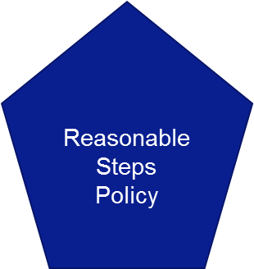
Defining Reasonable Steps
The Policy should:
Provide clear guidance (examples and templates, but not overly prescriptive) and tools for Staff to define and evidence their reasonable steps, specific to their role.
Be aligned with other key processes within the firm, e.g. IAF/SEAR framework, firm strategy, risk management framework.
Promote consistency (and evidence) in the approach of the firm to demonstrate it and it’s staff act reasonably and in the interests of their stakeholders.
Typically policies and staff documented reasonable steps in this area incorporate the following key categories that we will explore in detail.
1. Knowledge & Experience
3. Establishing Effective Local Risk Management and Culture
2. Resourcing and Continuous Improvement

Slide 31
Defining Reasonable Steps
1. Knowledge & Experience
Commencement: On assuming the role, obtain appropriate handover documentation form predecessor in relation to key ongoing projects, initiatives, issues and areas of focus. Typically supplemented by you performing your own independent assessment of the function, its remit and capabilities. This is then utilised to develop your own strategic and/or multi-year plan for your function. Annually review, enhance and re-state strategic plan as appropriate.
Understand the risks: relevant to the function, and work with the three lines of defence to fully understand and manage these risks;
Governance: Adhere to the conduct rules and shape the culture, standards and policies of the firm as a whole and promote positive behaviours that reduce harm;
Annual Personal Training Plan: Ensure you stay up to date on emerging technical and strategic areas up to date knowledge and training
Your firm: Demonstrate understanding of the wider business & strategic context.
3. Establishing Effective Local Risk Management and Culture
Governance and Speaking Up: Establish team fora to discuss emerging issues and action plan updates. Utilising these meetings and townhalls to promote a safe Speak-Up environment for your function.
Risk Culture: Promote a positive risk culture, that is aligned with the corporate culture, values and behaviours.
Risk and Controls: Understand your risk and control environment, including key risks, controls and control effectiveness.
Risk Appetite: Ensure that your function has a defined risk appetite, aligned with the firmwide risk appetite statement supported by relevant management information and/or key risk indicators.
Proactive action: If you become aware of an issue. Take formal steps to resolve and make others aware of the issue. Be able to demonstrate the extent of root cause, remedial actions undertaken and control enhancements implemented.
Escalate: Escalate issues in a timely, open and transparent manner within management, Board and/or the regulator aligned with internal governance requirements and external regulatory requirements
Assurance: Utilising the three lines of defence and/or external experts to obtain independent assurance on the design and effectiveness of systems and controls.
Action plans: Maintain plans with clearly appointed owners and deadlines to enable key issues to be resolved, or projects to be completed on time.
Reporting: Critically interrogate the information that you receive and the information your function creates to ensure it is accurate and timely.
2. Resourcing and Continuous Improvement
Performance management: Proactively engage in team and individual objective setting. Oversee and ensure performance management processes are executed within your team(s), including identifying the development needs of your team.
Resourcing: Continually monitor resource requirements and proactively engage in team and individual objective setting ensure gaps are understood and action or escalation is taken.
Roles and responsibilities: Ensure team members have in place up to date job descriptions aligned with team structure and reporting lines.
Succession Planning: Identify and define critical roles, to be incorporated within your local succession plan. The succession plan should identify the short, medium and long term recruitment plans for each critical role. Also a key tool for identifying and managing key talent.
Training and development: ensuring training needs are aligned with performance management and new strategic initiatives being undertaken by the firm

Slide 32
06
Impact on the staff Lifecycle

Slide 33
Impact on the Staff Lifecycle
The Staff Lifecycle Process Will Experience the Greatest Amount of Scrutiny
Employment Lifecycle
Recruitment
Joining process/ promotions
Training
Succession planning
Appraisal and certification process
Reward
Exit and Dismissals
It has been noted by the Central Bank of Ireland, the Department of finance and other commentators that one of the key objectives of an IAF/SEAR is positively impact the culture and behaviours within firms. The key processes that transcends all of the proposed enhancements is the staff Lifecycle.
Within this section we have outlined in our experience the key impacts on HR processes and the requirement for Compliance Input

Slide 34
Impact of on the Staff Lifecycle
The Staff Lifecycle Process Will Experience the Greatest Amount of Scrutiny
Recruitment
Human Resources Processes |  | Job description/role profiles aligned with the MRM where relevant Regulatory implication of the role SEF or CF Interview process to be aligned to the required competencies and behaviours – in particular SEFs and CFs Assessment of the candidate’s attitude, ethics and values Clarity of reporting lines, to be aligned with the MRM where relevant Contract to ensure alignment with requirements of the new regime, in particular highlighting conditional elements within offer letter
Compliance Input |  | Reviewing and setting standards for fitness and probity assessments for SEFs and CFs Reviewing and assessing the adequacy of reference checks Advising on the scope and practical impact of conduct standards
Joining Process
Human Resources Processes |  | Obtaining references, covering an extended of period of time, rather than allowing staffs to choose their own references Performing additional background checks Prepare and deliver an appropriate induction programme
Compliance Input |  | Review and assess the adequacy of background information being collected for individuals and/or whether in line with CBI requirements Ensure induction covers at a minimum relevant regulatory requirements specific to PCF and/or CF role

Slide 35
Impact on the Staff Lifecycle
The Staff Lifecycle Process Will Experience the Greatest Amount of Scrutiny
Promotions
Human Resources Processes |  | Manage changes to roles and responsibilities, in particular for non-certified that become certified and certified that become a SEF. Consider the types of behaviour being incentivised, are these aligned with standards for businesses conduct standards, common conduct standards and additional conduct standards Ensure promotion process is appropriately documented
Compliance Input |  | Review and advise on the process surrounding promotions specifically as they relate to movement between non-certified staff, certified staff and SEFs.
Reward
Human Resources Processes |  | Ensure reward is aligned with the firms corporate values, behaviours and conduct standards Ensure the firm’s remuneration policies are aligned with the relevant regulatory remuneration requirements
Compliance Input |  | Review and assess the adequacy of background information being collected for individuals and/or whether in line with CBI requirements Ensure induction covers at a minimum relevant regulatory requirements specific to SEF and/or CF role

Slide 36
Impact on the staff Lifecycle
The Staff Lifecycle Process Will Experience the Greatest Amount of Scrutiny
Training
Human Resources Processes |  | Ensure relevant staff members have a documented training plan in place and obtain the relevant amount of Continued Professional Development hours per their relevant qualifications. Develop and launch IAF/SEAR/conduct standards training for each relevant staff cohort. Training should also incorporate staff are appropriately aware of the firm’s values and expected behaviours Communication of the importance of the annual certification process. Certificates should not be issued (or re-issued) if all mandatory training has not been completed
Compliance Input |  | Setting standard content for training of SEFs and certified staff. Advising and ensuring conduct standards training translate the conduct standards into measurable items, set threshold and establishing monitoring, review and governance norms Support the initial delivery and on-going delivery of training, especially if responsibilities are shared with HR
Succession Planning
Human Resources Processes |  | Ensure the talent pipe-line of staff is ready and able to assume SEF and certified roles Ensure that succession plans are kept up to date and aligned with the MRM Continual monitoring of fitness and probity of individuals within the succession plan especially where they are not already part of the relevant Certified staff or SEF population
Compliance Input |  | Review and advise on the adequacy of the succession plan and also the systems and controls in place to ensure that it is kept up to date and consistent with MRM.

Slide 37
Impact on the Staff Lifecycle
The Staff Lifecycle Process Will Experience the Greatest Amount of Scrutiny
Appraisal and Certification
Human Resources Processes |  | Need for meaningful appraisals of staff across all levels, conducted fairly and without bias to ensure ongoing employment of capable and competent staff. Furthermore this will also assist in keeping staff engaged and bought into the corporate strategy and objectives Incorporate relevant elements of SEAR, certification into the appraisal, e.g. prescribed responsibilities, conduct standards etc. Specifically consider if breaches of conduct standards occurred and/r may have occurred during the performance year Incorporate the relevant fitness and probity aspects within the appraisal to allow the appraisal to serve a dual purpose to support the certification process. Develop a Conduct Standards, Certification/SEF Working Group to triage and assess issues that require escalation.
Compliance Input |  | Advise on the design of the certification process during implementation phase, followed by periodic assessment of operating effectiveness. Act as an advisor and/or a member of the Conduct Standards, Certification/SEF Working Group
Disciplinary Process
Human Resources Processes |  | Regulatory impact of disciplinary processes must be incorporated and assessed as part of disciplinary investigations. Develop and consider conduct standard breach scenarios, to assess and consider actions management should take when assessing the impacts of disciplinary processes on staff ability to adhere to the relevant conduct standards.
Compliance Input |  | Provide advice to HR on escalation of conduct standards internally and externally to the regulator.

Slide 38
P
Questions & Answers
CPD CODE: 2022-1036

Slide 39

Thank You For Attending Preparing for the Senior Executive Accountability Regime
A recoding of this webinar and the CPD code will be available on our website later today.
CPD CODE – 2022-1036
compliance.ie

Slide 40
LinkedIn:
www.linkedin.com/company/Mazars-in-Ireland
Twitter:
www.twitter.com/MazarsIreland
Facebook:
www.facebook.com/MazarsIreland
Instagram:
www.instagram.com/MazarsIreland
Kian Caulwell
Head of Financial Services Consulting
T: +353 87 0665651
E: kian.caulwelll@mazars.ie
Block 3 Harcourt Centre
Harcourt Road
Dublin 2
Ireland
www.mazars.ie

