Slide 1

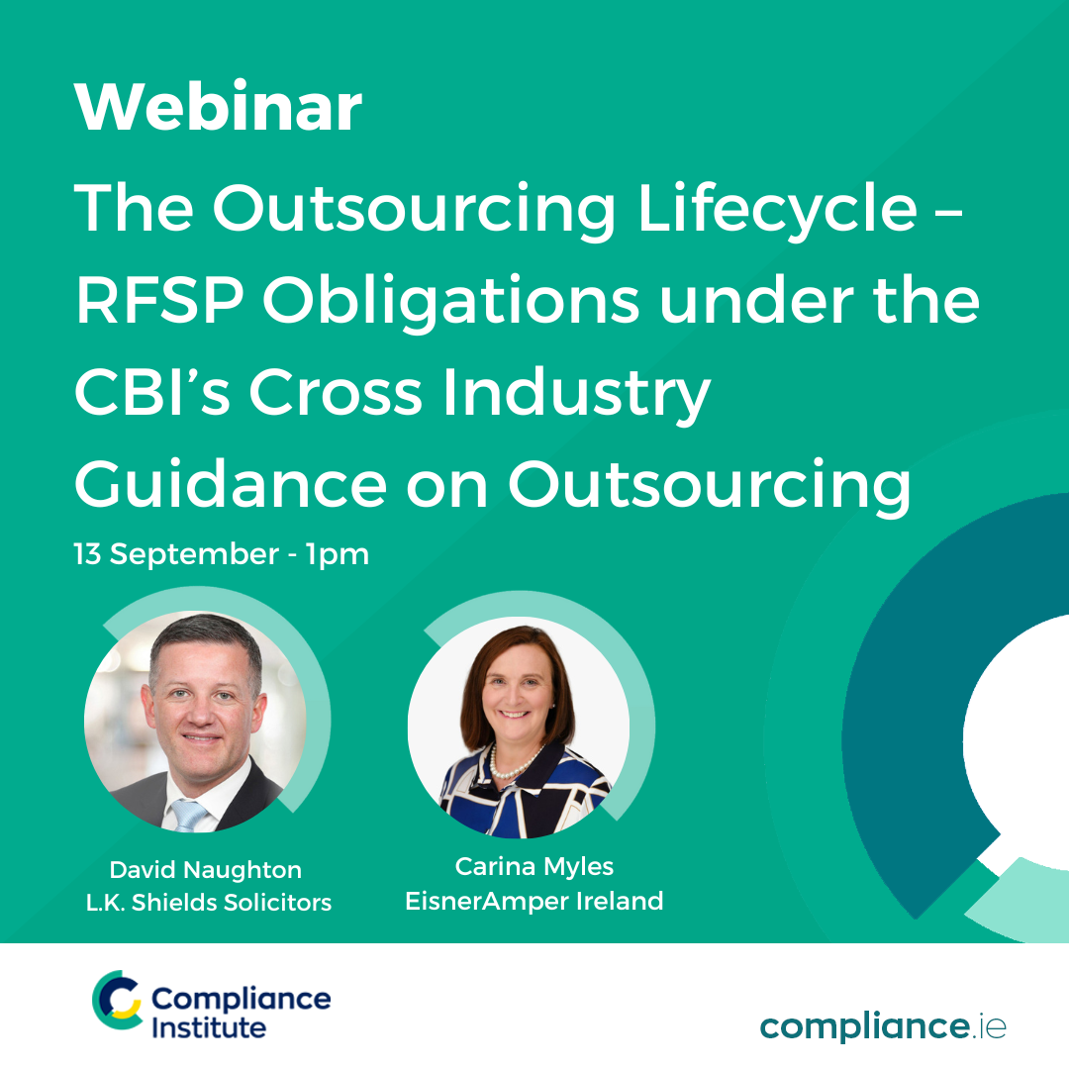
P
The Outsourcing Lifecycle
RFSPs Obligations under CBI’s Cross Industry Guidance on Outsourcing
13th September 2022 compliance.ie
CPD CODE: 2022 - 2129

Slide 2

Welcome & Introduction
Thank you for registering
Questions
  Please use the question box on the right of your screen to send the questions for our speaker
Today’s session will be recorded and will be on our website later today
The CPD code is noted below and will be sent out directly after this session has concluded
CPD CODE: 2022 - 2129

Slide 3
Introduction
CBI Cross Industry Guidance on Outsourcing
  Decision to Outsource
  Due Diligence
  Assess Risk & Criticality
  Contract & SLA’s
  Ongoing Monitoring
  Exit Strategy
  Lessons Learned
Outsourcing Lifecycle
1. Decision to Outsource
2. Due Diligence
3. Assess Risk & Criticality
4. Contract & SLA’s
5. Ongoing Monitoring
6. Exit Strategy

Slide 4

Decision to Outsource
Benefits of Outsourcing
  Reduced costs, increased efficiencies and access to skills, knowledge and technology
Outsourcing Strategy
  Integrated into firm’s overarching strategy, business model, risk appetite and risk management framework
Role of The Board
  Responsible for all activities undertaking by the regulated firm
  Includes activities conducted on the regulated firm’s behalf by a third party, including any group entity
  Embedded Outsourcing Framework
Outsourcing
  Intragroup Arrangements and Third Party OSPs
  Delegation & Outsourcing considered as the same concept by the CBI
  To be treated to the same onerous due diligence, oversight & monitoring.
Outsourcing decisions must be embedded in the firm’s business strategy, model, governance, risk and compliance structures and embedded across the 3 Lines of Defence.

Slide 5
Decision to Outsource
Outsourcing Strategy
  Holistic View
  Extent of Outsourcing
  Critical or Important Activities or Functions
  Outsourcing Register
  Risks Appetite
  Risk Register
  Risk Mitigation & Management
  Oversight & Monitoring – initial & ongoing
  Designated Responsible Individual – directly accountable to Board
  Governance & Internal Controls
  Outsourcing Policy – Board Approved (Annually)
Outsourcing Strategy
1. Regulated Firm remains responsible
2. Careful consideration and management of outsourcing risks
3. Structure & Governance initial and ongoing are key to maintaining adequate oversight

Slide 6
Due Diligence
Appropriate & Proportionate Due Diligence
Appropriate authorization
Ability to meet its obligations over duration of the contract
Conduct detailed initial due diligence
Review outsourced service providers of critical services – Annually
Review key contractual arrangements - Annually
Due Diligence
1. Appropriate & Proportionate
2. In line with criteria set out in Guidance
3. Periodic reviews during the lifecycle of the contract.
1

Slide 7
Due Diligence
Values & Ethical Behaviour
  Code of Conduct
  Ethics & Social Responsibility
  International Standards
Frequency of Due Diligence Review
  Initial
  Periodic – annual for key OSPs of critical or important services
  Contract Renewal
Due Diligence
1. Appropriate & Proportionate
2. In line with criteria set out in Guidance
3. Periodic reviews during the lifecycle of the contract.
1

Slide 8
Assess Risk & Criticality
Methodology
Core Business Lines / Critical Business Functions
Comprehensive Risk Assessments
Sub-Outsourcing Risk
  Visibility & Regulator’s ability to Supervise
  Compliance & Contractual rights of access & audit
Risk & Criticality
Strong Outsourcing Risk Management Framework
Comprehensive Risk Assessments & Documented Methodology
Inherent risks are identified, measured, monitored and managed.
Sensitive Data Risk
  Storage, management, retention & destruction
  EBA Guidelines / CBI Guidelines
Data Security Risk
  Secure transmission, storage and back-up
  Operationally effective controls
Concentration Risk
  Dependency on single or small no. of OSPs
  Limited no. of providers at sectoral level
Offshoring risk
  Effective oversight & supervision
  Country risk
1

Slide 9
SLA’s & Contracts
Formal Contracts
  Consideration of EBA Guidelines on Outsourcing & General Good Practice
  Inspections & Audit
  Termination Rights
  Dispute Resolution
  Indemnification
  Limits & Liability
  Provisions for amendment
  Notifications of financial difficulty, catastrophic events and significant incidents
  Periodic Review
  Non-Critical or Important Outsourcing Arrangements
  Business Continuity & Disaster Recovery
SLA’s & Contracts
1. Formal Contracts & Written Agreements
2. In line with criteria set out in Guidance
3. BCP & DR
1

Slide 10
Ongoing Monitoring
3rd Line
Internal & External Audit
2nd Line
Risk & Compliance
1st Line
Front-Line
3rd Line Defence – Internal & External Audit
Escalation
Internal – Outsourcing Policy & Risk Appetite
Internal – Criticality or Importance Assessment
External - Outsourcing Assurance
2nd Line Defence – Risk & Compliance
Risk Oversight & Trend Analysis
Regulatory Compliance Monitoring
Oversight & Remediation
Reporting & Escalation
Risk Based Approach
1st Line Defence – Front-Line Employees
SLA’s / OSPs Reporting – KPIs / KCI’s
BCP Testing
Operational Oversight
Controls & Remediation
Reporting to 2nd Line
1

Slide 11
Regulatory Engagement
Outsourcing Register
Guidelines & Register available on CBI website.
Submission Deadline 2022 – Extended to 19th October
Notification
Guidelines set out events that could give rise to Notification
Report of Adverse Incidents
Guidelines set out events that could give rise to reporting
Regulatory Engagement
1. Maintenance & Submission of Registers
2. Be aware of events that could rise to Notification Requirements
3. Report Adverse Incidents
1

Slide 12
Exit Strategy
Exit Strategy
  Viable, Appropriately Planned & Tested
  Ability to substitute OSPs
  Ability to re-integrate
Reasons for Exit
Exit Strategy
Contractual
Documented Framework & Regular Review
Intragroup – in line with Guidance and Sectoral Requirements
  Failure to meet standards
  Unexpected termination
  Stressed Circumstances
Documented Framework
  Escalation of breach of tolerance
  Skills & Expertise
  Management & Timeframe to Transfer
Step-In
  Step-In Risks
  Step-In Rights
  Review Scenarios
Intra-Group
  Guidance, Sector Legislation & Regulatory Requirements
  Viable Plans
1

Slide 13
Lessons Learned
Lessons Learned
Inadequate
Outsourcing Risk Management Framework
Inadequate Board & Governance Arrangements
Inability to Identify, Mitigate and Manage Risk
Hinder Regulators
Ability to Supervise
1

Slide 14
P
Questions & Answers
CPD CODE: 2022-2129

Slide 15
Thank You For Attending The Outsourcing Lifecycle - RFSPs Obligations under CBI’s Cross Industry Guidance on Outsourcing
A recoding of this webinar and the CPD code will be available on our website.
CPD CODE – 2022 - 2129
compliance.ie

