Slide 1

P
INTUITIVE ANTI-MONEY LAUNDERING
24.10.2022 compliance.ie

Slide 2

Welcome & Introduction
Thank you for registering
Questions
  Please use the question box on the right of your screen to send the questions for our speaker
Today’s session will be recorded and will be on our website later today
The CPD code is noted below and will be sent out directly after this session has concluded
CPD CODE: 2022-2380

Slide 3


INTUITIVE ANTI-MONEY LAUNDERING
Presented by Patrick Ryan
Senior AML Analyst
Compliance.ie

Slide 4
INTUITIVE ANTI-MONEY LAUNDERING
Our Promise To Attendees
By the end of this 90 minute AML Session;
You will better understand how AML law is conceived and created, and then implemented by firms and people like you
You will realise why knowing the ultimate beneficial ownership of your clients is a critical component of AML
You will appreciate why your AML role is so important
Compliance.ie

Slide 5
SECTION I.
THE SOURCE AND OBJECTIVES OF AML LAW

Slide 6
AML LAW IN IRELAND
The Criminal Justice (Money Laundering and Terrorist Financing) Acts 2010 & 2013, with amendments in 2018 & 2021
Key update implemented in the 2021 Act – Beneficial Ownership (S2)
Section 25: Applies to Credit/Financial Institutions, Auditors, Accountants, Tax Advisors, Legal Professionals, Trusts, Property Agents, Casinos, etc
Why does the law require AML checks on our clients, who makes the rules?
Compliance.ie
1/10

Slide 7
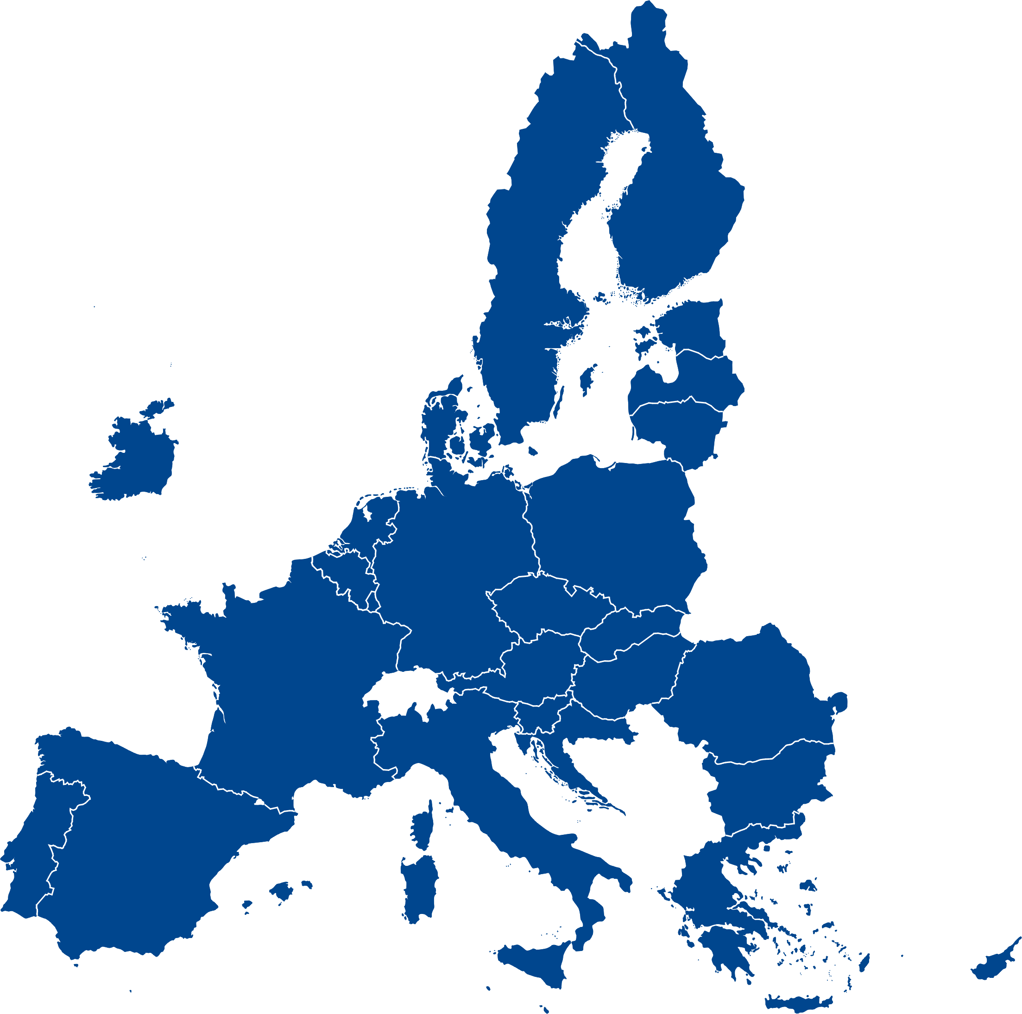
THE EU COMMISSION, PARLIAMENT AND COUNCIL
Compliance.ie
2/10

Slide 8
WHAT MAKES A GOOD AML PROGRAMME?
The Acts/Directives do not explain how to achieve the requirements they set out
Guidelines to the Act(s) (CP128) make it clear that a Risk-Based Approach is best
What constitutes a Risk-Based Approach according to the law?
Compliance.ie
3/10

Slide 9
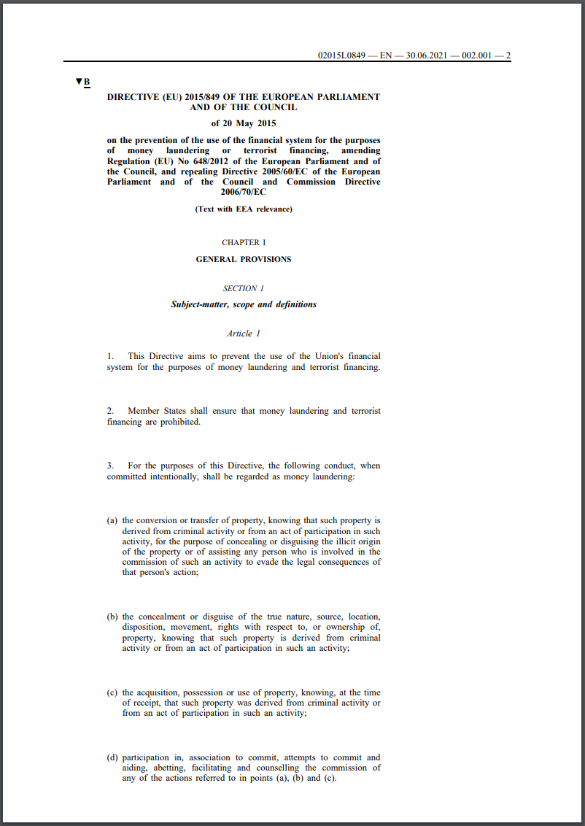
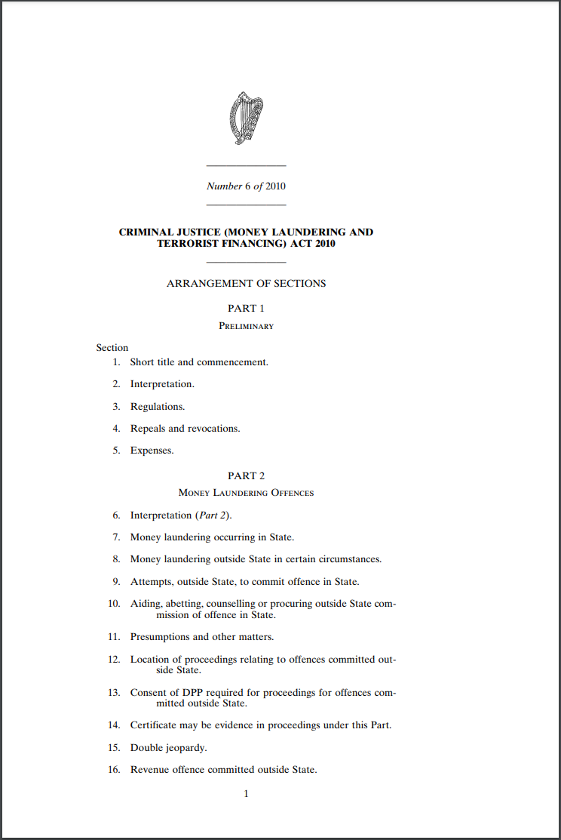
4/10

Slide 10
RISK-BASED APPROACH
Every designated person/entity must effectively create their own internal system of evaluating the AML risk posed by their clients & potential clients
Risk factors include; client type, jurisdiction, ownership, controllers, sanctions, etc
What are some best practices for Risk-Based AML?
Compliance.ie
5/10

Slide 11
AML RISK - BEST PRACTICES
Customer Due Diligence (CDD) should be applied on the basis of 3 tiers; Simplified, Standard, or Enhanced Due Diligence
Risk categories/factors for clients should be Low, Medium, or High, with a special category for Politically Exposed Persons (PEPs) or Sanctioned Persons/Entities
Client profiles should be re-evaluated/updated every 1/3/5 years per risk level
How should AML Risk be assessed?
Compliance.ie
6/10

Slide 12
ASSESSING AML RISK FACTORS
Jurisdiction; FATF, Basel Institute, Sanction Lists, Industry Leaders
Entity Type; Complexity, Ownership Structures, Stated Purpose
Business Activity; Industry Sector, Handling of Funds, Regulated, Listed
Controlling Parties; Management Structures, Ownership, Trustees, Jurisdiction
Individuals; PEPs, Sanctions, Adverse Press, Jurisdiction
Higher Complexity = Higher Risk
Compliance.ie
7/10

Slide 13
UNEXPLAINED COMPLEXITY = HIGH RISK = MORE AML REQUIREMENTS
CLIENT
CLIENT
Compliance.ie
8/10

Slide 14
THE ISSUE OF VAGUERY
2010 Act
Section 33; Collecting documents
Section 37; Detecting PEPs
Section 38; Using 3rd parties
Section 54; Developing policies
Section 55; Keeping records
2018 Amendment
Section 54; Monitoring frequency
2021 Amendment
Section 8; Ownership registers
Compliance.ie
9/10

Slide 15
COMMON QUESTIONS ON AML REQUIREMENTS
“Do all documents received from clients need to be certified as true copies of originals?” – No, this is not strictly required by the law in Ireland
“Do ID and Address documents need to be kept in date at all times?” – No, once they are in date/from within the last 6 months at the time received
“Can you provide services to a new client during initial AML onboarding?” – No, all prospective clients must be officially approved according to the firm’s internal AML policies before services are offered
Compliance.ie
10/10

Slide 16

SECTION II.
UNDERSTANDING OWNERSHIP

Slide 17
OWNERSHIP – KEY TERMINOLOGY
“Ownership” is not equal to Ultimate Beneficial Ownership
“Ultimate Benefit” refers to individual natural persons. (Human Beings) Entities can be owners, but they cannot be UBOs. Entities do not benefit from or enjoy property, they are vehicles for ownership by real people
Salomon v Salomon & Company (1897); Companies are ‘Legal Persons’ with separate legal personality, but not actual persons, therefore not UBOs
Interchangeable terms; Members, Subscribers, Beneficiaries, Shareholders
Compliance.ie
1/11

Slide 18
ULTIMATE BENEFICIAL OWNERS – HOW FAR DO WE GO?
CLIENT
Compliance.ie
2/11

Slide 19
ULTIMATE BENEFICIAL OWNERS – HOW FAR DO WE GO?
?
?
BLUE 3
BLUE 4
50%
50%
BLUE 2
100%
BLUE Ltd
12%
CLIENT
Compliance.ie
3/11

Slide 20
ULTIMATE BENEFICIAL OWNERS – HOW FAR DO WE GO?
?
?
GRAY 4
GRAY 5
?
?
40%
60%
BLUE 3
BLUE 4
GRAY 3
50%
50%
100%
BLUE 2
GRAY 2
100%
79%
BLUE Ltd
GRAY LP
12%
23%
CLIENT
Compliance.ie
4/11

Slide 21
ULTIMATE BENEFICIAL OWNERS – HOW FAR DO WE GO?
?
?
?
?
GRAY 4
GRAY 5
JOHN
ANNA
?
?
40%
60%
?
15%
55%
BLUE 3
BLUE 4
GRAY 3
RED 5
RED 6
50%
50%
100%
?
18%
64%
?
BLUE 2
GRAY 2
RED 2
RED 3
RED 4
100%
79%
7%
80%
13%
BLUE Ltd
GRAY LP
RED Ltd
12%
23%
65%
CLIENT
Compliance.ie
5/11

Slide 22
ULTIMATE BENEFICIAL OWNERS – HOW FAR DO WE GO?
?
?
GRAY 4
GRAY 5
?
?
40%
60%
?
BLUE 3
BLUE 4
GRAY 3
RED 5
RED 6
50%
50%
100%
?
18%
64%
?
BLUE 2
GRAY 2
RED 2
RED 3
RED 4
100%
79%
7%
80%
13%
BLUE Ltd
GRAY LP
RED Ltd
12%
23%
65%
CLIENT
Compliance.ie
6/11

Slide 23
ULTIMATE BENEFICIAL OWNERS – HOW FAR DO WE GO?
?
?
TRADED/REGULATED
GRAY 4
GRAY 5
RED 7
?
?
40%
60%
?
100%
BLUE 3
BLUE 4
GRAY 3
RED 5
RED 6
50%
50%
100%
?
18%
64%
?
BLUE 2
GRAY 2
RED 2
RED 3
RED 4
100%
79%
7%
80%
13%
BLUE Ltd
GRAY LP
RED Ltd
12%
23%
65%
CLIENT
Compliance.ie
7/11

Slide 24
ULTIMATE BENEFICIAL OWNERS – HOW FAR DO WE GO?
?
?
?
?
GRAY 4
GRAY 5
JOHN
ANNA
?
?
40%
60%
?
15%
55%
BLUE 3
BLUE 4
GRAY 3
RED 5
RED 6
50%
50%
100%
?
18%
64%
?
BLUE 2
GRAY 2
RED 2
RED 3
RED 4
100%
79%
7%
80%
13%
BLUE Ltd
GRAY LP
RED Ltd
12%
23%
65%
CLIENT
Compliance.ie
8/11

Slide 25
ULTIMATE BENEFICIAL OWNERS – HOW FAR DO WE GO?
7.2%
10.9%
4.9%
18.3%
GRAY 4
GRAY 5
JOHN
ANNA
6%
6%
40%
60%
9.3%
15%
55%
BLUE 3
BLUE 4
GRAY 3
RED 5
RED 6
50%
50%
100%
4.5%
18%
64%
8.4%
BLUE 2
GRAY 2
RED 2
RED 3
RED 4
100%
79%
7%
80%
13%
BLUE Ltd
GRAY LP
RED Ltd
12%
23%
65%
CLIENT
Compliance.ie
9/11

Slide 26
ULTIMATE BENEFICIAL OWNERS – HOW FAR DO WE GO?
7.2%
10.9%
4.9%
18.3%
GRAY 4
GRAY 5
JOHN
ANNA
6%
6%
40%
60%
9.3%
15%
55%
BLUE 3
BLUE 4
GRAY 3
RED 5
RED 6
50%
50%
100%
4.5%
18%
64%
8.4%
BLUE 2
GRAY 2
RED 2
RED 3
RED 4
100%
79%
4.8%
7%
80%
13%
BLUE Ltd
GRAY LP
RED Ltd
12%
23%
65%
CLIENT
Compliance.ie
10/11

Slide 27
ULTIMATE BENEFICIAL OWNERS – IMPACT ON RISK?
7.2%
10.9%
4.9%
18.3%
GRAY 4
GRAY 5
JOHN
ANNA
6%
6%
40%
60%
9.3%
15%
55%
BLUE 3
BLUE 4
GRAY 3
RED 5
RED 6
50%
50%
100%
4.5%
18%
64%
8.4%
BLUE 2
GRAY 2
RED 2
RED 3
RED 4
100%
79%
4.8%
7%
80%
13%
BLUE Ltd
GRAY LP
RED Ltd
12%
23%
65%
France
Cayman
Ireland
China
CLIENT
Compliance.ie
11/11

Slide 28
SECTION III.
SANCTIONS AND REGULATIONS

Slide 29
THE SOURCE OF SANCTIONS
Devised by - The Council of the European Union, through sub-committees such as the High Representative of the Union for Foreign Affairs and Security Policy, and the European External Action Service
Implemented by - EU Member States, Sanctions form part of EU law, so they must be transposed by members into national law and adopted by the governments and individuals/entities within
Enforced by - The EU Commission, ensuring uniformity across jurisdictions and reprimanding failures, even sanctioning EU member states for breaches of EU law, such as Hungary and Poland (Rule of Law)
The EU may also choose to implement UN/US Sanctions etc
Compliance.ie
1/12

Slide 30
THE EU COUNCIL AND ITS MEMBER STATES - SANCTIONERS
Compliance.ie
2/12

Slide 31
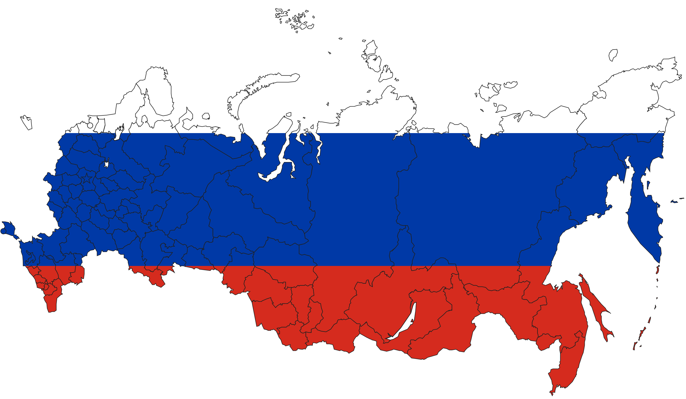
THE RUSSIAN FEDERATION – 147 MILLION PEOPLE SANCTIONED - FALLOUT
Compliance.ie
3/12

Slide 32
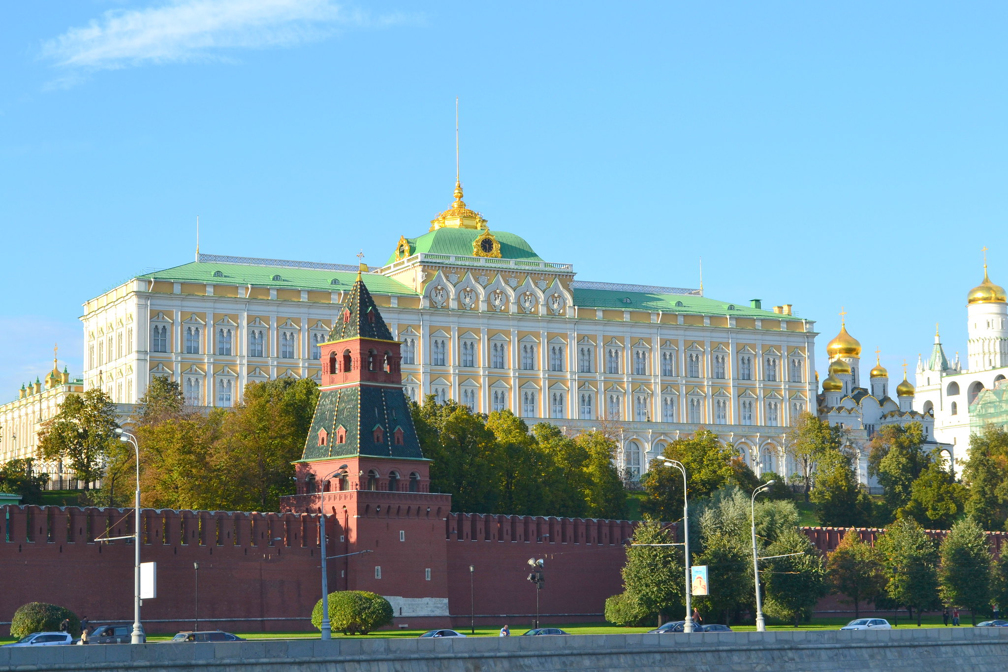
THE DIFFERENCE BETWEEN A COUNTRY AND ITS GOVERNMENT
Compliance.ie
4/12

Slide 33
TYPES AND FORMS OF SANCTIONS
Individuals - Usually subject to an asset freeze and the prohibition to make funds and economic resources available to them, in targeted response to their activities/policies the EU deems contrary to international law, human rights and fundamental freedoms (ECHR, CJEU, CFR)
Entities/Nations – Many different relevant entity types exist, such as companies, pensions, foundations, charities, trusts, partnerships. All are in scope for Sanctions and Enhanced Due Diligence if registered/domiciled in the Russian Federation
Forms - Asset freezing or confiscation, travel bans, import and export restrictions, restrictions on banking/financial services, embargoes, etc. There are over 2000 Individuals/Entities on the EU’s Financial Sanctions List (Not all Russian)
Compliance.ie
5/12

Slide 34
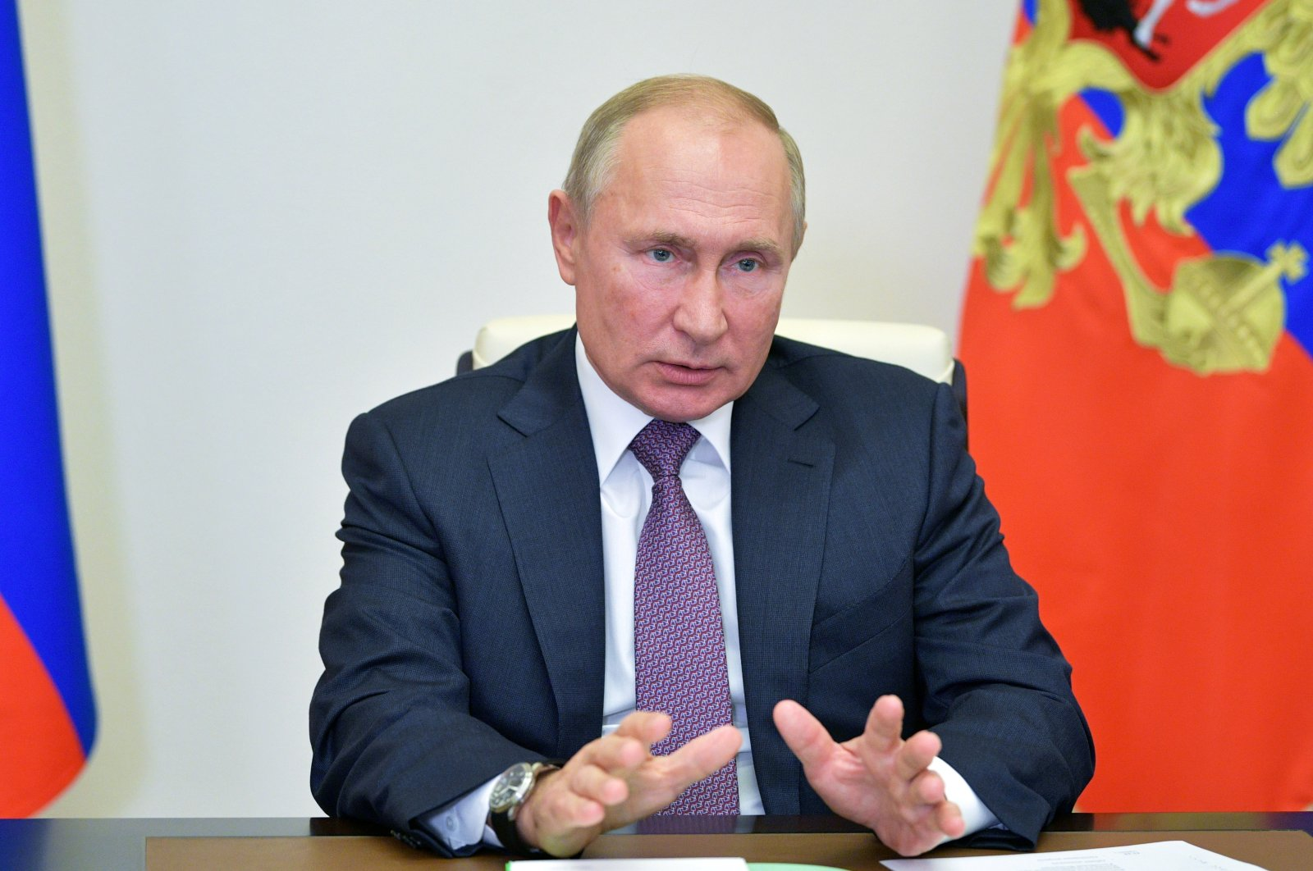
SANCTIONED INDIVIDUALS
EU reference number: EU.7510.16
Legal basis: 2022/332 (OJ L53) (Journal of the EU)
Programme: UKR - Ukraine
Name/Alias: Влади́мир Влади́мирович ПУ́ТИН
Name/Alias: Vladimir Vladimirovich PUTIN
Function: President of the Russian Federation
Birth date: 07/10/1952
Birth place: Russian Federation, Leningrad (now Saint-Petersburg)
Compliance.ie
6/12

Slide 35
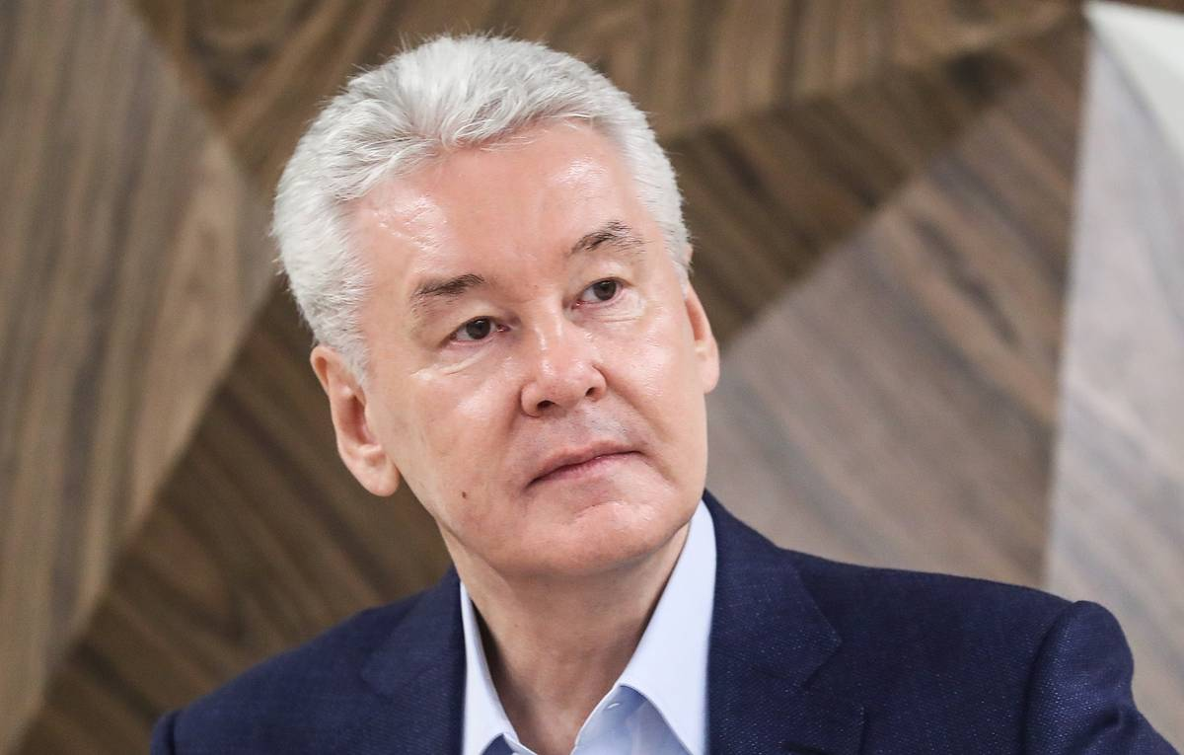
SANCTIONED INDIVIDUALS
EU reference number: EU.8492.36
Legal basis: 2022/1270 (OJ L193)
Programme: UKR - Ukraine
Name/Alias: Сергей Семёнович СОБЯНИН
Name/Alias: Sergey Semyonovich SOBYANIN
Function: Mayor of Moscow and has close ties with Vladimir Putin. Head of the presidential administration from 2005-2008 and served as Deputy Prime Minister of Russia from 2008-2010 in Vladimir Putin’s Second Cabinet. Member of the Security Council
Birth date: 21/06/1958
Birth place: Russian Federation, Nyaksimvol
Compliance.ie
7/12

Slide 36

SANCTIONED INDIVIDUALS
EU reference number: EU.7891.85
Legal basis: 2022/581 (OJ L110)
Programme: UKR - Ukraine
Name/Alias: Игорь Евгеньевич КОНАШЕНКОВ
Name/Alias: Igor Evgenievich KONASHENKOV
Title: Major General
Function: Head of the Department of Information and Communications of the Ministry of Defense of the Russian Federation
Birth date: 15/05/1966
Birth place: Moldova, Republic Of, Chisinau
Compliance.ie
8/12

Slide 37
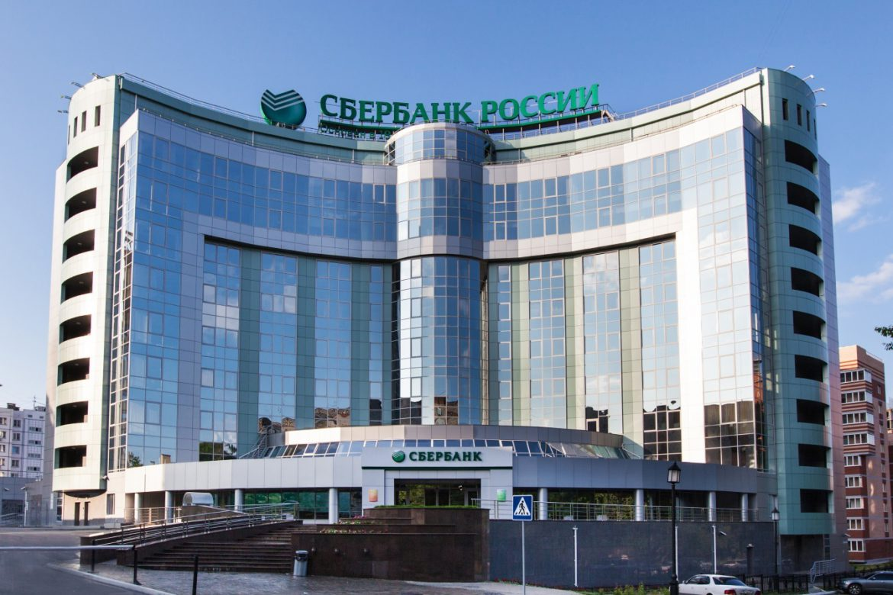
SANCTIONED ENTITIES
EU reference number: EU.8537.32
Legal basis: 2022/1270 (OJ L193)
Programme: UKR - Ukraine
Company name:
Name: Сбербанк
Name: Sberbank
Address: Russian Federation, Moscow, 19 Vavilova St., 117997
Compliance.ie
9/12

Slide 38
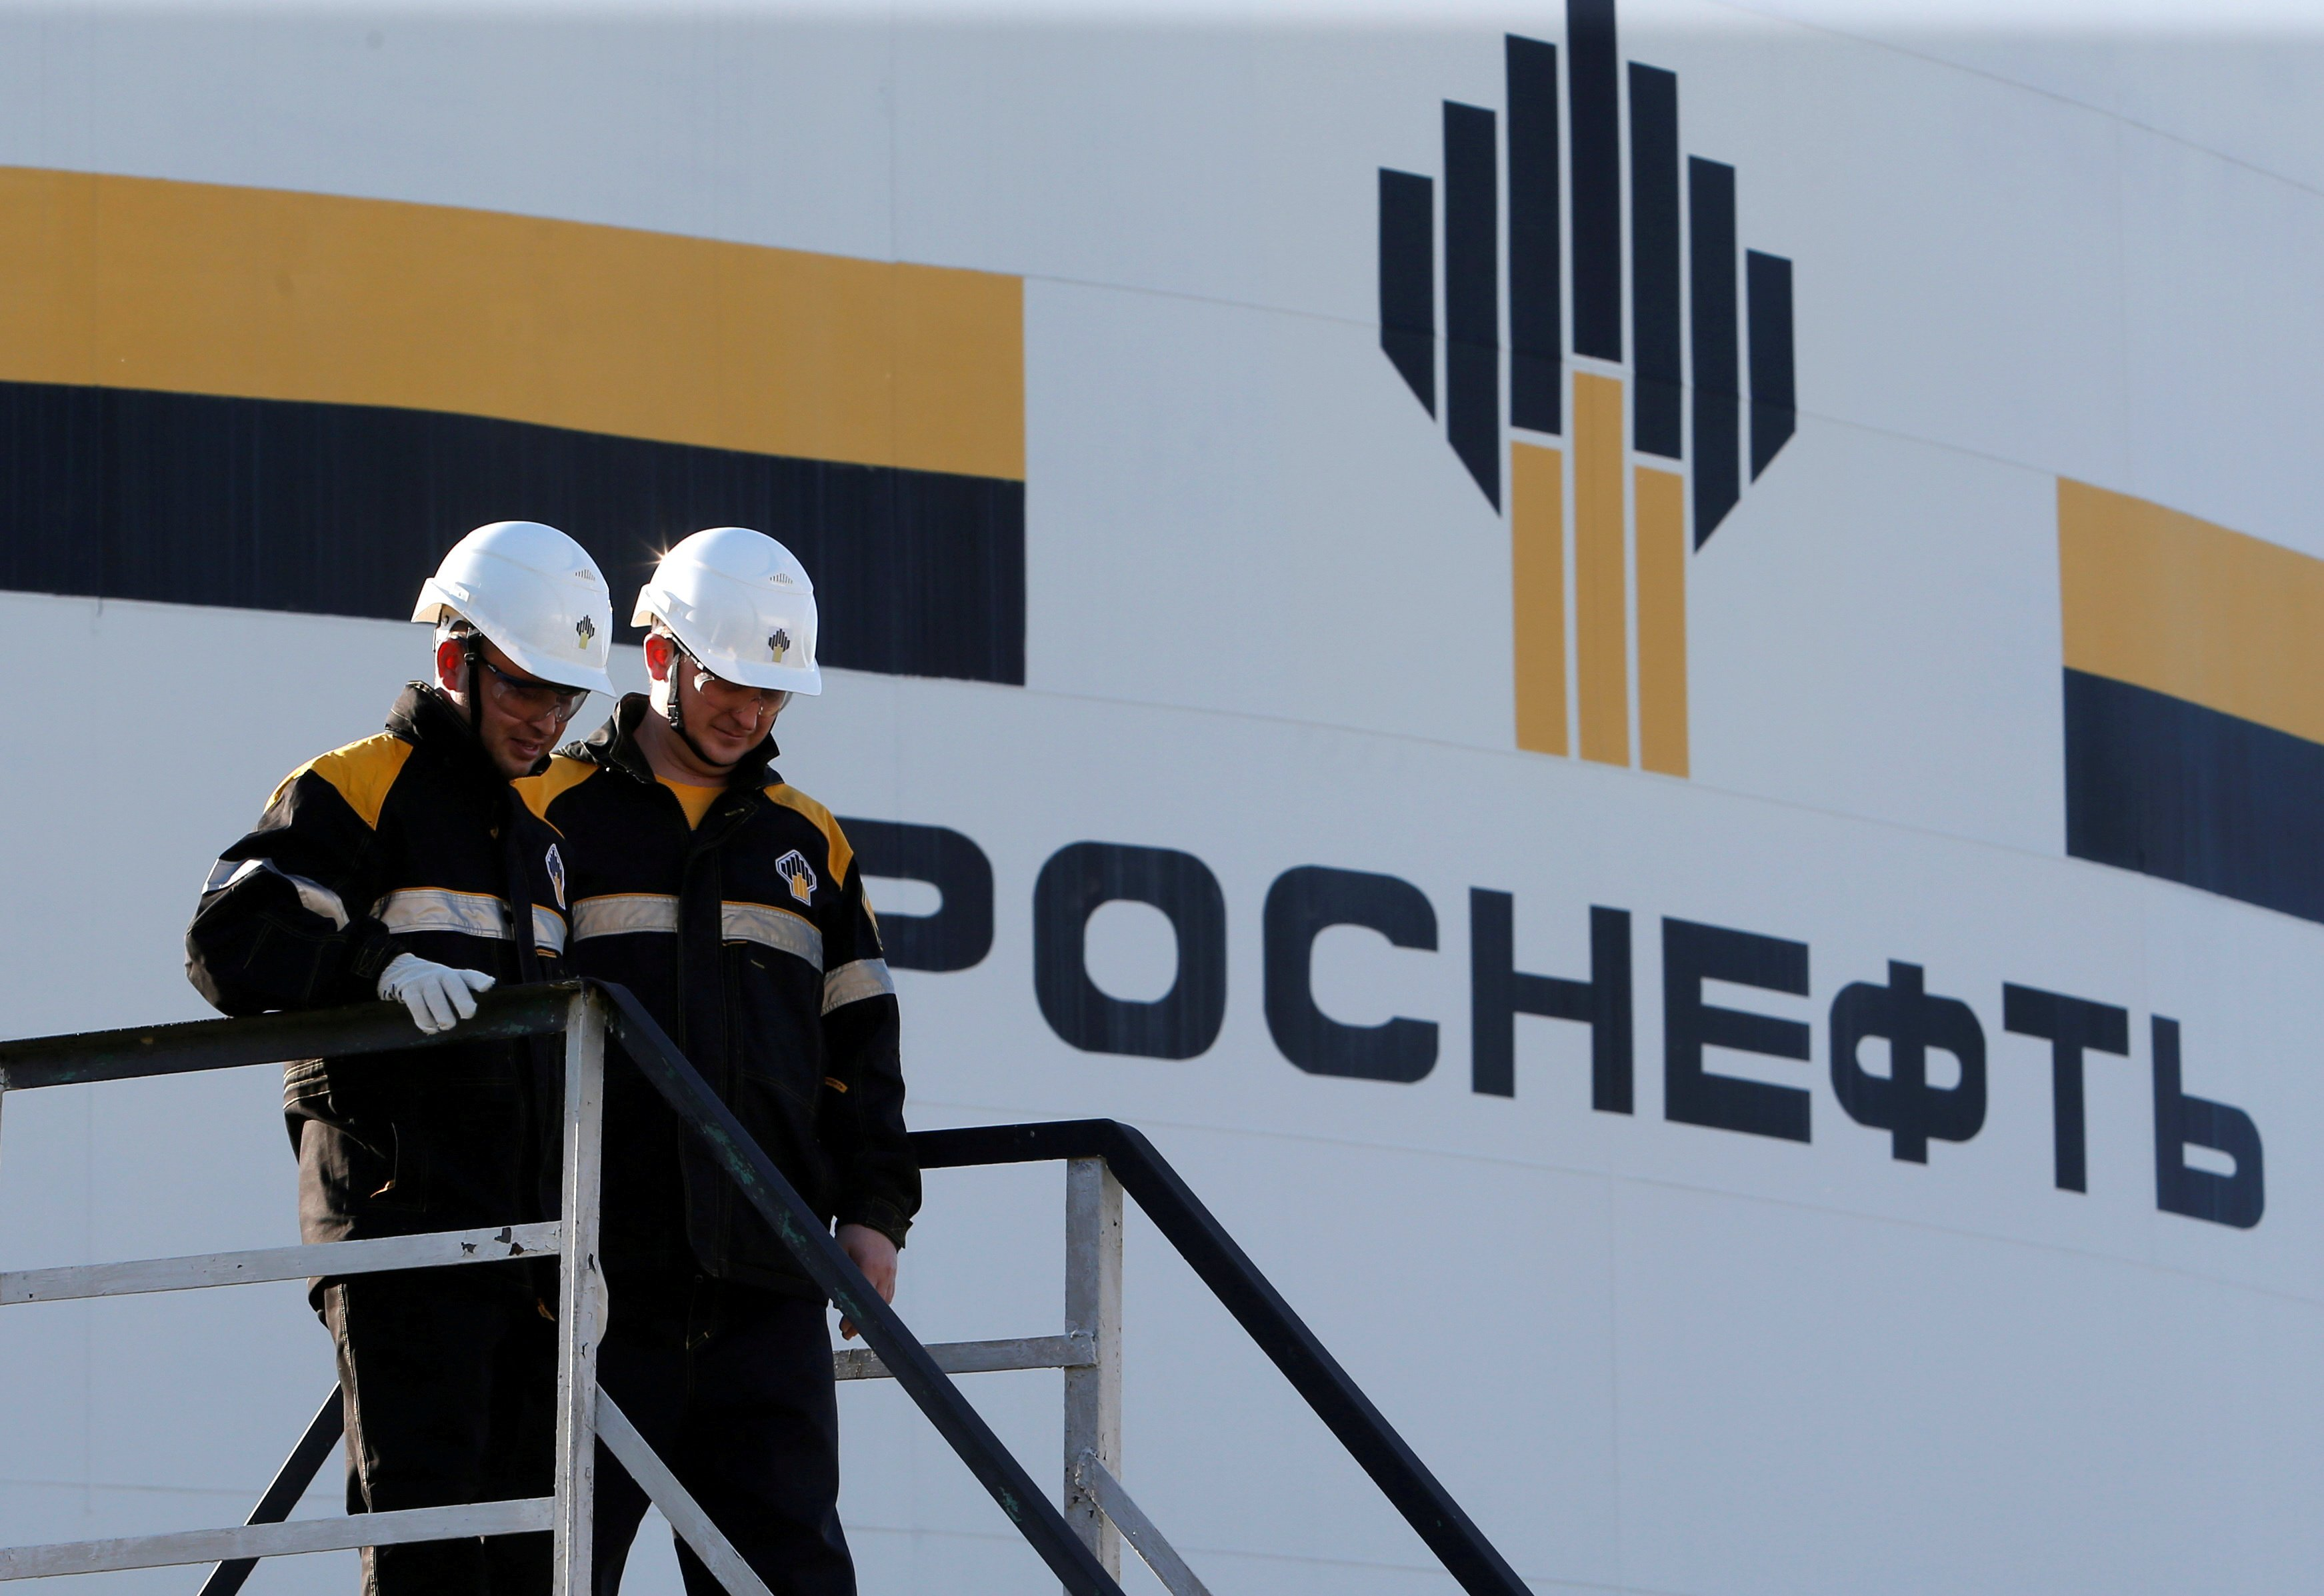
SANCTIONED ENTITIES
EU reference number: EU.7807.67
Legal basis: 2022/427 (OJ L87I)
Programme: UKR - Ukraine
Company name:
Name: РН-Аэро
Name: RN AERO
Name: Роснефть-Аэро
Name: ROSNEFT AERO
Address: Russian Federation, 119071 Moscow, 15, Malaya Kaluzhskaya
Compliance.ie
10/12

Slide 39
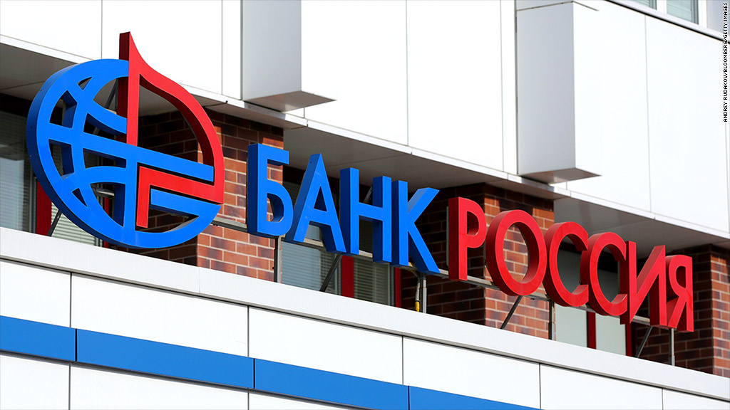
SANCTIONED ENTITIES
EU reference number: EU.7394.37
Legal basis: 2022/260 (OJ L42I)
Programme: UKR – Ukraine
Company name:
Name: Bank Rossiya
Name: Банк «Росси́я»
Remark: Founded on 27.6.1990
Associated individuals: Dmitri LEBEDEV (Chairman)
Address: Russian Federation, 191124 Saint Petersburg, Pl Rastrelli 2
Compliance.ie
11/12

Slide 40
DETECTING PEPs AND SANCTIONED PERSONS
Request the correct information/documentation per client entity type
Fully understand the ownership and control of your client entity, apply the correct level of risk evaluation and requisite due diligence
Use screening software to search names through Sanctions databases such as the EU FSF, US OFAC, FATF, etc
When in doubt about a client, escalate internally before accepting them
Compliance.ie
12/12

Slide 41
INTUITIVE ANTI-MONEY LAUNDERING
Our Promise To Attendees
Having now attended this AML session;
You understand how AML law is channelled from the EU into the real world, relying on you and your firm to comply
You recognise complex ownership structures and how to calculate ultimate beneficial ownership of your clients
You know the risks and stakes of non-compliance with AML law, and how access to money can fund extreme ideology
Compliance.ie
This presentation does not represent professional legal advice or intend to create any legally binding representations. Neither the presenter nor the Compliance Institute assume any responsibility or liability for any errors or omissions related to this presentation's content.

Slide 42
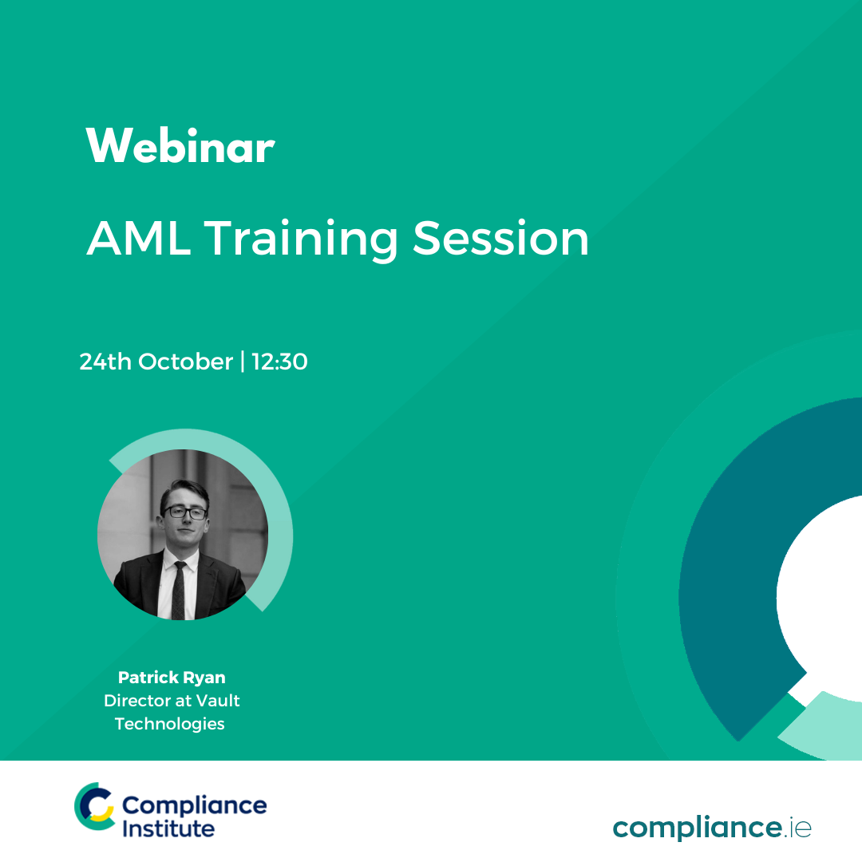
Thank You For Attending
AML Training Session
A recoding of this webinar and the CPD code will be available on our website later today.
CPD CODE – 2022- 2380
compliance.ie

Slide 43
INTUITIVE ANTI-MONEY LAUNDERING
amlvault.com
VAULT TECHNOLOGIES LIMITED
13 Upper Baggot Street, 2nd Floor, Dublin 4, D04W7K5, Ireland

