Slide 1

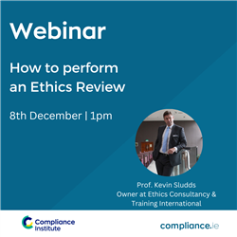
P
How to Perform an
Ethics Review
Dec, 2022 compliance.ie

Slide 2

Welcome & Introduction
Thank you for registering
Questions
  Please use the question box on the right of your screen to send the questions for our speaker
Today’s session will be recorded and will be on our website later today
The CPD code is noted below and will be sent out directly after this session has concluded
CPD CODE: 2022 – 2643

Slide 3
Professor Kevin Sludds
How to Perform an Ethics Review
Compliance Institute (8th December 2022)

Slide 4
Coming-up
What Ethics is
Heightening Ethical Awareness
Professional Ethicist – what’s that?
Performing an Ethics Review
Heightening Ethical Awareness – Key Questions
The Benefits of Performing an Ethics Review
Thanks for listening/Q&A

Slide 5


‘Ethics’ custom, character, practice - a consistent mode of behaviour
Heightening ethical awareness
Ethics ‘in’ Action Principle

Slide 6
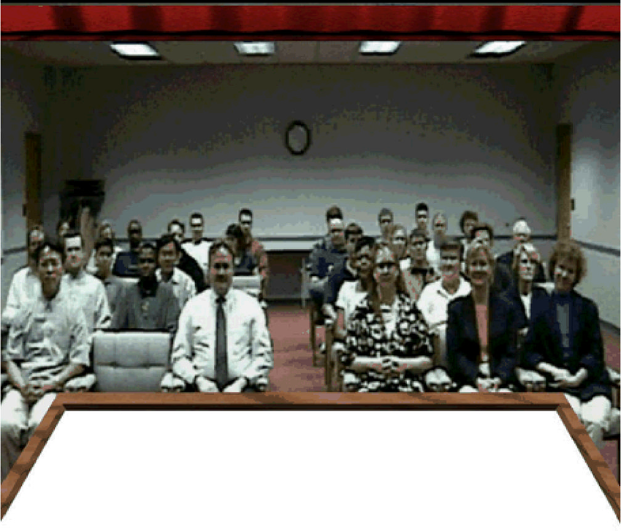
What is it?
It’s what you’re doing right now . . .
and it’s a branch of philosophy

Slide 7


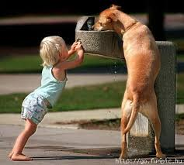

Ethics ‘in’ Action vs. Business Ethics
Ethics - Hidden in Plain Sight

Slide 8
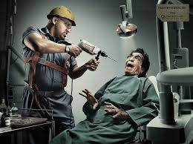
A ‘professional ethicist’ - what’s that?
Raymond Baumhart asked: What does ethics mean to you?
ethics has to do with my religious beliefs
ethics has to do with what my feelings tell me is right or wrong
being ethical is doing what the law requires
I don’t know what the word means
Ethical actions must be supported by consistent and well-founded reasons
and up-dated to come into line with revised insights and new understanding.
The financial audit comparison!

Slide 9

Heightening Awareness: Nan-in & Zen
Quest - ion
Search
Ongoing

Slide 10

Ethics is what we make it
Ethical issues only become ethical when the intentions behind them, their results & the values (individual, corporate or societal) they reflect are considered.
Facts alone do not decide whether something is right or wrong.

Slide 11

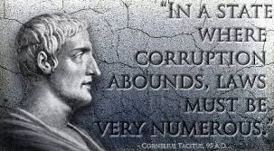
Ethical Leadership is about wriggle-room
Culture drives ethics not laws or regulations

Slide 12

Heightening Ethical Awareness – Key Questions
from where do the values of your organisation stem?
how do you treat/relate to your colleagues/clients?
how effectively is your ‘ethics’ communicated to staff, clients, regulators etc.?
what are the unique features of your ‘way of working’?
how can you improve the ethical profile of your organisation?

Slide 13
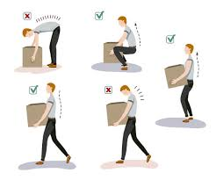

Ethics training = manual handling training
40 years ago scepticism abounded when mandatory manual handling training was formally introduced into many companies.
Staff were being instructed to look again the very basics of how they worked.

Slide 14
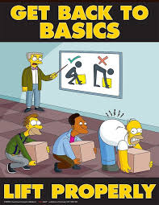
Ethics training = manual handling training
Now of course manual handling training is an essential legal and ethical tool to help ensure the safety of staff and customers.
Ethics training and its application is also about what we do and how we do it and it too should be embraced by progressive companies keen to establish and promote themselves as sincerely ethical.

Slide 15

Building an Ethics ‘in’ Action Principle
Generating an ethics ‘in’ action mentality means ensuring the core values of your organisation are recognised, monitored and improved.
Too often organisations simply cherry-pick ethics terms from what others promote, without considering the need to delve into their own individual cultural mentality.
“Ethical awareness is the development of appropriate habits so that an organisation can respond both effectively and swiftly when ethical crises & dilemmas arise” Sludds.

Slide 16
Ethics ‘in’ action principle – it’s about what you do (i.e. Culture)
Commercial activities across the board are each inseparable from the climate within which they operate and the cultural practices which they engender.
Understanding and utilising ethics for professionals should exemplify how action is managed and made evident through the behaviour which underpins the ethos of any company.

Slide 17
Performing an Ethics Review
What is it and why is it important?
An ethics review is a process which evaluates the way in which a business, and its key personnel, understand and utilise the dynamic of ethics in their organisation.
Competitive Advantage
Ethics should never be considered merely a part of your business rather it is an opportunity to concretely distinguish who you are - your products, services and ways of working from competitors by re-defining and re-profiling what you do.

Slide 18


Slide 19


Slide 20
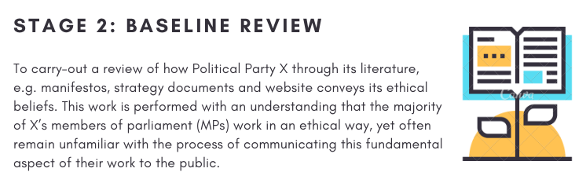

Slide 21
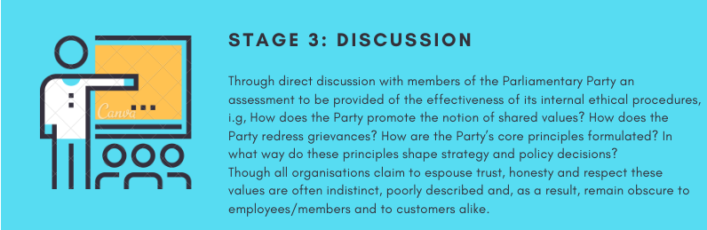

Slide 22
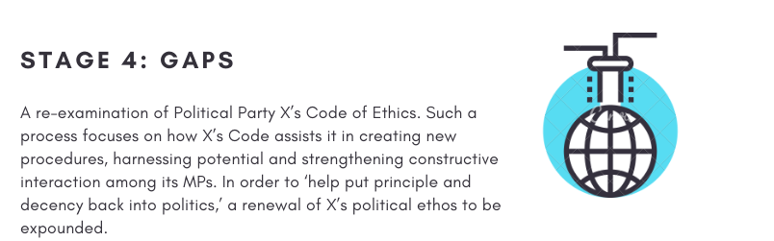

Slide 23
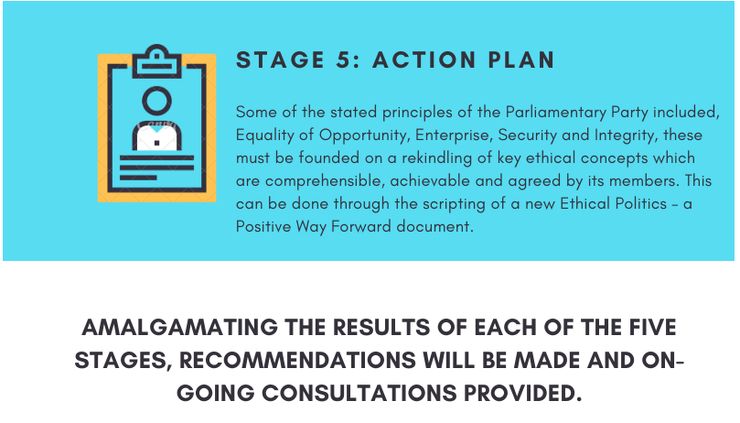

Slide 24
The types of problems uncovered by an Ethics Review
- referencing poorly defined and generic ethics terms which leads to diverse understandings of what to do and how to behave
- little awareness of an organisation’s motivational drivers/purpose
- abusing confidential, sensitive or privileged information
- behaving immorally in personal relationships e.g. acquiring goods more cheaply from clients
Ethical Leadership

Slide 25
Ethics measurability – demonstrate & promote
Direct/indirect
a) Carry out an Ethics Review
b) Create your unique Ethics Pyramid
c) Staff/customer surveys
d) Compliance levels
e) Absenteeism
f) Staff/customer retention levels
g) Reputation capital
h) ISO 26000 Social Responsibility adherence
i) Levels of goodwill

Slide 26
The Benefits of Heightening Ethical Awareness
& Performing an Ethics Review
increases responsiveness to the notion of the right way to work
enhances good relations with clients, the media and regulators
heightens decision-making procedures which require members to make enlightened judgments based on discretion and tact
helps to isolate what unethical behaviour is and how to react to it effectively
guides matters related to risk management, morale and compliance
increases reputational and goodwill levels
helps to attract and retain members

Slide 27
P
Questions & Answers
CPD CODE: 2022-2643

Slide 28

Thank You For Attending How to Perform an Ethics Review
A recoding of this webinar and the CPD code will be available on our website later today.
CPD CODE – 2022 - 2643
compliance.ie

Slide 29
              Thanks for Listening
Contact
Web: www.drkevinsludds.ie
Email: drsludds@gmail.com
Mobile: 086 8581293
Phone: 053 91 63070

