Slide 1
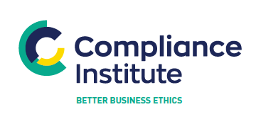
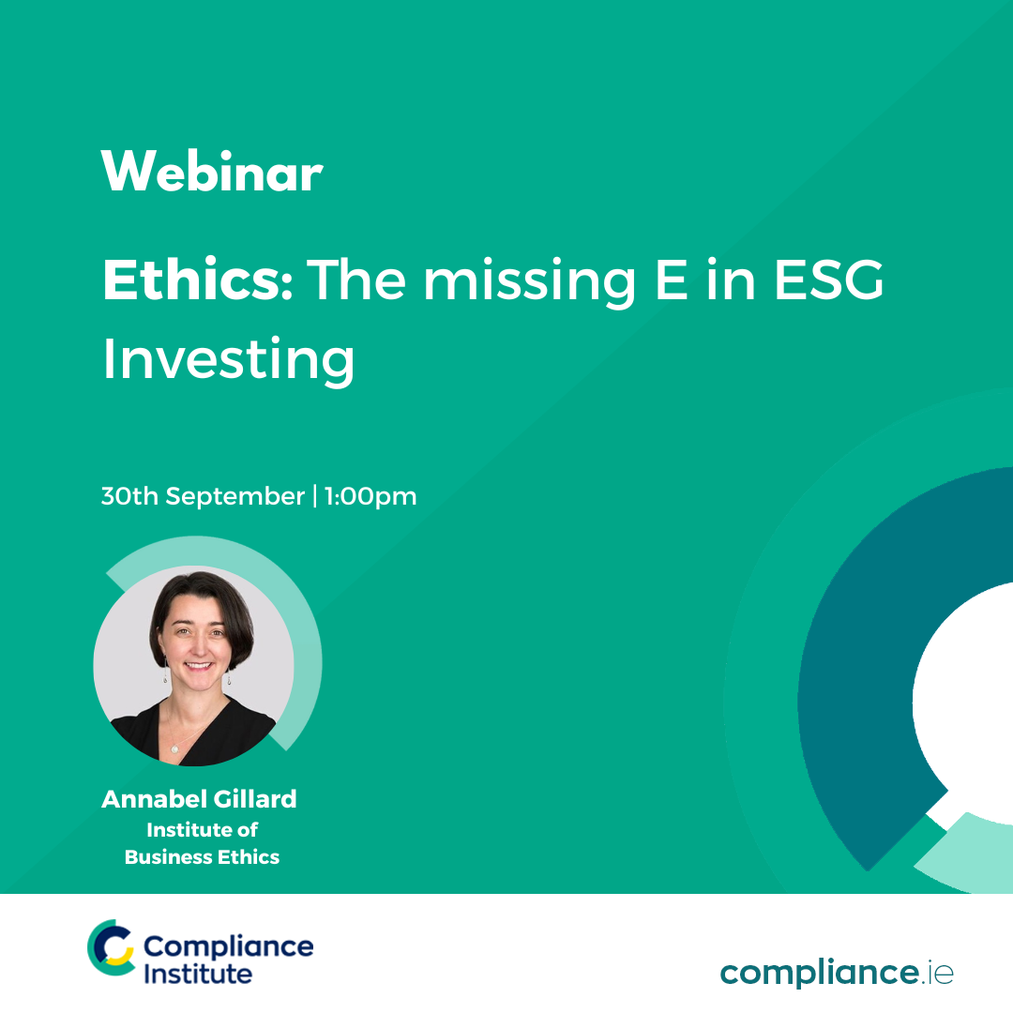
P
Ethics: The missing E in ESG Investing
30 September, 2022 compliance.ie

Slide 2

Welcome & Introduction
Thank you for registering
Questions
  Please use the question box on the right of your screen to send the questions for our speaker
Today’s session will be recorded and will be on our website later today
The CPD code is noted below and will be sent out directly after this session has concluded
CPD CODE: 2022 - 2146

Slide 3

The missing ‘E’ in ESG
Perspectives from the asset management industry
Notes:
Thanks Chris – so over the next c. 12 minutes I’m going to talk you through the highlights of the report – before turning to the discussion to bring it to life.

Slide 4
Report highlights
What do we mean by Ethics?
What is ESG?
How do they relate?
Key findings
What next?
Notes:
Wanted to start with some definitions because this project made clear to me that there are different understandings of business ethics – so let’s agree the definitions up front,
First of ethics, then of ESG before looking to an overview of the findings and finishing with some recommendations.

Slide 5
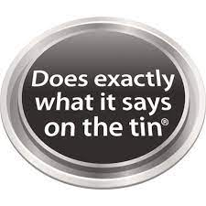
What is business ethics?
IBE defines it as “the application of ethical values to business behaviour”
  The values the organization chooses to prioritise
  Different things to different people
  Authenticity and integrity (the ‘say/do’ gap)
  Understanding this needs safeguards and support because ‘life’
“What we should or shouldn’t do to be consistent with our values” Alison Taylor, Executive Director, Ethical Systems
Notes:
The way IBE defines business ethics is…
So the ethics of a particular business are those values they choose to prioritise, and that will mean different things to different people
What it definitely does mean is authenticity & integrity – limiting the ‘say do gap’ and passing the ronseal test
It also means recognizing the need for back ups because – human nature, stuff happens, time is short…
Alison Taylor defines it as ‘what we should or shouldn’t do to be consistent with our values’

Slide 6
business ethics MYTHS!
What it is not:
Telling people how to live
Telling people how to do business
Adherence to a particular religion or morality - “saints and sinners”
Purity and perfection
Unattainable and unrealistic
Everything has an ethical profile, and everything has ethical trade offs. Your choices can either be accidental or intentional
Notes:
But there is some resistance to the term from those who conflate it with moralizing..
So some myths to bust:
Not about telling people how to live, how to do business, or imposing a morality from the outside.
Not expecting purity and perfection – this can put some people off because that would be unrealistic. Having business ethics is not about claiming to be perfect.
To paraphrase Stephen Beer, a contributor who kindly went ‘on the record’ – everything has an ethical profile and has trade offs. There is no such thing as perfect. You can’t avoid having an ethical impact in the choices you make – but you can choose whether you want to be deliberate or have it ‘happen to you’!
Turning to ESG

Slide 7

Esg: broadening horizons
Company finances are increasingly assessed for business vulnerability to ‘externalities’ in ESG categories:
Environmental
Social
Governance
“The mainstreaming of sustainability is the recognition of real risks that might affect future cashflows” Asset manager
Notes:
Stands for Environmental, Social and Governance and similarly reflects the understanding that every company has some bearing on the environment it operates in, goods, energy supply, waste, etc. and every company has social intersection and a governance structure. Sometimes those effects have been outside of the timeframe of investors – but now asset managers are analysing every company to see its E, S and G profile. Mark Carney is one of those who has shown that these issues will have real economic impacts.
Clear from the survey, and from the huge growth in funds investing in these strategies that this is here to stay, regulators are encouraging this longer term perspectiv and offers a clear role for active managers
So where does Ethics fit in?
E Concern about climate change has become mainstream
S increasingly likely to be drivers of public opinion and corporate reputation
G UK Corporate Governance Code requires board promotion of a culture that is aligned with the company’s purpose, values and strategy
Link for the image which says its free
https://www.istockphoto.com/search/search-by-asset?affiliateredirect=true&assetid=1331964973&assettype=image&utm_campaign=srp_photos_top&utm_content=https%3A%2F%2Funsplash.com%2Fs%2Fphotos%2Fesg&utm_medium=affiliate&utm_source=unsplash&utm_term=esg%3A%3A%3A
Could put the graphic on funds growth but I can’t copy & paste the pdf

Slide 8
Shareholders integrating ESG into COMPANY ANALYSIS….
A combination of powerful drivers:
Regulatory change
Commercial dynamics (margins under pressure)
Climate activism/ public opinion
Social license to operate
Recognition of the financial risks of getting it wrong
2020
2021
2022
Climate ‘costs’ makes E critical
Attention turning to S
Notes:
I referred to this a year ago as an ‘arms race’ – since when it has increased in speed and intensity. The cartoon went viral on linked in amongst the institutional investment community.
Trends that were already in play have been given added impetus by new regulation
Consequently all these requests land on the corporate boards in turn

Slide 9
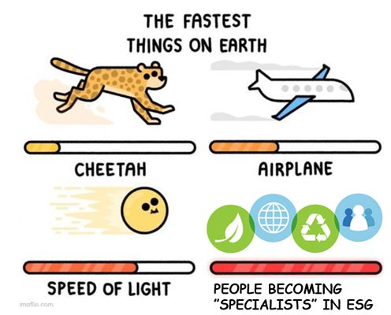
….at speed!
Notes:
I referred to this a year ago as an ‘arms race’ – since when it has increased in speed and intensity. The cartoon went viral on linked in amongst the institutional investment community.
Trends that were already in play have been given added impetus by new regulation
Consequently all these requests land on the corporate boards in turn

Slide 10
Esg: EXPANDING DATA REQUIREMENTS
This aspect of asset manager analysis is here to stay
Enormous growth in funds investing in these strategies
A value-added role for active managers
Allows for breadth of stakeholder perspective
Regulators encouraging a longer-term perspective
“If some companies fail to adapt to the just transition to a low carbon economy, they will fail to exist.” Mark Carney, former Bank of England Governor
Notes:
Stands for Environmental, Social and Governance and similarly reflects the understanding that every company has some bearing on the environment it operates in, goods, energy supply, waste, etc. and every company has social intersection and a governance structure. Sometimes those effects have been outside of the timeframe of investors – but now asset managers are analysing every company to see its E, S and G profile. Mark Carney is one of those who has shown that these issues will have real economic impacts.
Clear from the survey, and from the huge growth in funds investing in these strategies that this is here to stay, regulators are encouraging this longer term perspectiv and offers a clear role for active managers
So where does Ethics fit in?
E Concern about climate change has become mainstream
S increasingly likely to be drivers of public opinion and corporate reputation
G UK Corporate Governance Code requires board promotion of a culture that is aligned with the company’s purpose, values and strategy
Link for the image which says its free
https://www.istockphoto.com/search/search-by-asset?affiliateredirect=true&assetid=1331964973&assettype=image&utm_campaign=srp_photos_top&utm_content=https%3A%2F%2Funsplash.com%2Fs%2Fphotos%2Fesg&utm_medium=affiliate&utm_source=unsplash&utm_term=esg%3A%3A%3A
Could put the graphic on funds growth but I can’t copy & paste the pdf

Slide 11

IS ethics Relevant?
Asset Managers, seek to analyse business vulnerability to ‘externalities’
However, do they think about the culture that drives company behaviour before investing?
Can ESG investing be done properly without considering the values that shape company decision-making?
Notes:
When asset managers are analysing companies, do they think about the culture that is driving behaviour?
Given our definition of ESG up front, especially thinking about authenticity & Integrity – is it possible to do ESG properly without thinking about values?
Interviewed 28 leading firms in the UK investment industry these questions on an unattributed basis, to encourage candour.
??
We found that…
E Concern about climate change has become mainstream
S increasingly likely to be drivers of public opinion and corporate reputation
G UK Corporate Governance Code requires board promotion of a culture that is aligned with the company’s purpose, values and strategy
Image is from CFA Institute blog so should be ok (can check)

Slide 12
We asked investors…
We asked 28 leading UK investors about the place of ethics when analysing companies’ ESG credentials:
Is ethics part of ESG? If so, where? If not, why not?
What measurements are useful?
How does it relate to corporate engagement?
How does asset management stack up?
Notes:
When asset managers are analysing companies, do they think about the culture that is driving behaviour?
Given our definition of ESG up front, especially thinking about authenticity & Integrity – is it possible to do ESG properly without thinking about values?
Interviewed 28 leading firms in the UK investment industry these questions on an unattributed basis, to encourage candour.
??
We found that…
E Concern about climate change has become mainstream
S increasingly likely to be drivers of public opinion and corporate reputation
G UK Corporate Governance Code requires board promotion of a culture that is aligned with the company’s purpose, values and strategy
Image is from CFA Institute blog so should be ok (can check)

Slide 13
Ethics: the silent ‘e’?
Despite resistance to the term, something like ethics does get factored into asset management
‘Who do I trust with the money?’ - company values and culture matter
In assessing ESG, asset managers want companies:
  not to treat ESG targets as a tick box exercise
  not to game the system
  not greenwashing
Some recommend the ESG agenda is owned by the board and embedded in the culture
As active stewards of client capital, investors have a role in governance, oversight and accountability
Most asset managers believe their own firms should aspire to high standards
Notes:
There is resistance to the term (due to a mistaken assumption it is about taking a moral position in deciding which shares to buy) but once clarified….it is clear that Ethics does form part of the assessment, but ‘silently’ – without being explicitly thought of as such:
Who do I trust with my client’s money ?
When it comes to ESG, managers want companies who don’t treat ESG as a box ticking exercise, not overpromising and underdelivering
Some suggest that the ESG agenda will be best served when authentically integrated at board level
As active stewards of client capital – mangers mostly recognize their role in governance, oversight and accountability – all of which have an ethical aspect
Most managers think their own firms need to walk the walk as well.

Slide 14
Analysing ethical culture
  Some managers do not believe it is possible or do not know how to do it
  Some asset managers analyse culture - levels of resource, commitment and sophistication differ
    Both qualitative and quantitative aspects are relevant
    Trends and lifecycle understanding are more helpful than absolute numbers
  There is no formal training for analysts’ assessments, or analytic model for valuations
    Inefficiencies offer investment opportunities
Notes:
But how to do it?
Many managers are not clear on how to go about this, if it is even possible
Some do - although the resource, commitment and degree of development differ. Generally the longer term the investment horizon, the more this features within their analysis
Keen to observe it is qual as well as quant and that numbers shouldn’t be looked at in isolation but as trends and within a lifecycle
No formal training for analysts and no consensus on how to model it – those who are doing it well have mostly developed their own thinking, but this does not form part of training. Misnomer that it doesn’t exist
But it does! I’m not going to go through some of the detail now, we can come to that in the discussion if of interest – and there’s more in the report next week.
So in summary:

Slide 15
Examples of metrics
  Staff turnover: departures from certain areas of the business, or changing trends
  Tech verification: using social media, satellite imagery
  Tracking management promises - the say/do gap
  Diversity – beyond the top team
  Whistleblowing approach & response
  Incentive structures – by design and in comparison
  Response to things going wrong
  What have they shown commitment to – does it map to stated purpose or short-term share price gains?
Notes:
But how to do it?
Many managers are not clear on how to go about this, if it is even possible
Some do - although the resource, commitment and degree of development differ. Generally the longer term the investment horizon, the more this features within their analysis
Keen to observe it is qual as well as quant and that numbers shouldn’t be looked at in isolation but as trends and within a lifecycle
No formal training for analysts and no consensus on how to model it – those who are doing it well have mostly developed their own thinking, but this does not form part of training. Misnomer that it doesn’t exist
But it does! I’m not going to go through some of the detail now, we can come to that in the discussion if of interest – and there’s more in the report next week.
So in summary:

Slide 16
Key findings
ESG is profoundly changing the way that companies are assessed and analysed
Some client and regulatory expectations are proving counterproductive
Major challenges exist on data, analytic framework, targets, engagement, communication, and their own firms’ priorities and culture
Aspects of investee companies’ culture and behaviour may help address these issues
Asset managers have appetite for greater insights into internal corporate behaviour – but don’t call it “Ethics”!
Notes:
ESG is profoundly changing the way companies are assessed and it is here to stay
Although regulators, clients and the public are MOSTLY supportive – some of the expectations are proving counterproductive
There is a LOT of work going on at asset managers to address this issue – but the challenges on data, conflicting targets, misaligned expectations etc are significant.
Addressing investee company ethical culture could help address some of that & there is general appetite for such insights – but don’t call it ethics!
Where next?

Slide 17
Recommendations for Investors
  Ethical culture analysis can help ‘quality control’ ESG measurements
  Developing methodologies to assess ethical culture offers a source of performance
  Board-led organizational authenticity needs to match to avoid ‘greenwashing’
What’s in it for Investors?
  Lower risk, greater sustainability
  Untapped source of alpha
  Better long-term results
Notes:
Recommendations for AM:
- Culture as quality control can help with some of the data overload
Developing methodologies offers value
Companies need to raise their own game to avoid greenwashing
Recommendations for companies:
- Authenticity
Demonstrate values and links to decisions & behaviours
Could be a role here for ethics functions
And these aren’t just adding to an already pressed workload, they offer benefits too.

Slide 18
Recommendations for COMPANIES
  ESG measures need to be part of an authentic narrative – not box ticking
  Explain how cultural values are embedded in decisions and behaviours
  Ethics function could oversee integrity of ESG metrics and provide cultural indicators
What’s in it for companies?
  Lower risk, greater sustainability
  Untapped source of alpha
  Better long-term results
Notes:
Recommendations for AM:
- Culture as quality control can help with some of the data overload
Developing methodologies offers value
Companies need to raise their own game to avoid greenwashing
Recommendations for companies:
- Authenticity
Demonstrate values and links to decisions & behaviours
Could be a role here for ethics functions
And these aren’t just adding to an already pressed workload, they offer benefits too.

Slide 19
What’s happened in 2022?
Emergence of culture-based investment strategies
Market falls have brought intense cost pressures to investment management
The inevitable backlash against ESG as ‘woke capital’ in the USA
But… the need for corporates to report reliable metrics on ES and G is here to stay
Further comment or discussion is welcome
  annabelgillard@gmail.com
  info@ibe.org.uk
Notes:
ESG is profoundly changing the way companies are assessed and it is here to stay
Although regulators, clients and the public are MOSTLY supportive – some of the expectations are proving counterproductive
There is a LOT of work going on at asset managers to address this issue – but the challenges on data, conflicting targets, misaligned expectations etc are significant.
Addressing investee company ethical culture could help address some of that & there is general appetite for such insights – but don’t call it ethics!
Where next?

Slide 20
A wave of regulatory and advisory ESG guidance
COP 26
Accounting changes (SASB)
BOARDS
Stakeholders
Society
Task force for climate
(TCFD)
suppliers
sourcing
employees
customers
PR pressure
Reputation
Conscious consumer
Social license
BoE
DWP consultation
INVESTORS
Investor requests
UN PRI
UN SDG
EU regulation (SFDR)
Task force?
Client due diligence
FRC: Stewardship Code
Portfolio design
Various coalitions
Net Zero
These headlines represent thousands of data points
Notes:
A graphic to try and illustrate different pressures and influences on various intersecting stakeholders to give a sense of the multi-faceted nature of development and influences at play.

Slide 21
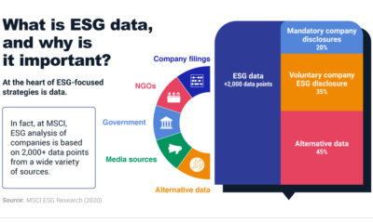
ESG data collection and measurement
Task force?
Investor requests
Accounting changes (SASB)
2nd order effects on clients, employees, suppliers, society….

Slide 22
P
Questions & Answers
CPD CODE: 2022-2146

Slide 23

Thank You For Ethics: The missing E in ESG Investing
A recoding of this webinar and the CPD code will be available on our website later today.
CPD CODE – 2022 - 2146
compliance.ie

Slide 24

Biography – Annabel Gillard
With a background in asset management, Annabel is investigating the place of ethical values and organisational culture in an AI-driven future workplace, and its impact on the changing nature of work and society. After recently completing an MA in Philosophy and AI at NCH she is currently at LSE studying Behavioural Science, alongside working with CFU, a not-for-profit dedicated to improving ethics in technology and equipping investors with the stewardship tools they need to ensure tech is a force for societal good.
Previously Annabel spent over 20 years building institutional business and working with clients to develop innovative strategies at M&G, UBP, SWIP, Barings, has volunteered for CFA Institute and held board positions at CFA UK and Prudential Staff Pension Scheme.
She is a member of the Institute of Business Ethics advisory council and an advocate for the power of ethics in delivering sustainable growth and enabling talent to flourish.

