Slide 1

P
Digital Markets Act - Implications for Compliance Professionals
A Panel Discussion
Rob Leslie, Sedicii
Nicola Flannery, Deloitte
Sean O’Sullivan BL,
Rob Corbet, Arthur Cox
24th November 2022 compliance.ie

Slide 2

Welcome & Introduction
Agenda
  Introductions
  The Digital Markets Act – the Law, the Stakeholders and the Timelines
  A new compliance era for big tech
  Key Changes for Gatekeepers – Practical implications
  Opportunities for Compliance Professionals under DMA
  How the DMA sits in a “3 lines of defence” environment
  Other implications for users of Gateway services
  Enforcement
Questions
  Please use the question box on the right of your screen to send the questions to our panel
Today’s session will be recorded and will be on our website later today
The CPD code will be sent out directly after this session has concluded

Slide 3
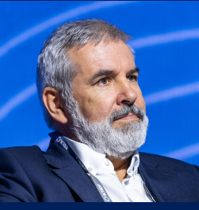

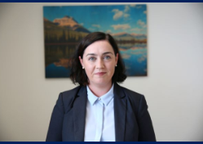
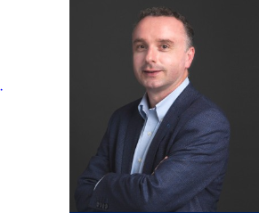
Today’s Panel
Sean O’Sullivan B.L. , The Bar of Ireland
Rob Leslie
Founder and CEO of Sedicii
Nicola Flannery Director, Data Privacy and Internet Reg, Deloitte Ireland
Rob Corbet, Partner, Head of Technology & Innovation, Arthur Cox

Slide 4
P
Questions & Answers
CPD CODE: 2022-2750

Slide 5

Thank You For Digital Markets Act - Implications for Compliance Professionals
A recoding of this webinar and the CPD code will be available on our website later today.
CPD CODE – 2022 - 2750
compliance.ie

