Slide 1
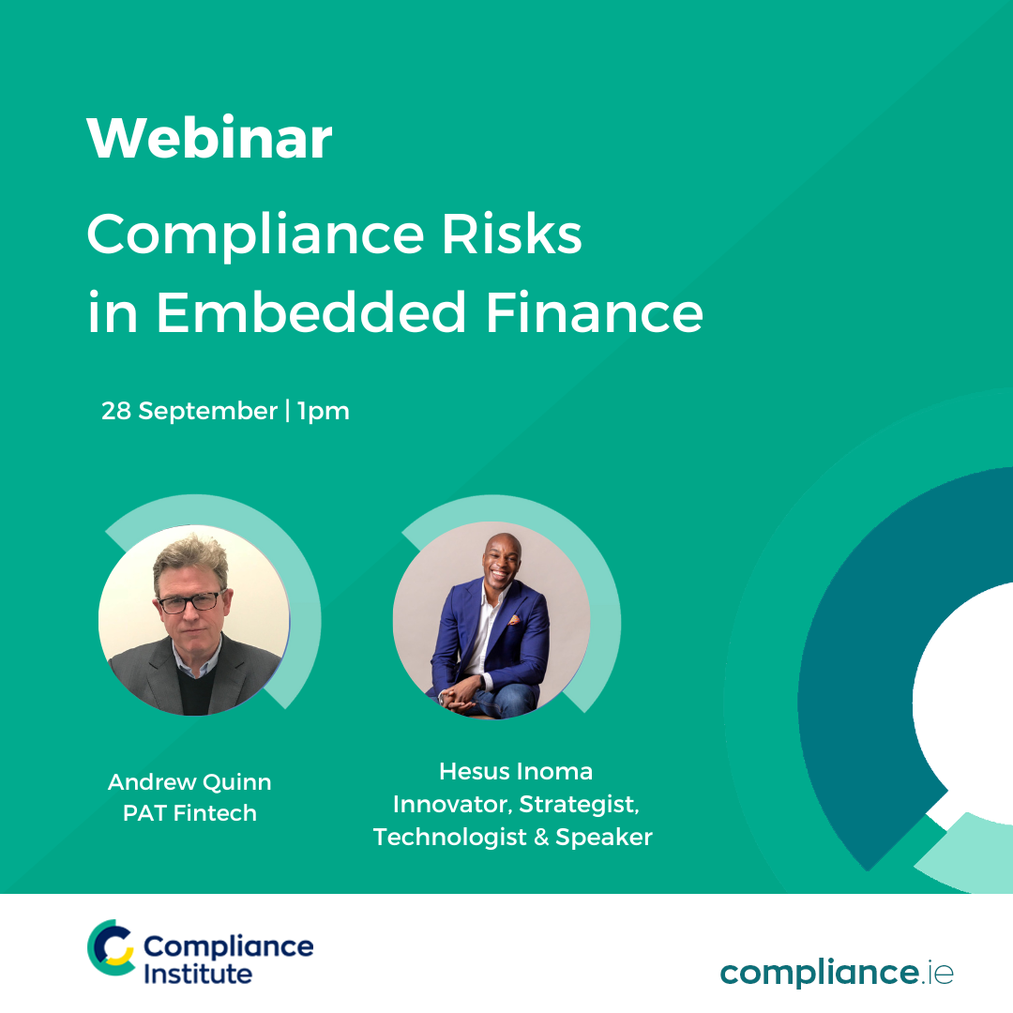
Compliance Risk in
Embedded Finance
September, 2022 compliance.ie

Slide 2

Thank you for registering
Questions
  Please use the question box on the right of your screen to send the questions for our speaker
Today’s session will be recorded and will be on our website later today
The CPD code is noted below and will be sent out directly after this session has concluded
CPD CODE: 2022 - 2094

Slide 3
AGENDA
1pm – 1.05pm: Introductions
1.05pm – 1.25pm: What is Embedded Finance?
1.25pm – 1.45pm: Compliance Risks in Embedded Finance
1.45pm – 2.00pm: Roundtable Q&A
CPD CODE: 2022 - 2094

Slide 4
Embedded Finance – A Definition
Put simply, embedded finance is the integration of financial services or tools – traditionally obtained via a bank – within the products or services of a non-financial organisation.
Think of an online store offering short-term loans in the form of BNPL, or the digital wallet on your phone enabling instant contactless payments. But this is just the beginning.

Slide 5

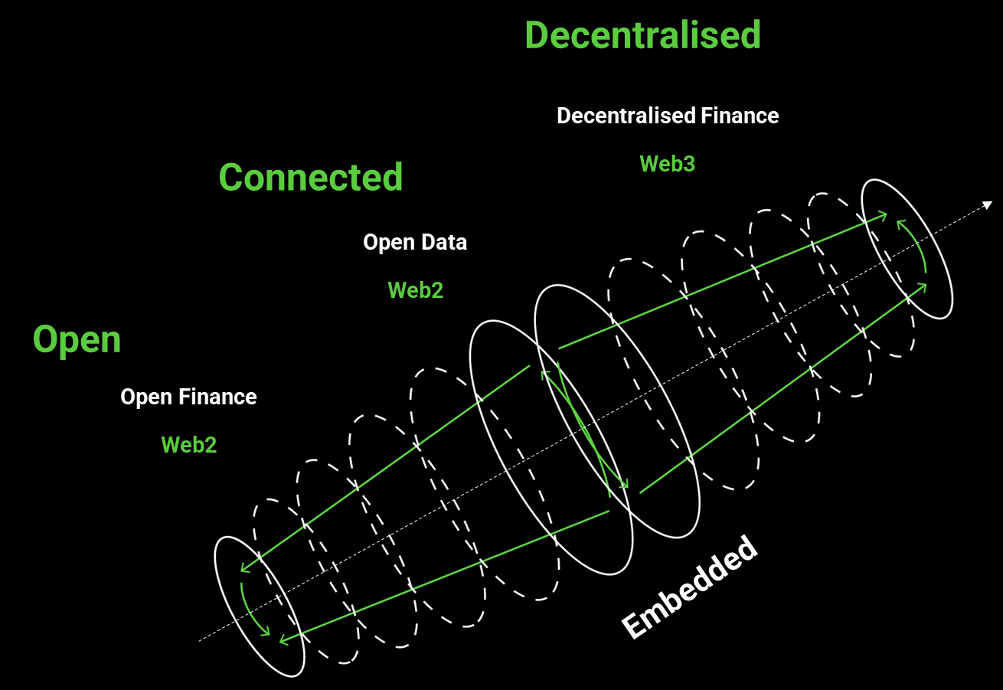
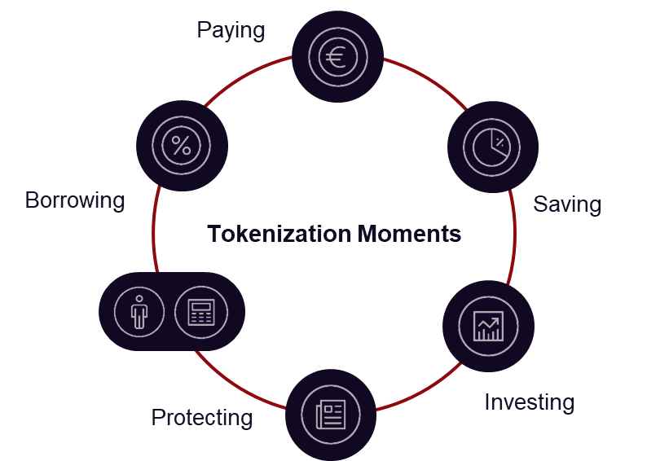



FEmbedded Finance - New Horizons
@hesusci
hesusci.com

Slide 6
Questions & Answers
CPD CODE: 2022 - 2094

Slide 7


Thank You For Attending Compliance Risk in
Embedded Finance
A recoding of this webinar and the CPD code will be available on our website later today.
CPD CODE – 2022 - 2094
compliance.ie

