Slide 1

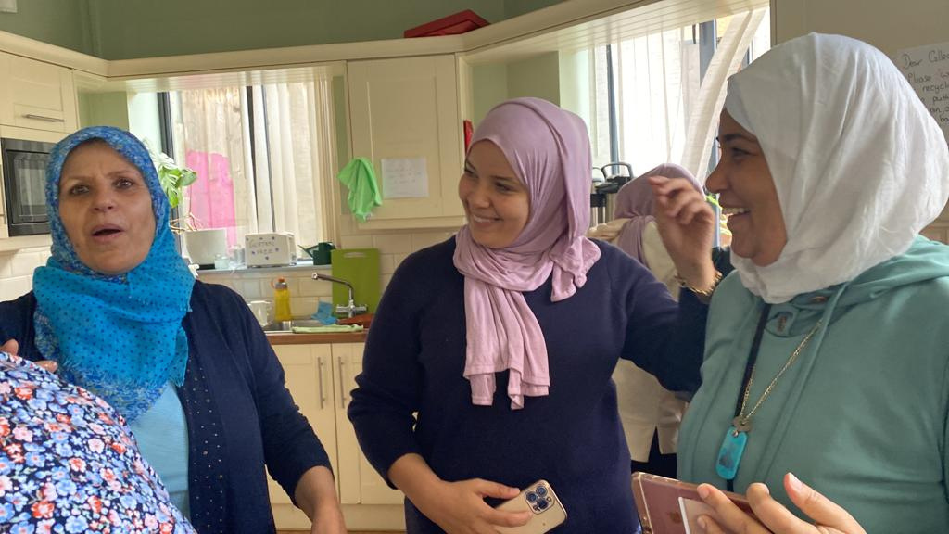
Supporting Refugees in Ireland
Katie Mannion
Irish Refugee Council

Slide 2
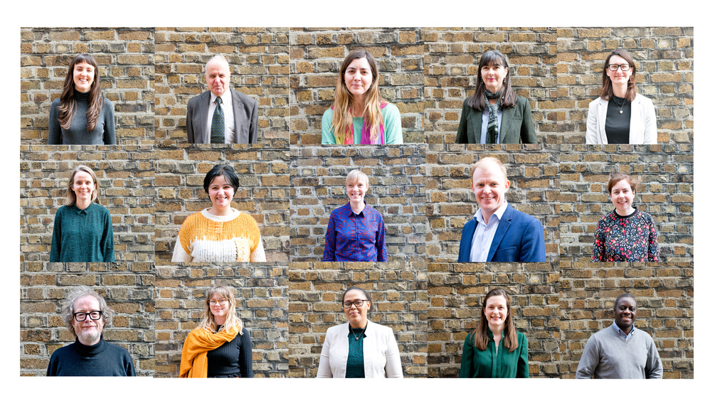

Who we are
OUR MISSION
OUR VALUES
OUR IMPACT
We provide services and support for people seeking protection and people recognised as refugees in Ireland and advocate for humane and dignified protection procedures and responses to people fleeing persecution.
We work with people who have to flee their home country, as it is no longer safe for them to be there.
Independence
Human Rights
Inclusion
Expertise
Partnership
Since our creation, we have provided support to more than 10,000 people.

Slide 3
DROP IN CENTRE
EDUCATION
1
4
Reception services for all people seeking information about their cases
Scholarships and advices to help students get back into their education
Areas of work
LAW CENTRE
YOUTH WORK
2
5
Legal representation for people seeking refugee status
Mental health services and support to young isolated people
HOUSING
6
EMPLOYMENT
3
Helping people to find their safe home
Coaching and training people to find jobs in Ireland
Sky Ireland

Slide 4

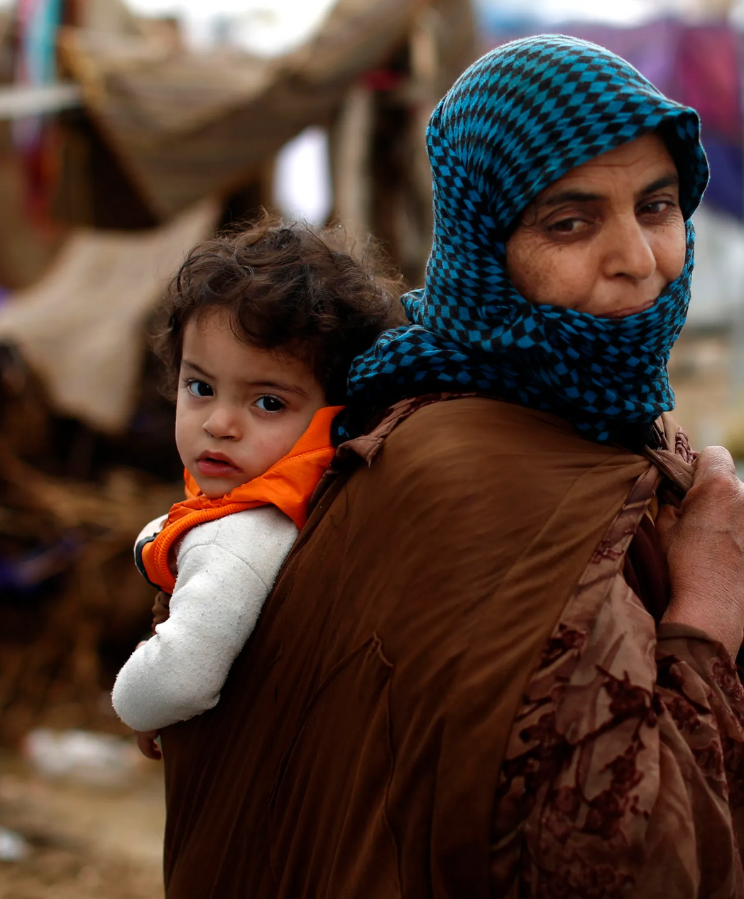
What is a refugee ?
The 1951 Refugee Convention is a key legal document and defines a refugee as:
“someone who is unable or unwilling to return to their country of origin owing to a well-founded fear of being persecuted for reasons of race, religion, nationality, membership of a particular social group, or political opinion.”
Refugees have to flee their home country, as it is no longer safe for them to be there. The most visible example of this is people fleeing war or conflict. However, persecution is not always born of war or conflict.
People also become refugees after persecution that is less visible. People who have experienced torture, death threats, and violence because of aspects of their identity or their actions – persecution based on their sexual identity, their religious beliefs, their political stance, for protesting, for being female or for being an ethnic minority.

Slide 5
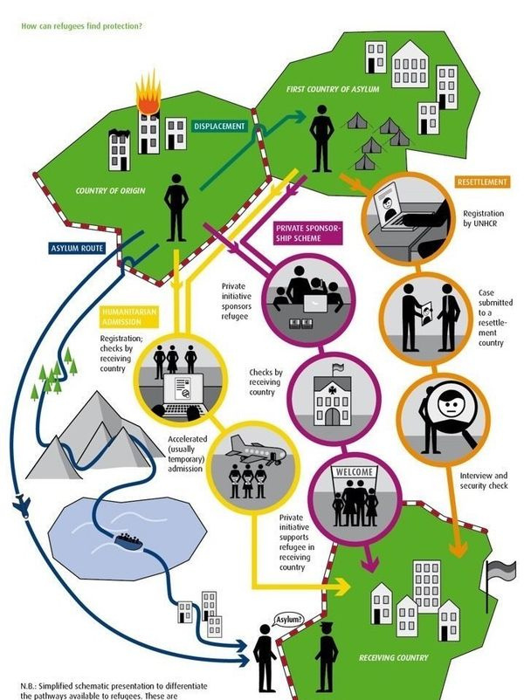


International Displacement
By the end of 2021, there were 103 millions of people forcibly displaced worldwide.
The UN refugee agency estimates that one person is forcibly displaced from home due to conflict or persecution every two seconds. Refugees face challenges relating to poverty, education, language, sexual violence, exploitation and human trafficking, health and more. Those challenges can persist beyond political asylum and resettlement.
Refugees in Number (source UNHCR, 2022):
Ukraine: 10 million
Syrian Arab Republic : 6.8 million
Venezuela : 4.1 million
Afghanistan : 2.6 million
South Sudan : 2.2 million

Slide 6
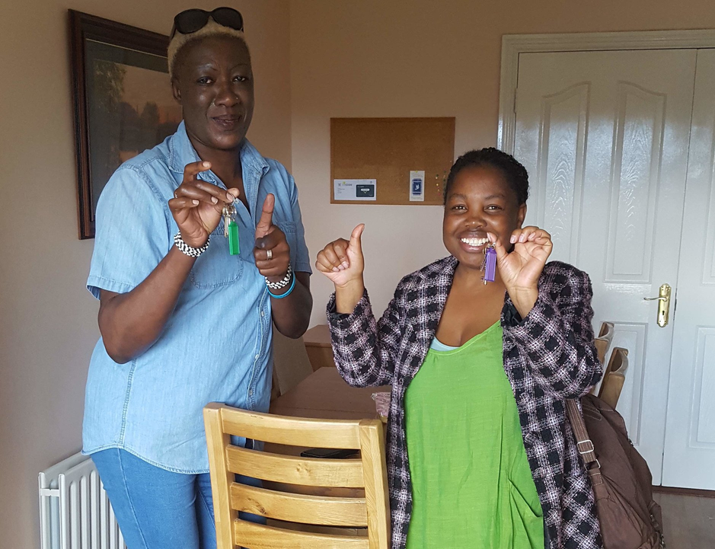
Refugees in Ireland
  In Ireland, people who are seeking International Protection (claiming ''asylum'') need to make an application through the IPO (International Protection Office). The application is long and thorough and can be very difficult for people who are already coming from major trauma.
  In 2020, 1,566 people applied for International Protection in Ireland.
  In 2021, approx. 2000 individuals applied.
  In 2022, nearly 10,000 individuals.
  When trying to get their status (or even after getting their status), people are housed in Direct Provision Centres.
  Direct Provision Centres are privately managed centres where people are often accommodated in very degrading conditions (often several people in the same room...).

Slide 7
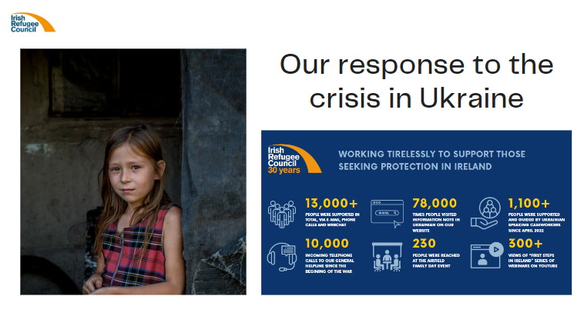

Slide 8
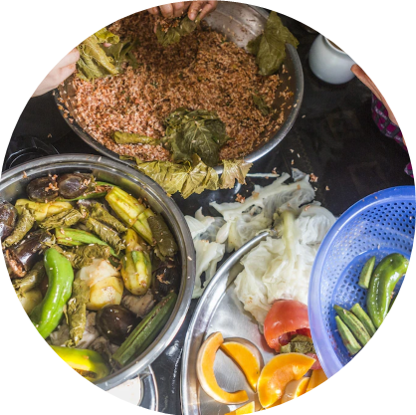
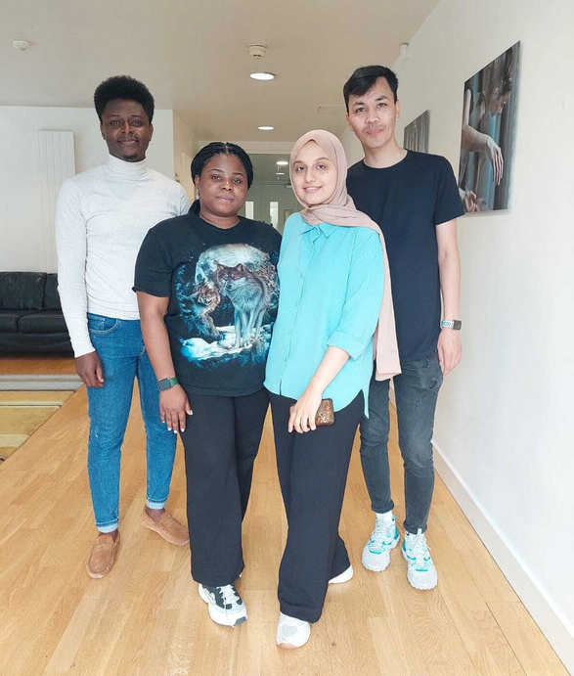
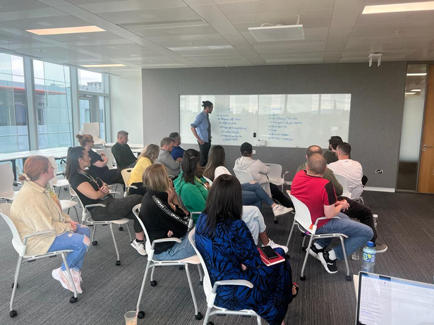
What you can do:
  Employ international protection applicants and refugees
  Training and skill sharing
  Supporting businesses owned by refugees
  Fundraise for refugees
  Offer accommodation through County Council for Ukrainian refugees
  Host Ukrainians in your home

Slide 9

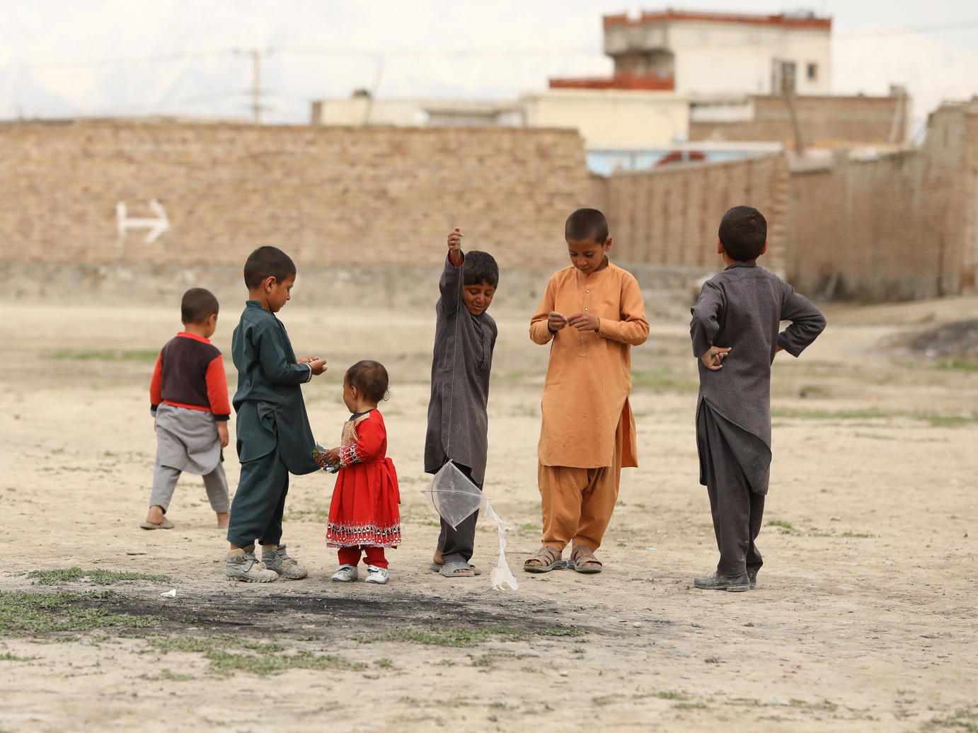
Thank you for your support

