Slide 1

P
Sustainable Finance/ESG
The Integration of ESG into Investments Decisions – Where Are We Now?
24th August, 2022 compliance.ie

Slide 2

Welcome & Introduction
Thank you for registering
Questions
  Please use the question box on the right of your screen to send the questions for our speaker
Today’s session will be recorded and will be on our website later today
The CPD code is noted below and will be sent out directly after this session has concluded
CPD CODE: 2022 - 2060

Slide 3



Overview
Policies – Sustainability Risk Policy and Remuneration Policy
Article 6 Disclosures
Article 8 Products
Article 9 Products
Taxonomy Regulation
Principal Adverse Impact Statement
MiFID Level 2 Amendments
What’s Next?

Slide 4
Overview

Slide 5
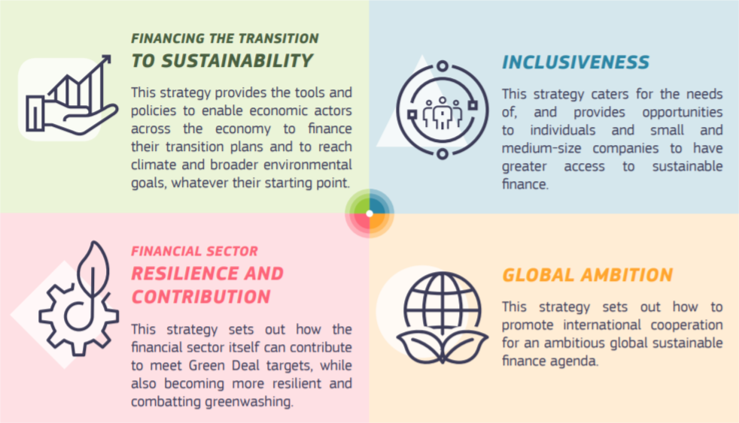
The EU Action Plan on Financing Sustainable Growth 2018
The EU Sustainable Finance Strategy 2021
Objectives:
  Reorient capital flows towards sustainable investment to achieve sustainable and inclusive growth
  Manage financial risk stemming from climate change, natural disasters, environmental degradation and social issues
  Foster transparency and long-termism in financial and economic activity
  Key Actions:
  Establish a common language for sustainable finance
  Create standards and labels for green financial products
  Clarify institutional investors’ and asset managers’ duties to ensure they consider ESG issues in their investment decision process
  Incorporate sustainability in prudential requirements
  Strengthen sustainability disclosure and improve accounting rule-making
Objectives:
  Support the European Green Deal aims
  Support inclusive and sustainable recovery from the COVID-19 pandemic
Source: European Commission Factsheet: EU Sustainable Finance Strategy 6 July 2021

Slide 6




Legislative Initiatives Arising from Action Plan
EU Taxonomy
A common classification of economic activities substantially contributing to environmental objectives, using science-based criteria
Taxonomy Regulation
Disclosures
Tools
Comprehensive disclosure regime for both non-financial and financial institutions to provide investors with the information necessary to make sustainable investment choices
Broad toolbox for companies, market participants and financial intermediaries to develop sustainable investment solutions, while preventing greenwashing
Sustainable Finance Disclosures Regulation applies since 10 March 2021
Corporate Sustainability Reporting Directive applies from January 2023
Sustainability Preferences (MiFID L2 amendments) apply since August 2022
Product Governance, Approval and Oversight (MiFID L2 amendments) apply from November 2022
Sustainability Risk Integration (UCITS & AIFMD amendments) apply since August 2022
EU Climate Benchmarks Regulation applies since April 2020
Standard for European green bonds (EuGB)
Source: European Commission Factsheet: EU Sustainable Finance Strategy 6 July 2021

Slide 7
What are the Key Dates?
10 March 2021
SFDR
Application date of most provisions (pre-contractual and website requirements) of the SFDR
1 January 2023
Taxonomy Regulation
Application date in respect of activities that substantially contribute to environmental objectives other than climate change mitigation and adaptation
1 January 2022
Taxonomy Regulation
Application date in respect of activities that substantially contribute to climate mitigation and adaptation
November 2022
Level 2 Amendments to MiFID II
Amendments to Level 2 requirements to integrate sustainability factors in product governance, approval and oversight
30 June 2021
SFDR
PAIS: FMPs with more than 500 employees or which are parent undertakings of large groups with more than 500 employees must publish and maintain on their websites a statement of their due diligence processes with respect to the principal adverse impacts of investment decisions on sustainability factors
August 2022
Level 2 Amendments to UCITS Directive, AIFMD, MiFID, Solvency II, IDD
Amendments to Level 2 requirements to integrate sustainability factors, risks and preferences
30 December 2022
SFDR
Product level PAI disclosure: Where the manager considers principal adverse impacts of investment decisions on sustainability factors, pre-contractual disclosures to disclose whether, and if so how, each financial product considers impacts on sustainability factors
1 January 2023
SFDR
Delayed application date of 13 SFDR RTS bundled as single delegated act

Slide 8
What are FMPs be required to do?
Process:
Integrate ESG risks and
factors in organisational, operating and risk management processes
Disclosure:
Website:
Sustainability risk policies
Adverse sustainability impacts
Remuneration policies
Pre-contractual:
Sustainability risks and sustainable investments
ESG focused products
Reporting:
Extent to which ESG characteristics are met
Impact of investments using relevant sustainability indicators
Specific index related reporting requirements

Slide 9
Policies – Sustainability Risk Policy and Remuneration Policy

Slide 10
What is “Sustainability Risk”
“an environmental, social or governance event or condition that, if it occurs, could cause an actual or a potential material negative impact on the value of the investment”
What are the requirements?
Article 3
Sustainability Risk Policy – Website Disclosure
Article 5
Sustainability Risk in Remuneration Policy
Article 6
Sustainability Risk in Pre-contractual Disclosures

Slide 11

Article 3 – Disclosure of Policy on Website
“Transparency of sustainability risk policies
Financial market participants shall publish on their websites information about their policies on the integration of sustainability risks in their investment decision‐making process.”
  Similar provision for disclosure by Financial Advisers
  No supplementary provisions at Level 2
  No template disclosures or policies from Commission or ESMA
  Clients will drive the content of policies

Slide 12
Article 5 – Remuneration Policy
“Transparency of remuneration policies in relation to the integration of sustainability risks
Financial market participants and financial advisers shall include in their remuneration policies information on how those policies are consistent with the integration of sustainability risks, and shall publish that information on their websites.”

Slide 13
Article 6 – Pre-contractual Disclosures for All Financial Products

Slide 14
Article 6 Scope
  What?
  Article 6 provides FMPs must include a description of the following in pre-contractual disclosures:
  The manner in which sustainability risks are integrated into their investment decisions; and
  The results of the assessment of the likely impacts sustainability risks on the returns of the financial products they make available.
  Where FMPs do not deem sustainability risks to be relevant, they must provide a clear and concise explanation.
  Practical Implications
All FMPs should conduct a sustainability risk assessment to determine whether sustainable risks are deemed to be relevant to a product
Where it is determined that they are relevant, the extent to which sustainability risks may impact a product can be disclosed in either qualitative or quantitative form
Does the FMP have any ESG / sustainability focus at group level which may not currently be reflected in their product documents?
Does the FMP consider ESG / sustainability elements when choosing underlying investment products?
  Who?
  FMPs and Financial Products
    Insurance undertakings and IORPs
    Insurance intermediaries
    IBIPs

Slide 15
Article 8 Products

Slide 16
What is an Article 8 Product?
Promotes social and/or environmental characteristics
  What does “promote” mean?
Not defined in SFDR
Recitals indicate it is distinguished from Article 9, which refers to “objectives”
Initial draft RTS refers to “marketing communications or in mandatory investor disclosures” referring to “sustainability factors that are taken in consideration when allocating the capital invested of the product”.
Commission SFDR Q&A July 2021:
The term ‘promotion’ within the meaning of Article 8 of Regulation (EU) 2019/2088 encompasses, by way of example, direct or indirect claims, information, reporting, disclosures as well as an impression that investments pursued by the given financial product also consider environmental or social characteristics in terms of investment policies, goals, targets or objectives or a general ambition in, but not limited to, pre-contractual and periodic documents or marketing communications, advertisements, product categorisation, description of investment strategies or asset allocation, information on the adherence to sustainability-related financial product standards and labels, use of product names or designations, memoranda or issuing documents, factsheets, specifications about conditions for automatic enrolment or compliance with sectoral exclusions or statutory requirements regardless of the form used, such as on paper, durable media, by means of websites, or electronic data rooms.
No definition of social or environmental
Can also promote other characteristics
Portfolio companies must follow good governance

Slide 17
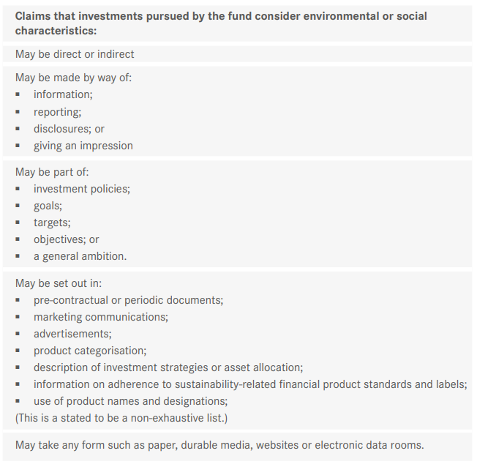
What does “promote” mean in the context of an Article 8 Product?
European Commission Q&A July 2021

Slide 18
Disclosure Obligations for
Article 8 Products
  Pre-contractual: SFDR Level 1 Obligations
  Information on how social/environmental characteristics are met
  Information on whether and how the benchmark (if any) is consistent with those characteristics
  Pre-contractual: Draft RTS
  Template published 6 April 2022– Annex II to Draft SFDR RTS
  What environmental and / or social characteristics are promoted by the financial product?
  Does the financial product consider principal adverse impacts on sustainability factors?
  What investment strategy does the financial product follow?
  What is the asset allocation planned for the financial product?
    To what minimum extent are sustainable investments with an environmental objective aligned with the EU Taxonomy?
    What is the minimum share of sustainable investments with an environmental objective that are not aligned with the EU Taxonomy?
    What is the minimum share of socially sustainable investments?
    What investments are included under “#2 Other”, what is their purpose and are there any minimum environmental or social safeguards?
  Reference benchmark (if relevant)
  Can I find more product specific information online?
  Pre-contractual: Taxonomy Regulation Level 1 Obligations
  Information on the environmental objective(s) to which the investment contributes
  A description of how and to what extent the investments underlying the financial product are in economic activities that quality as environmentally sustainable

Slide 19
Disclosure Obligations for
Article 8 Products
  Website
Description of the environmental or social characteristics
Information on the methodologies used to assess, measure and monitor the characteristics, including its data sources, screening criteria and the relevant sustainability indicators used
Draft RTS lists 12 sections, including a summary limited to two A4 pages (when printed)
Summary of pre-contractual disclosures and annual report disclosures
  Annual Report
Attainment of the environmental or social characteristics promoted by the financial product
No significant harm of sustainable investment objectives
Top investments of the financial product
Sustainable performance of the index designated as a benchmark
Proportion of sustainability-related investments
Actions taken to attain environmental or social characteristics

Slide 20
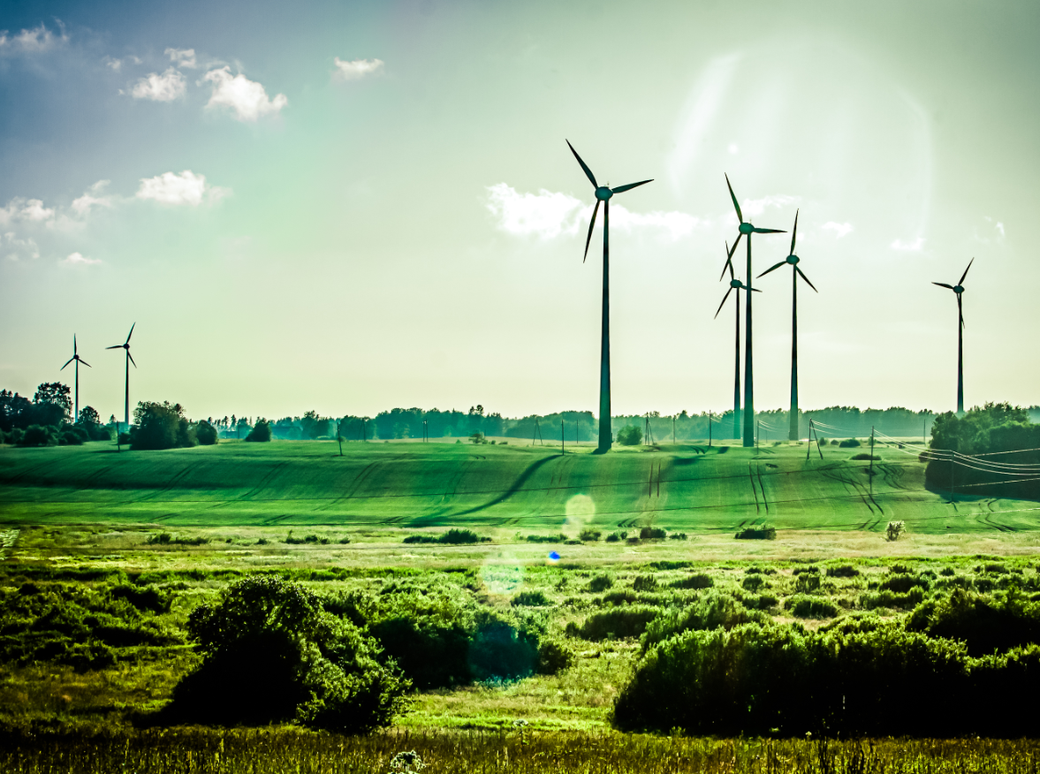
Article 9 Products

Slide 21
What is an “Article 9” Product
A product that has “sustainable investment” as its objective
“Sustainable investment” defined as
  investments in economic activity that contributes to an environmental objective
  investments in economic activity that contributes to a social objective and in particular an investment that contributes to tackling inequality, an investment fostering social cohesion, social integration or labour relations and investments in human capital or economically or socially disadvantaged communities
  provided that such investments do not significantly harm any of those objectives and that the investee companies follow good governance practices, in particular with respect to sound management structures, employee relations, remuneration of staff and tax compliance

Slide 22
Sustainable Investment Definition
Definition
Issues
“Sustainable Investment”
Meeting Article 9 threshold
MiFID sustainability preferences
investment in an economic activity that contributes to an environmental or social objective
Defining “contribution”
Activity v company
provided the investment does not significantly harm any of those objectives
Defining “significant”
Selecting optional PAIs to be assessed
investee companies follow good governance practices
No current issues

Slide 23
Disclosures for Article 9 Products
Pre-contractual
Product that does not have a reference benchmark:
  in addition to the Article 6 requirements, the pre-contractual disclosures must disclose how the sustainable investment objective will be attained
Product that has a reference benchmark:
  the pre-contractual disclosures must also disclose how the index is aligned with the objective of sustainable investment and how the index differs from a broad market (ie, non-ESG) index
  Pre-contractual: Draft RTS
  Template published 6 April 2022– Annex II to Draft SFDR RTS
  What is the sustainable objective of this financial product?
  Does the financial product consider principal adverse impacts on sustainability factors?
  What investment strategy does the financial product follow?
  What is the asset allocation and the minimum share of sustainable investments?
    To what minimum extent are sustainable investments with an environmental objective aligned with the EU Taxonomy?
    What is the minimum share of sustainable investments with an environmental objective that are not aligned with the EU Taxonomy?
    What is the minimum share of sustainable investments with a social objective?
    What investments are included under “#2 Other”, what is their purpose and are there any minimum environmental or social safeguards?
  Reference benchmark (if relevant)
  Can I find more product specific information online?
  Pre-contractual: Taxonomy Regulation Level1 Obligations
  Information on the environmental objective(s) to which the investment contributes
  A description of how and to what extent the investments underlying the financial product are in economic activities that quality as environmentally sustainable

Slide 24
Disclosures for Article 9 Products
Website
A description of the sustainable investment objective of the product
Information on the methodologies used to assess, measure and monitor the impact of the sustainable investments on the product
Similar disclosures to those required to be included within the pre-contractual disclosures
Similar disclosures to those required to be included within the annual report
Annual Report
A description of the sustainable investment objective of the product
Information on the methodologies used to assess, measure and monitor the impact of the sustainable investments on the product
Similar disclosures to those required to be included within the pre-contractual disclosures
Similar disclosures to those required to be included within the annual report

Slide 25
Taxonomy Regulation

Slide 26






Taxonomy Regulation
  Harmonised classification system for economic activities that qualify as environmental sustainable for investment purposes
  Level 1 requirement to disclose:
    information on the environmental objective(s) to which the investment contributes
    how and to what extent the investments underlying the financial product are in environmentally sustainable economic activities
  Level 1 applies from 1 January 2022 (first two environmental objectives) and 1 January 2023 (last four environmental objectives)
  RTS addressing disclosures under SFDR and Taxonomy Regulation due to apply from 1 January 2023
1. Climate change mitigation
4. Transition to circular economy
2. Climate change adaptation
5. Pollution prevention and control
3. Sustainable use and protection of water and marine resources
6. Protection and restoration of biodiversity and ecosystems

Slide 27
Taxonomy Regulation:
Disclosures / Disclaimers
Product which has sustainable investment as an objective (Article 9)
Detailed disclosure requirements
No disclaimer required
Detailed disclosure requirements
“The “do no significant harm” principle is applied only for the investments underlying the product that take into account the EU criteria for environmentally sustainable investments.
The investments underlying the remaining portion of this financial product do not take into account the EU criteria for environmentally sustainable investments.”
Product which promotes environmental characteristics (Article 8)
Product which does neither
“The investments underlying this financial product do not take into account the EU criteria for environmentally sustainable investments.”

Slide 28
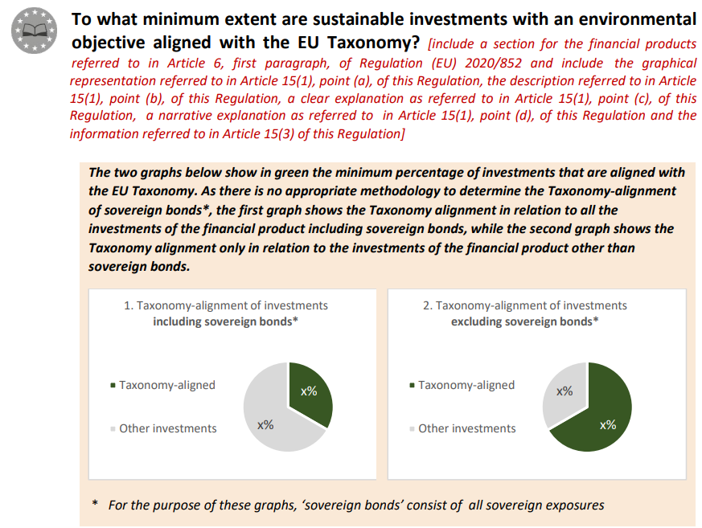
Taxonomy Regulation:
Alignment Disclosure
European Commission Adopted Delegated Act 6 April 2022
Annex II Template pre-contractual disclosure for Article 8 Light Green Products

Slide 29
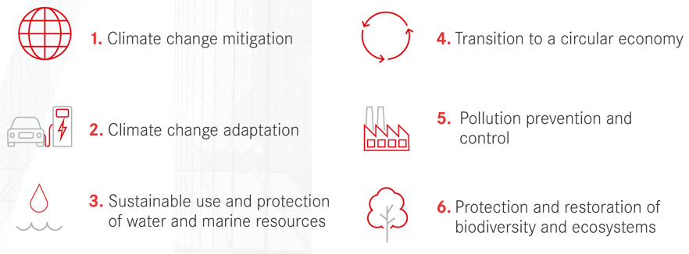
Taxonomy Regulation (Regulation (EU) 2020/852)
Taxonomy Regulation
Applies from 1 January 2022
Climate Delegated Act
Applies from 1 January 2022
Delegated regulation establishing technical screening criteria for determining the conditions under which an economic activity qualifies as contributing to climate change mitigation or climate change adaptation and does no significant harm to other environmental objectives
Complementary Delegated Act
Applies from 1 January 2023
Delegated regulation setting out technical screening criteria for climate change mitigation and climate change adaptation for additional economic activities in the energy sectors not include in the Climate Delegated Act – natural gas and nuclear energy sectors
Article 8 Delegated Act
Applies from 1 January 2022 on a phased basis
In scope non-financial undertakings will need to disclose:
Taxonomy-eligibility from 1 January 2022
Taxonomy-alignment from 1 January 2023
In scope financial undertakings will need to disclose:
Taxonomy-eligibility from 1 January 2022
Taxonomy-alignment from 1 January 2024
Regulatory Technical Standards
Applies from 1 January 2023
Regulatory technical standards under the SFDR providing for additional Taxonomy-related disclosures for Article 8 and Article 9 SFDR products

Slide 30

Principal Adverse Impact Statement

Slide 31
What is a Principal Adverse Impact
Statement?
Where FMPs consider principal adverse impacts (“PAI”) of investment decisions on sustainability factors – they must disclose a statement on their website on the due diligence policies with respect to those impacts, taking due account of their size, the nature and scale of their activities and the types of financial products they make available
Template provided in Annex I to Draft SFDR RTS
  policies on the identification and prioritisation of principal adverse sustainability impacts and indicators
  a description of the principal adverse sustainability impacts and of any actions taken or, where relevant, planned
  brief summaries of shareholder engagement policies
  a reference to their adherence to responsible business conduct codes and internationally recognised standards for due diligence and reporting and, where relevant, the degree of their alignment with the objectives of the Paris Agreement
PAIS
Level 1

Slide 32
Do all FMPs have to comply?
  The requirement applies on a comply or explain basis (unless the FMP has an average of 500 employees or is the parent undertaking of a large group which has an average of 500 employees, in which case they must comply).
  Where FMPs do not consider PAI, they need to disclose on their website clear reasons for why they do not do so, including, where relevant, information as to whether and when they intend to consider such adverse impacts.
  It is worth bearing in mind that the requirement is relevant to all FMPs offering services into the EU, not just those with licences to provide services in the EU (although there is no enforcement mechanism for non-EU entities).

Slide 33
Draft Template PAIS – Mandatory Indicators
Indicators applicable to investments in investee companies (14)
Greenhouse gas (GHG) emissions
Indicators applicable to investments in sovereigns and supranationals (2)
GHG intensity
Investee countries subject to social violations
Indicators applicable to investments in real estate assets (2)
Exposure to fossil fuels through real estate assets
Exposure to energy-inefficient real estate assets
Carbon footprint
GHG intensity of investee companies
Exposure to companies active in the fossil fuel sector
Share of non-renewable energy consumption and production
Energy consumption intensity per high impact climate sector
Activities negatively affecting bio-diversity-sensitive areas
Emissions to water
Hazardous waste ratio
Violations of UN Global Compact principles and OECD Guidelines for Multinational Enterprises
Lack of processes and compliance mechanisms to monitor compliance with UN Global Compact principles and OECD Guidelines for Multinational Enterprises
Unadjusted gender pay gap
Board gender diversity
Exposure to controversial weapons
Plus at least one additional indicator related to principal adverse impacts on climate or other environment related sustainability factor (Table 2 Annex I) plus at least one additional indicator related to principal adverse impact on a social, employee, human rights, anti-corruption or anti-bribery sustainability factor (Table 3 Annex I).

Slide 34
Principal Adverse Impact Statement
  Do all FMPs have to comply?
  The requirement applies on a comply or explain basis (unless the FMP has an average of 500 employees or is the parent undertaking of a large group which has an average of 500 employees, in which case they must comply)
  Where FMPs do not consider PAI, they need to disclose on their website clear reasons for why they do not do so, including, where relevant, information as to whether and when they intend to consider such adverse impacts
  The requirement is relevant to all FMPs offering services into the EU, not just those with licences to provide services in the EU (although there is no enforcement mechanism for non-EU entities)
  How does this impact individual financial products?
  Where an FMP prepares a PAIS, the pre-contractual disclosures must disclose:
    a clear and reasoned explanation of whether, and, if so, how a financial product considers principal adverse impacts on sustainability factors
    a statement that information on principal adverse impacts on sustainability factors is available in the relevant periodic report of the financial product
  Where an FMP does not consider PAI, the pre-contractual disclosures should disclose:
    that the FMP does not consider PAI and the reasons why

Slide 35
PAIS Timeline
10 March 2021 FMPs opting in published PAIS on website
10 March 2021 Where the FMP does not consider PAI, pre-contractual disclosure included
30 June 2021 Large FMPs published PAIS on website
30 December 2022 Product pre-contractual disclosures and periodic report disclosures required
1 January 2023 Level 2 requirements apply
30 June 2023 First detailed PAIS with reference period information due for publication

Slide 36
MiFID Level 2 Amendments

Slide 37
New MiFID Requirements
Commission Delegated Regulation 2021/1253 as regards the integration of sustainability factors, risks and preferences into certain organisational requirements and operating conditions for investment firms | Amended MiFID – in particular, Delegated Regulation 2017/5657 Applies since 2 August 2022
Commission Delegated Directive 2021/1269 as regards the integration of sustainability factors into the product governance obligations | Amended MiFID – in particular, Delegated Directive 2017/593 Will apply from 22 November 2022
1. Organisational Requirements | Apply to all MiFID firms – incorporate ESG consideration / sustainability risk into MiFID Firms.
2. Product Governance | All manufacturers and distributors to integrate sustainability factors and preferences into product governance arrangements.
3. Sustainability Preferences | Portfolio manager and advisors - sustainability preferences of retail and institutional clients.

Slide 38
Summary of Requirements for MiFID Firms
Organisational and Systems / Controls Requirements (2 August 2022) | Take sustainability risks into account when complying with MiFID II organisational requirements and when establishing, implementing and maintaining adequate risk management policies Consider clients’ sustainability preferences when identifying conflicts
Suitability (2 August 2022) | Obtain information about sustainability preferences
ESG Due Diligence (2 August 2022) | Put in place adequate policies and procedures to understand the nature and features of investment services and financial instruments selected for clients including any sustainability factors
Pre-contractual Disclosures (Advisors) (2 August 2022) | Include sustainability factors in description of factors taken into consideration in the selection process used to recommend financial instruments
Product Governance (22 November 2022) | Include sustainability preferences and sustainability factors into target market analysis

Slide 39
MiFID Organisational Requirements
Applies since 2 August 2022
Organisational requirements: Take sustainability risks when complying with MiFID general organisational requirements
Risk management: Take sustainability risks into account in risk management policies and procedures.
Conflicts: regard damage to a client’s sustainability preferences as a type of client detriment for the purposes of their conflicts policies and procedures.
Sustainability Risk: “an environmental, social or governance event or condition that, if it occurs, could cause an actual or a potential material negative impact on the value of the investment”

Slide 40
MiFID Sustainability Preferences
Advisers and portfolio managers, both retail and institutional must:
  capture information about a client’s sustainability preferences; and
  where a client has such preferences, to comply with them when conducting transactions or recommending products
Relevant to manufacturers of products sold or distributed via advisor/portfolio manager
Applies since 2 August 2022.
Ex: Sell structured products to portfolio manager, and its client only wants products in its portfolio that match its sustainability preferences, the portfolio manager:
  will require information to ensure it matches relevant products
  exit products that do not match those preferences;
  may say it needs relevant products to incorporate certain ESG creds going forward, to match the actual or expected sustainability preferences of its underlying clients

Slide 41
MiFID Sustainability Preferences (cont.)
“Sustainability preferences” refers to:
  a financial instrument that is invested in environmentally sustainable investments as defined in the Taxonomy Regulation, in a minimum proportion determined by the client / potential client
  a financial instrument that is invested in sustainable investments within the meaning of the SFDR, in a minimum proportion determined by the client / potential client
  a financial instrument that addresses principal adverse impacts on sustainability factors, with the qualitative and quantitative elements that demonstrate this being determined by the client / potential client
ESMA consultation on changes to its Guidelines on certain aspects of the MiFID suitability requirements launched 27 January 2022 (closed 27 April 2022)
Practical challenges to implementation of amendments to MiFID as a result of the deferred date and timing of the Article 8 Taxonomy Regulation delegated act and SFDR Level 2

Slide 42
MiFID Product Governance
Will apply from 22 November 2022
Manufacturers and Distributors must:
  consider sustainability factors in the product approval process of each financial instrument
  consider sustainability factors in the other product governance and oversight arrangements for each financial instrument intended to be distributed to clients seeking financial instruments with a sustainability related profile
  when identifying the potential target market for a product and specify the types of client for whose needs, characteristics and objectives the product is compatible, you must include “any sustainability related objectives”
Sustainability factors: “environmental, social and employee matters, respect for human rights, anti‐corruption and anti‐bribery matters”
ESMA Guidance – CP published 8 July on MiFID II product governance on results of CSA 2021 and certain ESG requirements
Final Report Q1 2023

Slide 43
Product Governance - Manufacturers
Consider sustainability factors in product approval, governance and oversight
Target Market: when identifying the potential target market for a product, must include “any sustainability related objectives”. Must be granular (no general statement that a product has a sustainability-related profile)
No negative target market analysis where product considers sustainability factors
Information to distributors on sustainability factors of product in clear manner
Periodic Review: when periodically reviewing products, must consider if they remain consistent with the needs, characteristics and objectives, “including any sustainability related objectives”, of the target market

Slide 44
Product Governance - Distributor
Consider sustainability factors in due diligence, product approval process, governance and oversight arrangements
Due diligence and mis-selling risk: only offer or recommend products that do what they “say on the tin” from an ESG perspective
Target Market: when identifying the potential target market for a product, must include “any sustainability related objectives”. Must be granular (no general statement that a product has a sustainability-related profile)
No negative target market analysis where product considers sustainability factors
Information to distributors on sustainability factors of product in clear manner
Periodic Review: when periodically reviewing products, must consider if they remain consistent with the needs, characteristics and objectives, “including any sustainability related objectives”, of the target market

Slide 45
What’s Next?

Slide 46
What’s Next?
August 2022
Level 2 Amendments to UCITS Directive, AIFMD, MiFID, Solvency II, IDD
Amendments to Level 2 requirements to integrate sustainability factors
30 December 2021
SFDR
ESAs to prepare draft technical standards on disclosures to investors in relation to adverse impacts in the field of social and employee matters, respect for human rights, anti-corruption and anti-bribery
30 December 2022
SFDR
Where the manager considers principal adverse impacts of investment decisions on sustainability factors, prospectus to disclose whether, and if so how, each financial product considers impacts on sustainability factors
1 January 2023
Taxonomy Regulation
Application date in respect of activities that substantially contribute to environmental objectives other than climate change mitigation and adaptation
1 January 2022
Taxonomy Regulation
Application date in respect of activities that substantially contribute to climate mitigation and adaptation
November 2022
Level 2 Amendments to MiFID II
Amendments to Level 2 requirements to integrate sustainability factors in product governance, approval and oversight
1 January 2023
SFDR
Delayed application date of 13 SFDR RTS bundled as single delegated act

Slide 47
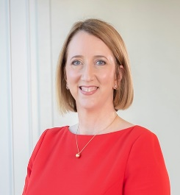

KEY CONTACTS
Tara Doyle
Louise Dobbyn
Partner | Head of Asset Management and Investment Funds
Partner | Financial Institutions
T
+353 1 232 2221
+353 86 854 9105
M
T
+353 1 232 2094
M
+353 83 178 3143
E
tara.doyle@matheson.com
E
louise.dobbyn@matheson.com
EXPERTISE
  Tara is a partner and head of the Asset Management and Investment Funds Department at Matheson. She practises Irish financial services law and advises many of the world's leading financial institutions, investment banks, asset management companies, broker-dealers and corporations carrying on business in Ireland or through Irish vehicles. Tara has extensive experience in advising a wide range of domestic and international clients on the structuring, establishment, marketing and sale of financing and investment vehicles and products in Ireland and other jurisdictions. In particular she specialises in advising on the legal and regulatory issues surrounding the establishment of private and public investment funds.
EXPERTISE
  Louise is a partner in the Financial Institutions Group, specialising in financial services regulation. Louise regularly advises banks, MiFID investment firms, asset managers, fund promoters, fintech firms, payment institutions, trading platforms, intermediaries and brokers on all aspects of Irish and EU financial regulation and compliance and related matters.
  Prior to joining Matheson, Louise was a UK general counsel for the Lombard Odier in London and also a financial services associate at Ashurst LLP in London. Louise also was a regulatory change secondee at an Investment Bank in London.

Slide 48
P
Questions & Answers
CPD CODE: 2022- 2060

Slide 49
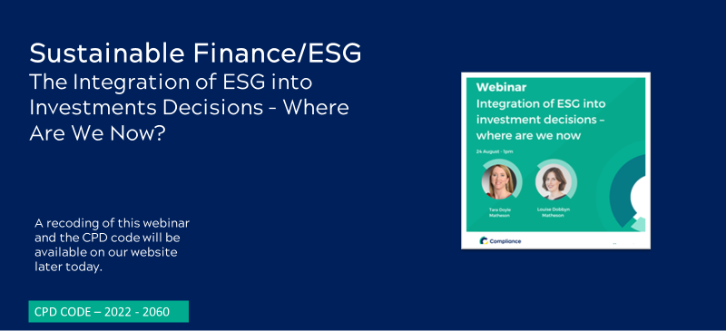
Thank You For Attending a Practitioners Guide to Compliance and Financial Crime Culture & Conduct
A recoding of this webinar and the CPD code will be available on our website later today.

