Slide 1
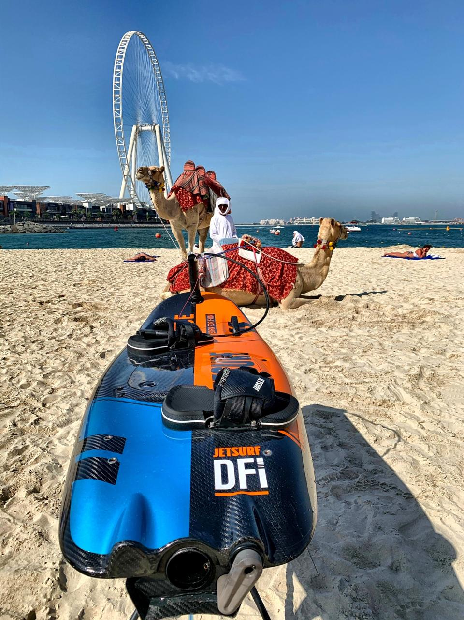


INTERNATIONAL
JETSURF TRAINING
CENTER ABU DHABI
30.1. – 27.3.2022

Slide 2
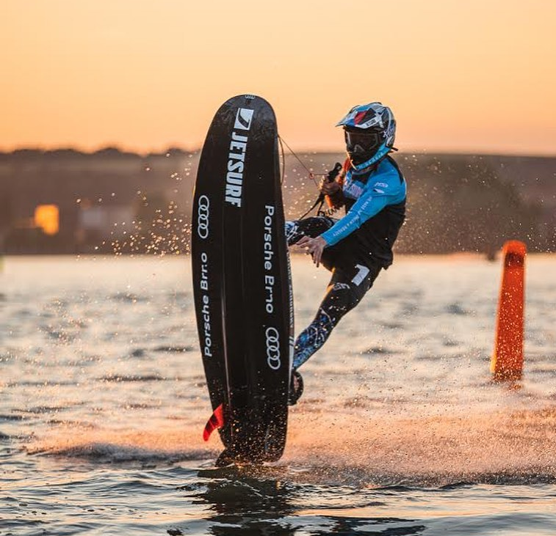
INTERNATIONAL
JETSURF TRAINING
CENTER ABU DHABI
30.1. – 27.3.2022
- for beginners & professionals
take your own board or rent ours
come anytime - for a week or more
bring your friends or come alone and meet new people
2 months of neverending jetsurfing
200 jetsurfers from all around the world
professional buoyes track & data recording
jetsurf academy for beginners & juniors
jetsurf rental
amazing beach Al Hudayriyat Island
training –fun – holiday - trips
MotoSurf WorldCup 25.-27.3.2022
BOOKING NECESSARY!
Jetsurf Academy / Martina +420 603 484 320
info@jetsurf-academy.cz www.jetsurf-academy.cz

Slide 3
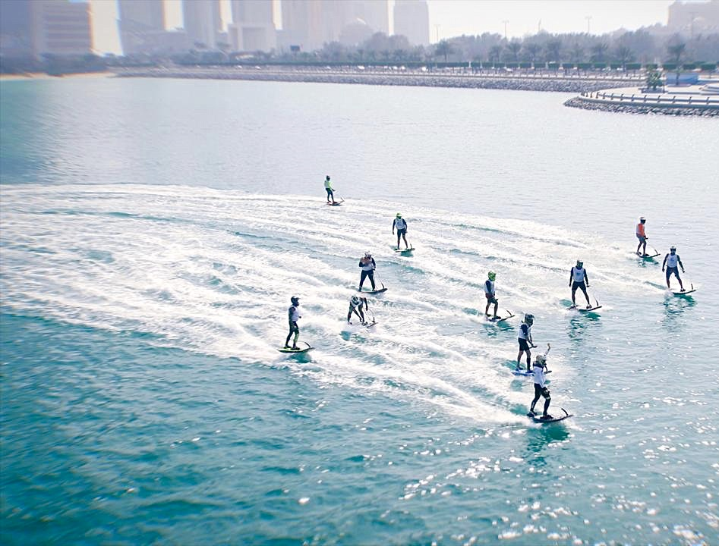
WHAT IS IT?
2 months / 8 weeks of neverending jetsurfing
activity for jetsurfers from all around the world
winter training base & jetsurf meeting point
jetsurf academy for beginners and juniors
professional buoyes track for professional riders and new race candidates
jetsurf rental for everybody

Slide 4
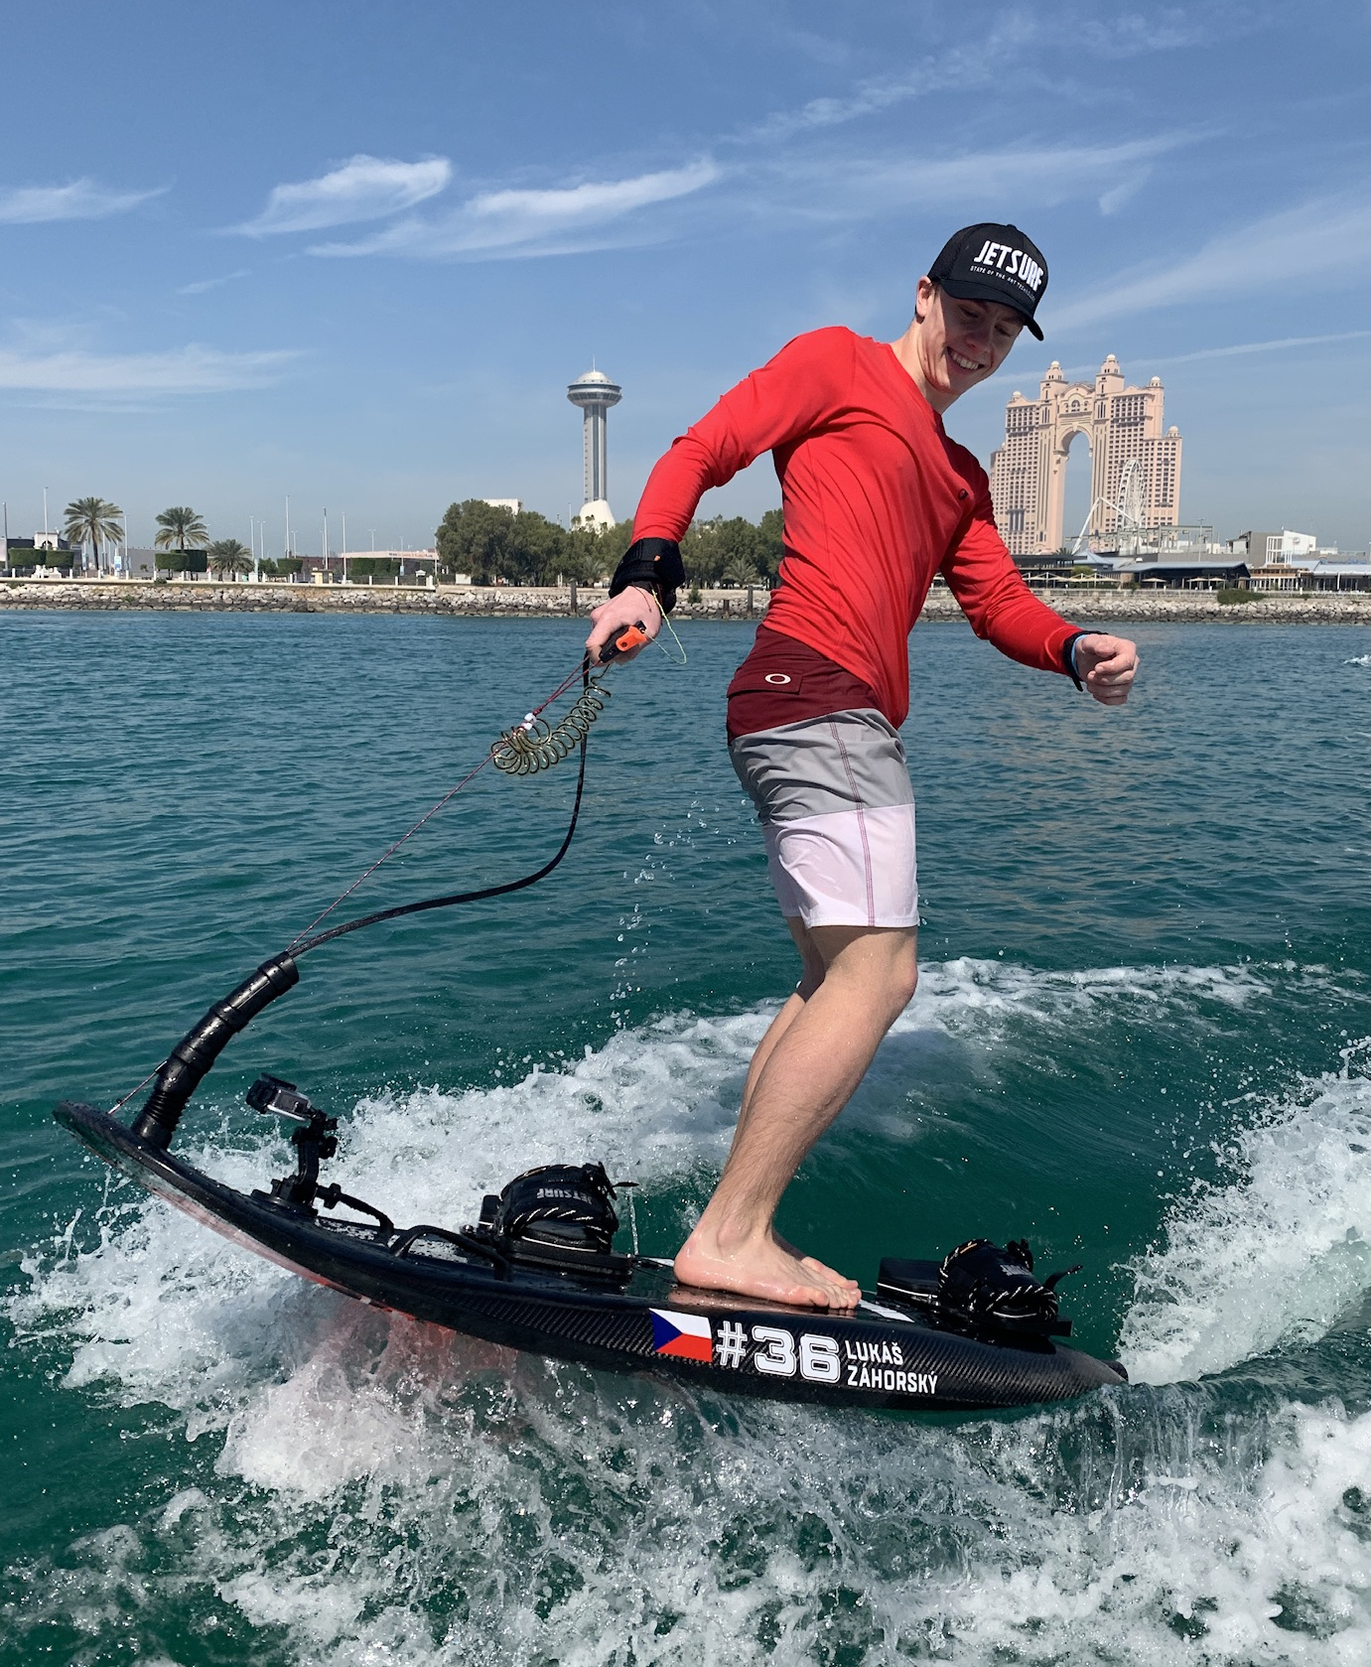
WHY INTERESTING?
bonus for all jetsurf clients
building of jetsurf community, new jetsurf friendships and experiences
more than 200 riders coming from all over the world
program for whole families: holiday fun, beaches, adventure trips, culture, shopping, dinners ..

Slide 5
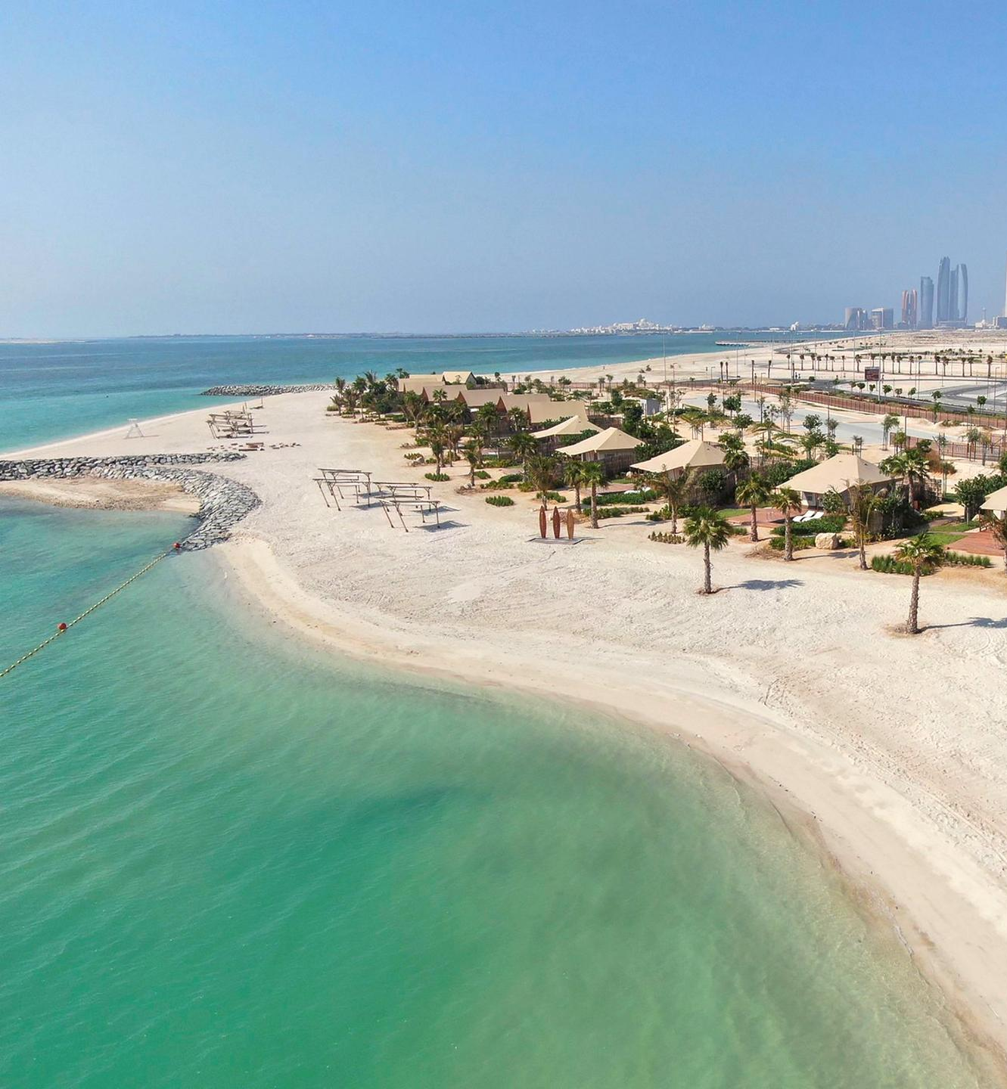
ABOUT THE SPOT
Abu Dhabi / Al Hudayriyat Island – new island with amazing long beaches, www.hudayriyatisland.ae
water sports, bike rental, basketball and tennis courts, skate park, pools
children playgrounds, restaurants, nightlife
sandy beach with tent, beach bags, toilettes
overnight storage and fuel included
easy entrance to the water, flat water
well-kept buoyes track with split
restaurants, bars, cafes nearby

Slide 6
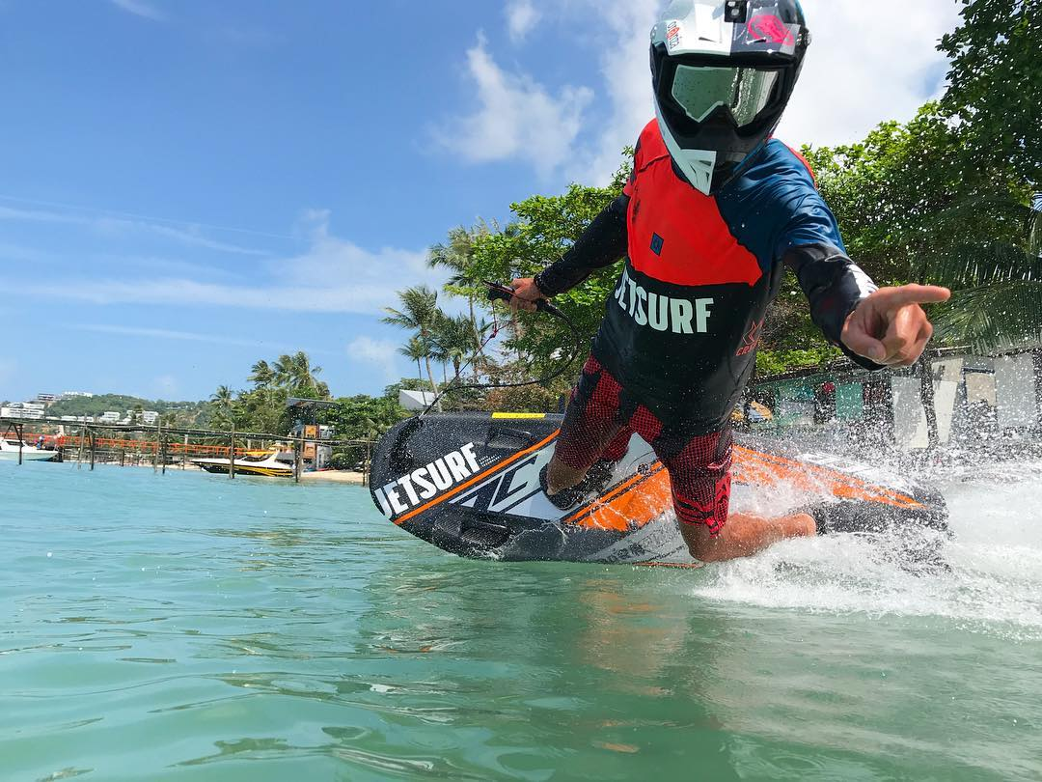
1. TRAINING
your own jetsurf or rental
professional buoyes track with split
data recording for speed measuring, ideal transit and acceleration
perfect training for MSWC
1st MSWC Abu Dhabí
storage and fuel included
some weeks possible to train with champs

Slide 7
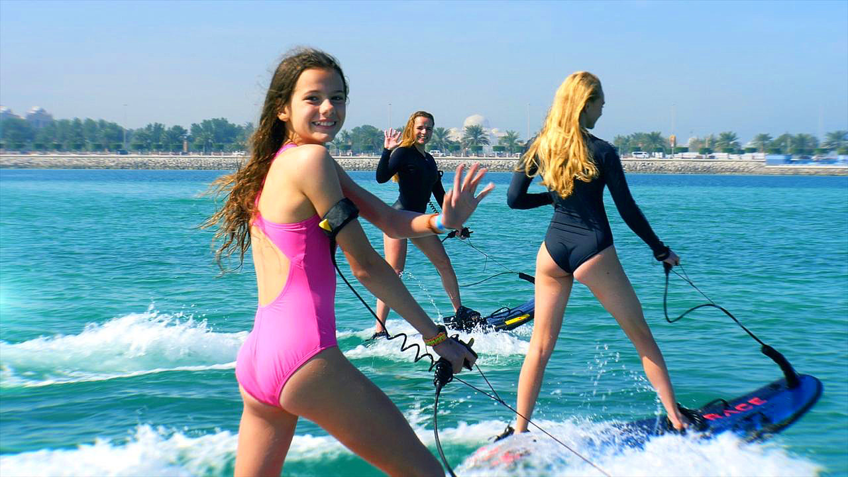
2. JETSURF ACADEMY
For beginners
1, 2, 3, 5 or 10 hours lessons
Experienced english speaking coaches
Equipment free – vests, helmets
After academy lessons possible to rent a jetsurf

Slide 8
3. SCHOOLS / UNIVERSITIES
For beginners / students from 8 to 25yo
Booking the Training Center only for schools
Sunday – Thursday / 2hours blocks
All safety equipment free of charge
Experienced English speaking coaches
We have long experiences and success with jetsurf riding of kids and juniors!

Slide 9
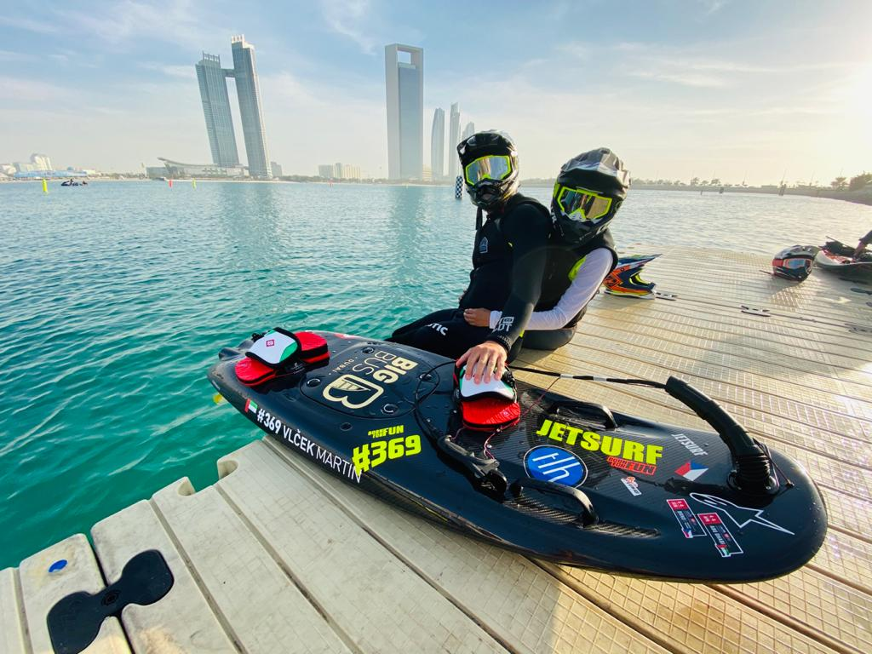
4. JETSURF RENT
Top boards: Jetsuf Race, Titanium, Adventure 2021
For a day / week / month
Fuel included on the
Possible to share a board / max 4 persons

Slide 10
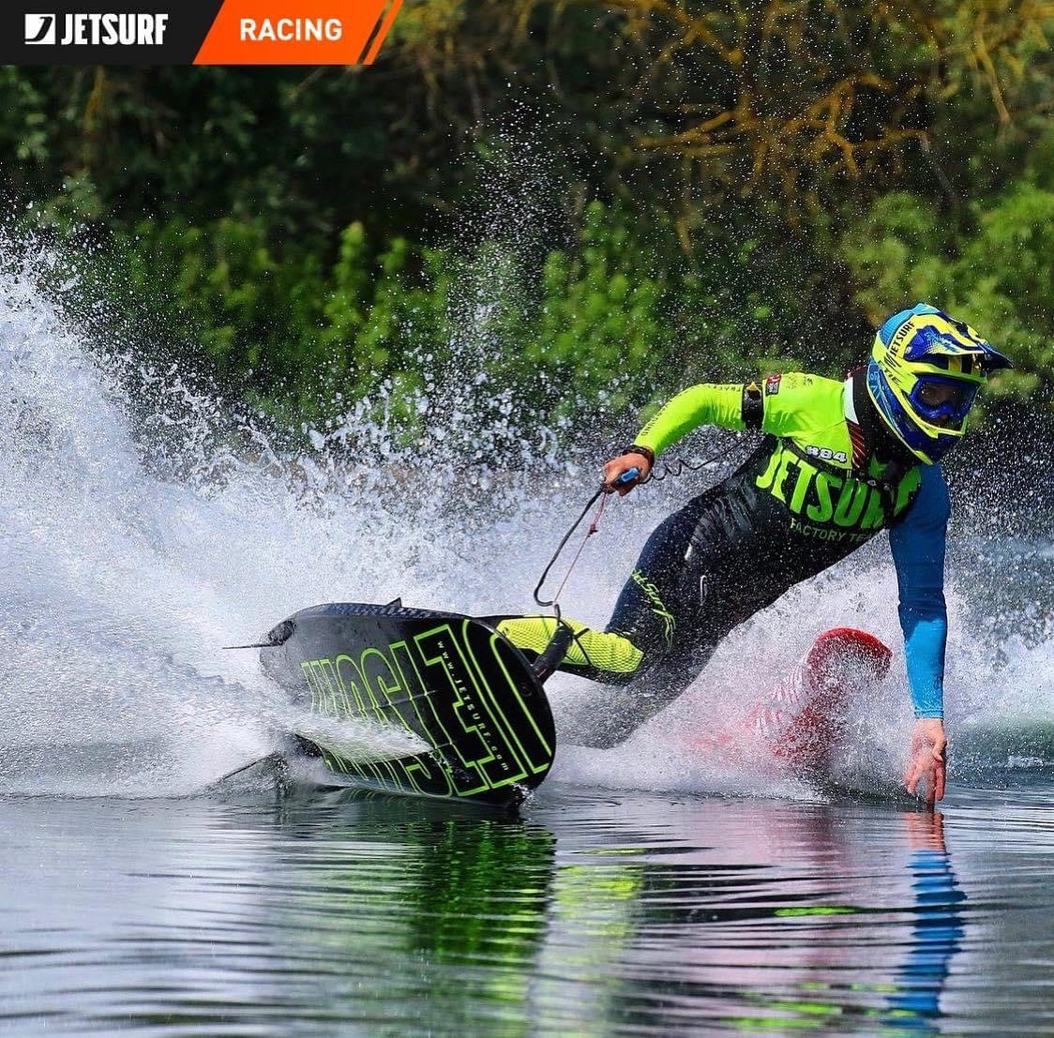
1. MSWC 2022
ABU DHABI 25.-27.3.
1st stop of Motosurf World Cup 2022
Riders from all around the World
5 cathegories: Men Open, Men Stock, Women, Rookies, Juniors
Special events – concerts, motocross show
www.motosurfworldcup.com

Slide 11
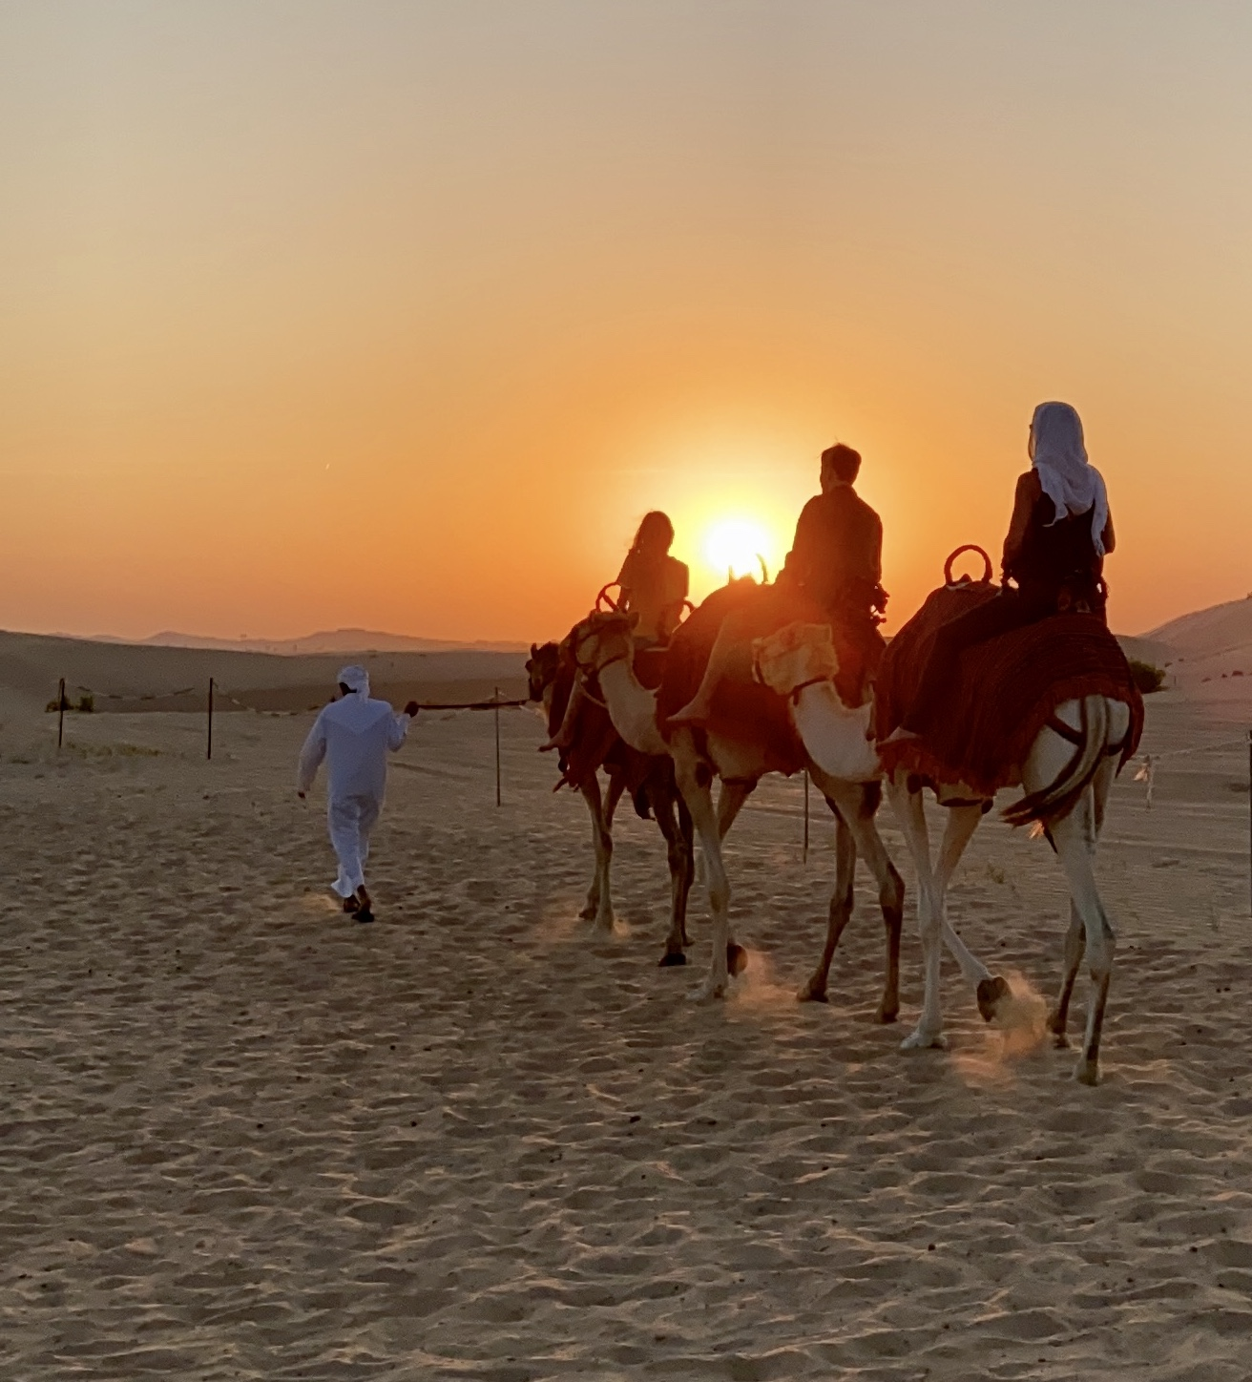
TRIPS
Sunset in desert / beduine village, camel ride, dancing, dinner & shisha
Abu Dhabi sightseeing – Mosque, Etihad towers, markets
1day trip Dubai
F1 Yas Marine / Ferrari Park
Water World
Shopping
Other water sports – wakeboard, wakesurf, flyboard, artificial wave surfing, skateboards ..

Slide 12
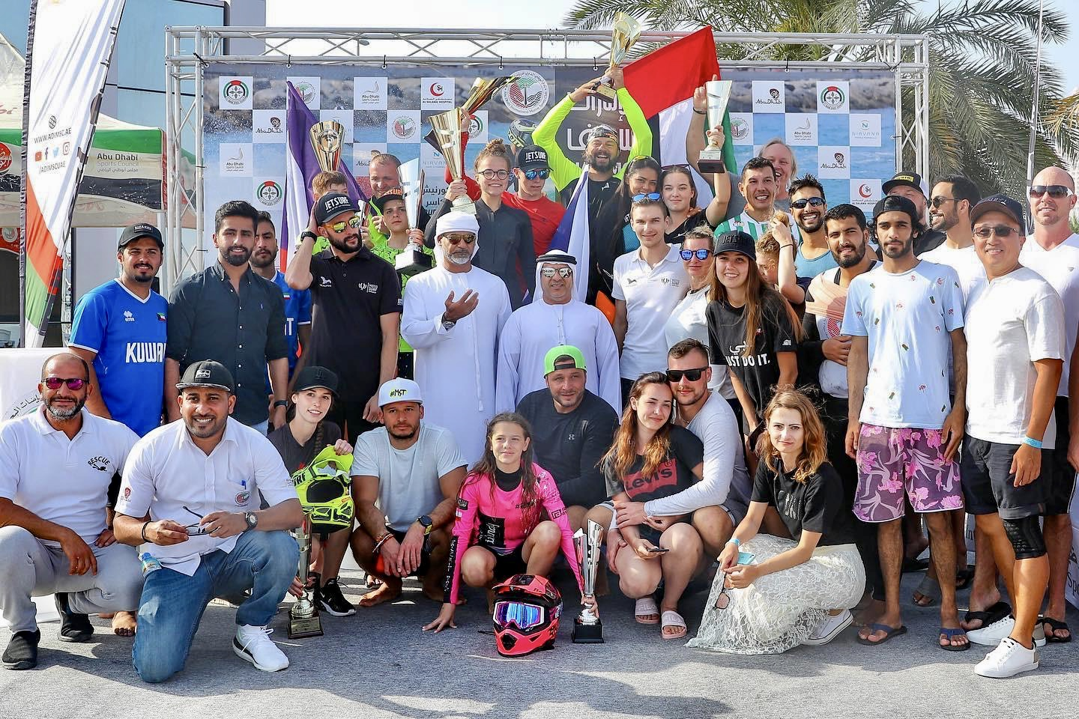
JETSURF ACADEMY / Martina Lukscheider +420 603 484 320
info@jetsurf-academy.cz www.jetsurf-academy.cz fb/ig Jetsurf Academy

