Slide 1

Securities-Based Lending
by

Slide 2
Agenda
What is Securities-Based Lending (SBL)?
The Value of SBL
How Clients are Using SBL
SBL at Leader Bank

Slide 3

What is Securities-Based Lending?
Convenient & flexible access to liquidity.

Slide 4
What is Securities-Based Lending?
Convenient & flexible access to liquidity.
Investment assets serve as collateral for revolving credit line.

Slide 5
What is Securities-Based Lending?
Convenient & flexible access to liquidity.
Investment assets serve as collateral for revolving credit line.
Proceeds can be used for any reason, except to buy securities.

Slide 6
What is Securities-Based Lending?
Convenient & flexible access to liquidity.
Investment assets serve as collateral for revolving credit line.
Proceeds can be used for any reason, except to buy securities.
Free to set up, no obligation to draw.

Slide 7
What is the Value For My Clients?

Slide 8
What is the Value For My Clients?
Avoid selling investments – maintain investment strategy and defer potential capital gains.
Lower interest rates than traditional loan products.
Flexible terms – no amortization; interest can be capitalized into the credit line.
Simplified application – online submission, typically no documentation required.
Fast underwriting – usually 1-2 business days; no impact to credit score.
No fees to set up or keep open; interest paid only on drawn balances.

Slide 9
What is the Value For My Clients?
Avoid selling investments – maintain investment strategy and defer potential capital gains.
Lower interest rates than traditional loan products.
Flexible terms – no amortization; interest can be capitalized into the credit line.
Simplified application – online submission, typically no documentation required.
Fast underwriting – usually 1-2 business days; no impact to credit score.
No fees to set up or keep open; interest paid only on drawn balances.

Slide 10
What is the Value For My Clients?
Avoid selling investments – maintain investment strategy and defer potential capital gains.
Lower interest rates than traditional loan products.
Flexible terms – no amortization; interest can be capitalized into the credit line.

Slide 11
What is the Value For My Clients?
Avoid selling investments – maintain investment strategy and defer potential capital gains.
Lower interest rates than traditional loan products.
Flexible terms – no amortization; interest can be capitalized into the credit line.
Simplified application – online submission, typically no documentation required.

Slide 12
What is the Value For My Clients?
Avoid selling investments – maintain investment strategy and defer potential capital gains.
Lower interest rates than traditional loan products.
Flexible terms – no amortization; interest can be capitalized into the credit line.
Simplified application – online submission, typically no documentation required.
Fast underwriting – usually 1-2 business days; no impact to credit score.

Slide 13
What is the Value For My Clients?
Avoid selling investments – maintain investment strategy and defer potential capital gains.
Lower interest rates than traditional loan products.
Flexible terms – no amortization; interest can be capitalized into the credit line.
Simplified application – online submission, typically no documentation required.
Fast underwriting – usually 1-2 business days; no impact to credit score.
No fees to set up or keep open; interest paid only on drawn balances.

Slide 14
What is the Value For My Clients?
Avoid selling investments – maintain investment strategy and defer potential capital gains.
Lower interest rates than traditional loan products.
Flexible terms – no amortization; interest can be capitalized into the credit line.
Simplified application – online submission, typically no documentation required.
Fast underwriting – usually 1-2 business days; no impact to credit score.
No fees to set up or keep open; interest paid only on drawn balances.

Slide 15
What is the Value to the Advisor?

Slide 16
What is the Value to the Advisor?
Offer Balanced Wealth Management
Help clients manage their entire financial picture, both sides of the balance sheet.

Slide 17
What is the Value to the Advisor?
Offer Balanced Wealth Management
Help clients manage their entire financial picture on both sides of the balance sheet.
Facilitate Asset Acquisition
Develop deeper relationships as a trusted advisor offering clients holistic financial guidance.

Slide 18
What is the Value to the Advisor?
Offer Balanced Wealth Management
Help clients manage their entire financial picture on both sides of the balance sheet.
Improve Asset Retention
Offer a liquidity solution that keeps investments intact, enabling more control over investing decisions.¹
Facilitate Asset Acquisition
Develop deeper relationships as a trusted advisor offering clients holistic financial guidance.
¹ There is no restriction on trading pledged securities.

Slide 19
What is the Value to the Advisor?
Offer Balanced Wealth Management
Help clients manage their entire financial picture on both sides of the balance sheet.
Improve Asset Retention
Offer a liquidity solution that keeps investments intact, enabling more control over investing decisions.¹
Facilitate Asset Acquisition
Develop deeper relationships as a trusted advisor offering clients holistic financial guidance.
Differentiation
Distinguish your value with a complete product offering.
¹ There is no restriction on trading pledged securities.

Slide 20
What is the Value to the Advisor?
Offer Balanced Wealth Management
Help clients manage their entire financial picture on both sides of the balance sheet.
Improve Asset Retention
Offer a liquidity solution that keeps investments intact, enabling more control over investing decisions.¹
Facilitate Asset Acquisition
Develop deeper relationships as a trusted advisor offering clients holistic financial guidance.
Differentiation
Distinguish your value with a complete product offering.
¹ There is no restriction on trading pledged securities.

Slide 21








How are Clients using SBL
An efficient way to finance virtually any personal or business need…
Real Estate purchases or construction financing
^{Help with debt consolidation}
Funds for tax payments or liabilities
^{Pay for education costs}
Cash flow to cover business expenses
Make home improvements or repairs
Car, boat, or any other personal luxury purchases
Help covering unexpected emergencies or expenses
Real Estate accounts for ~60% of Leader Bank SBL balances
*Data as of 12/31/2023

Slide 22


SBL at Leader Bank
Leader Bank Power Line
Empower your clients’ financial lives!
TM

Slide 23
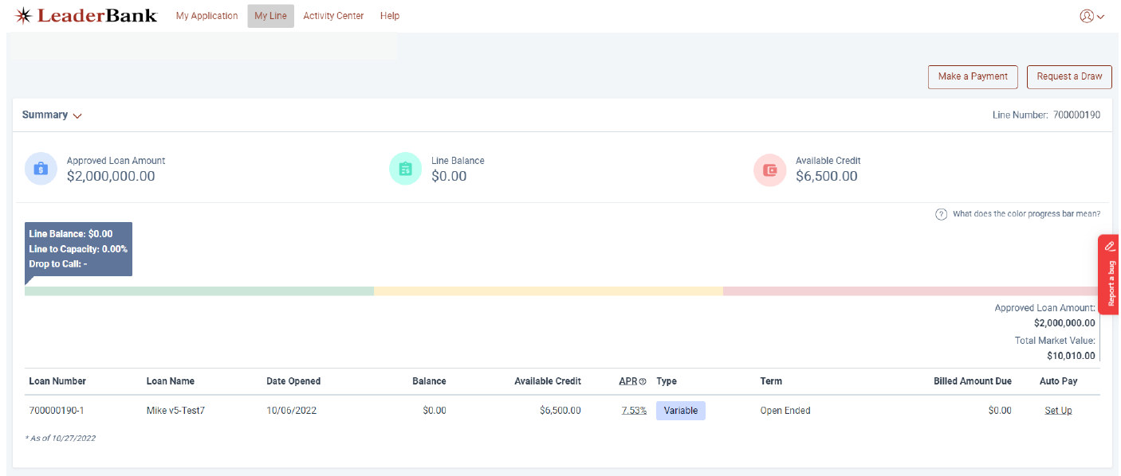
Leader Bank Power Line
TM
Easy and convenient online access
Exceptional client service from knowledgeable professionals (96% CSAT)
Experienced SBL partners
  1,200 credit lines activated
  $2.1 billion in pledged collateral assets monitored
  $1.4 billion in commitments booked
Average underwriting turnaround time → 0.6 days
  82% of applications decisioned same-day (~99% for apps received “In Good Order”)

Slide 24
Leader Bank Credit Policy
Eligible Collateral Account Types – Individual, joint, & trust (non-retirement only!)¹
Credit lines between $25,000 and $10 million with draws as low as $1,000²
Advance rates between 60%-95% based on security type³
Soft credit pulls avoid impacting client’s credit report
Trust certificates used for both revocable and certain irrevocable trust types⁴
No documentation or Personal Financial Statements typically required
Security Type | Typical Advance Rates
Equities | 60% - 65%
Mutual Funds & ETFs⁵ | 65% - 90%
Fixed Income⁶ | 65% - 95%
Cash & Equivalents | 90%
¹ Currently eligible for assets custodied at Schwab.
² Lines > $10 million are reviewed on an exception basis.
³ Haircuts may apply for portfolio concentrations.
⁴ Certain trust structures may require review of full trust documents, determined at time of application.
⁵ 30-day “seasoning” period does not apply for rebalanced or newly-purchased funds.
⁶ Investment Grade fixed income only.

Slide 25
Leader Bank Pricing Grid
Client rates are calculated by adding the Index and Spread Rates.
Credit Line Size is determined by the pledged collateral assets, calculated in accordance with Bank policy.
Index Rate resets weekly every Monday (or the following Business Day in the event of holiday).
Credit Line Size | Index Rate | Spread Rate
$5MM+ | 1-Month Term SOFR (5.33% as of 1/31/24) | 1.75%
$3MM - $4.99MM |  | 2.00%
$1MM - $2.99MM |  | 2.25%
$500k - $999k |  | 2.50%
$250k - $499k |  | 2.75%
$100k - $249k |  | 3.00%
< $100k |  | 3.50%

Slide 26
How to Get Started
Visit the Leader Bank Landing Page on WEALTHCAREGDX for more information on Leader Bank & SBL.
Email planning@wealthcarecapital.com indicating your interest to register.
You will receive an invitation email from Leader Bank to register on the SBL portal.
Once registered, you may begin initiating credit line proposals and applications for your clients.
Contact the Leader Bank Client Solutions Team at 844-807-6937 or PowerLine@leaderbank.com for support!

Slide 27




Any Questions?
Securities-Based Lending
Elevate Banking
Mike Fede
VP – SBL Product Team
Email: mfede@leaderbank.com
Phone: 732-887-5653
Matthew Bomgaars
Adam Shealy
Ashtin Latting
Client Solutions Team
Email: PowerLine@leaderbank.com
Phone: 844-807-6937
(available M-F, 9-5pm ET)
Dorothy Zahir
SVP – Head of Retail and Elevate Banking
Email: dzahir@leaderbank.com
Phone: 781-641-8660
Travis Hall
VP – Elevate Banking
Email: thall@leaderbank.com
Phone: 781-641-8642

Slide 28
Considerations
& Disclosures
Securities-based lines of credit carry certain risks that should be carefully considered to ensure this product is right for your clients:
A reduction in the market value of pledged collateral may trigger a maintenance call, which could require the pledge of additional eligible collateral, the repayment of borrowed funds, or the potential sale of pledged securities requested at the Bank’s discretion. Such sales may carry adverse tax or other consequences.
Leader Bank may modify the collateral requirements at any time without prior notice.
The Leader Bank Power Line™ is an uncommitted demand facility, which means the Bank may require full or partial repayment at any time or elect not to advance funds.
For more information on the Leader Bank Power Line™, please carefully review all loan materials provided with the application.
Leader Bank Power Line™ proceeds may not be used to purchase securities or to repay a margin loan that was used to purchase securities. Leader Bank, N.A. cannot provide tax advice concerning the legal, investment or tax consequences of a given transaction. Please consult with your financial or tax advisor about your particular circumstances before making any investment or financial decisions. To ensure compliance with requirements under Treasury Department Circular 230, we inform you that the contents of this publication are not intended or written to be used, and may not be used, for the purpose of (i) avoiding U.S. federal tax penalties or (ii) promoting, marketing, or recommending to another party any matter addressed herein. Each taxpayer should seek advice based on the taxpayer’s particular circumstances from an independent tax adviser.
Capitalizing interest means that any billed interest not paid by the due date will be automatically paid by drawing on the Leader Bank Power Line™, adding to the outstanding principal balance.
Banking products and services are offered through Leader Bank, Member FDIC.
The interest rate market data is the property of Chicago Mercantile Exchange Inc. or its licensors as applicable. All rights reserved, or otherwise licensed by Chicago Mercantile Exchange Inc.
180 Massachusetts Ave, Arlington, MA 02474 | 844-807-6937 | powerline@leaderbank.com | www.leaderbank.com

