Slide 1

Leader Bank Power Line
INTERNAL USE ONLY

Slide 2
Advisor Overview
INTERNAL USE ONLY
Email planning@wealthcarecapital.com indicating your interest to register for the Leader Bank Power Line portal.
    You will receive an email from Leader Bank inviting you to register.
Once registered, you may begin initiating credit line estimates and proposals for clients.
After creating an estimate, you may…
    Share the proposal with your client (borrowing amount and interest rate), or
    Start an application for your client.
The application must be assigned to the client to finalize the information and sign the loan documents (via DocuSign).
Contact the Leader Bank Solutions Team at 844-807-6937 or powerline@leaderbank.com for support

Slide 3
Estimate & Proposal
INTERNAL USE ONLY

Slide 4
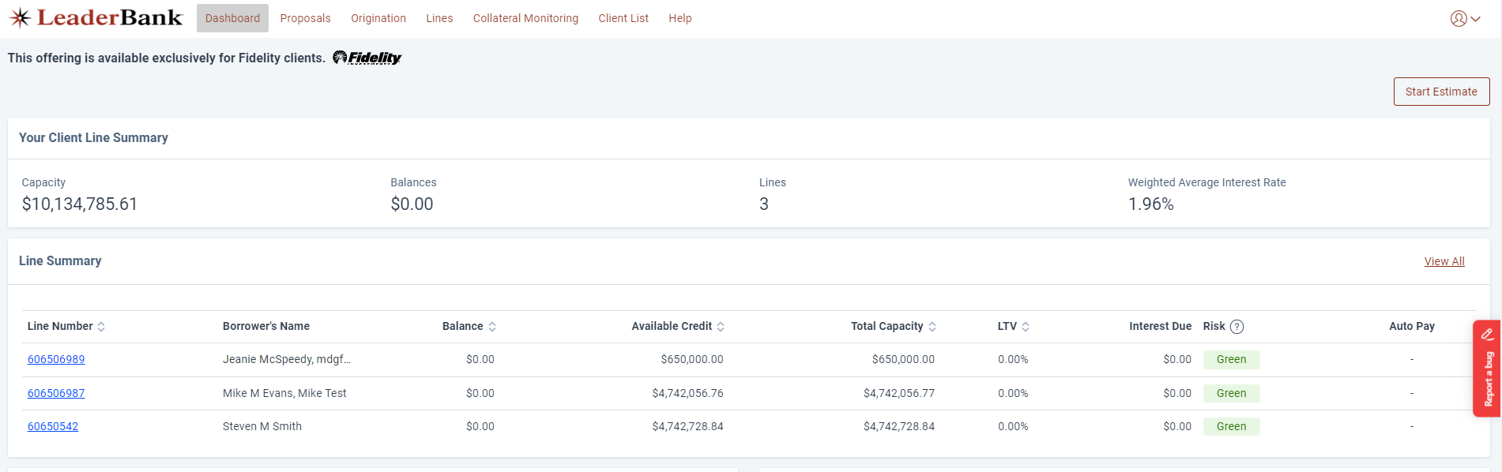
Estimate & Proposal
INTERNAL USE ONLY
Go to https://powerlinesbl.leaderbank.com/auth/login and log in using the credentials created during the registration process.
  Note: your email address is your username.
Click on the Start Estimate button to begin the proposal process.

Slide 5
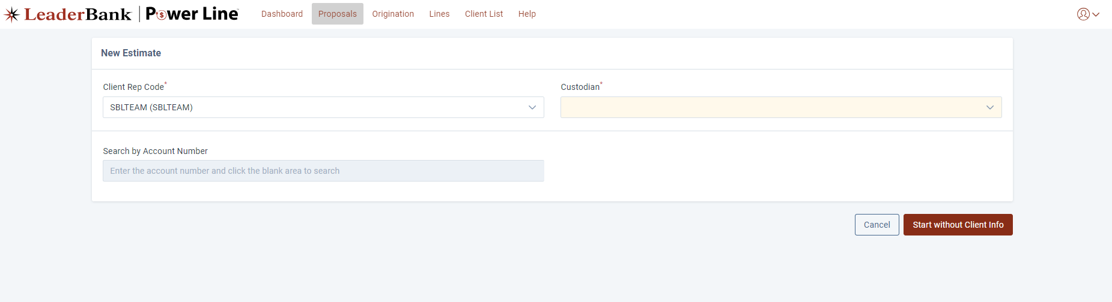
Estimate & Proposal
INTERNAL USE ONLY
Ensure your correct Client Rep Code is selected (set up during registration).
Select the proper Custodian for the investment assets.
  Note the Search by Account Number field is not required.
Click Start without Client Info button.

Slide 6
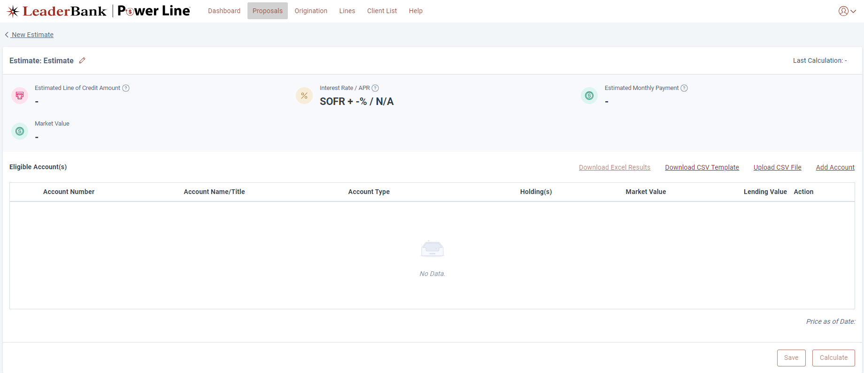
Estimate & Proposal
INTERNAL USE ONLY
Download the list of securities that will serve as collateral for the credit line.
Add those securities (tickers or CUSIPS) and quantities to this template.
Click the Upload CSV File button and upload the file.
  Contact the Leader Bank Solutions Team at 844-807-6937 for assistance with this process!

Slide 7
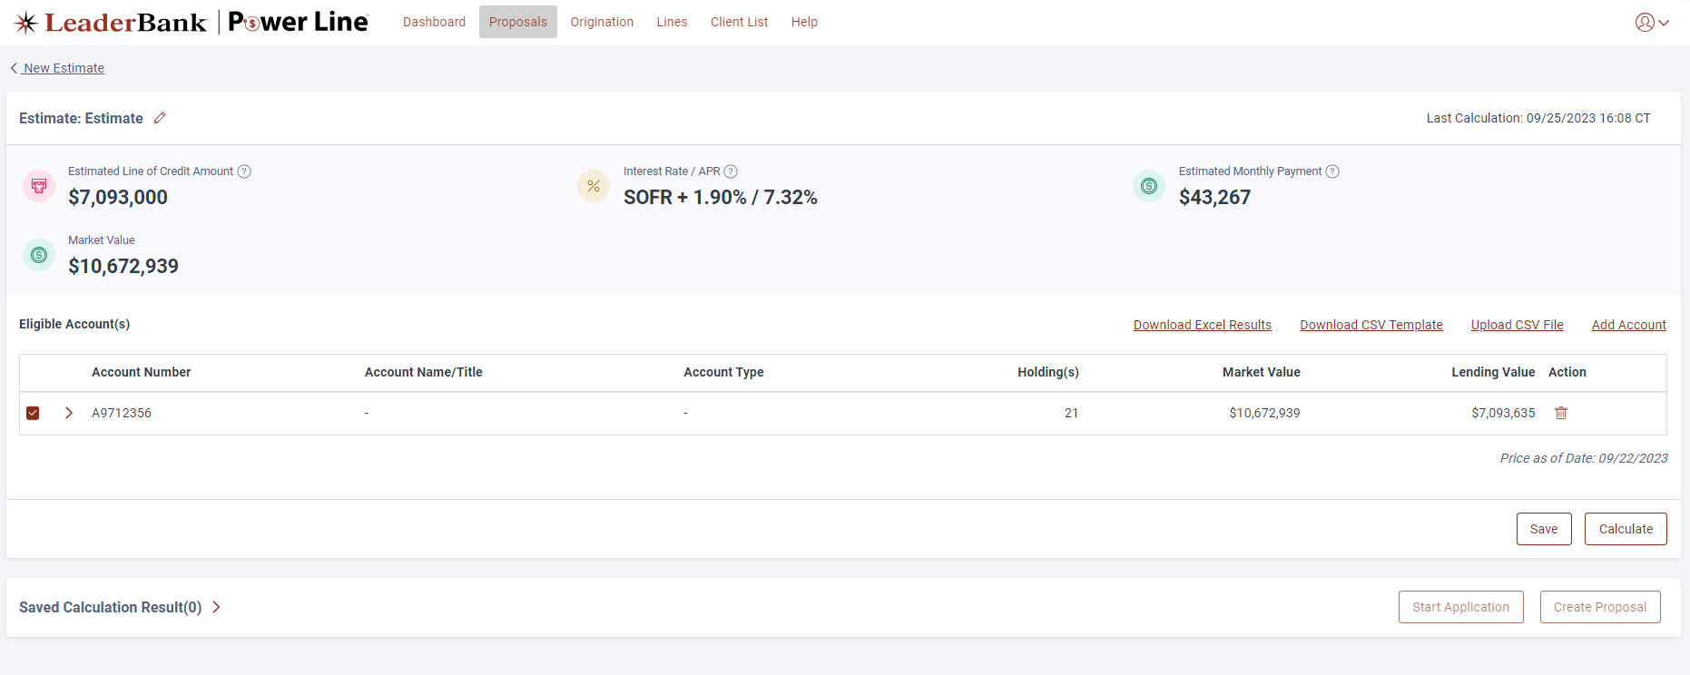
Estimate & Proposal
INTERNAL USE ONLY
Once uploaded, click the Calculate button to generate the Estimated Line of Credit Amount and the Interest Rate / APR.
  Expand the caret next to the Account Number to see the Lending Value for each individual security.
Once ready, click the Save button to save the estimate.

Slide 8
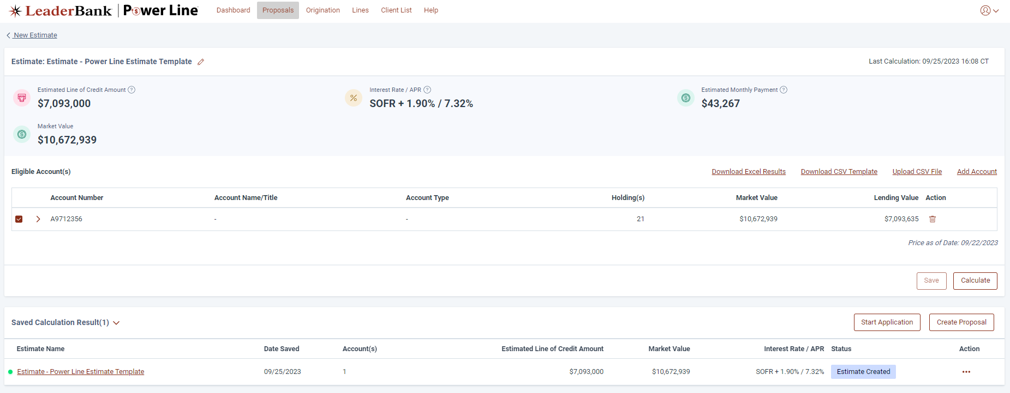
Estimate & Proposal
INTERNAL USE ONLY
Click Create Proposal to send the estimate to the client, or click Start Application to begin the digital application process.
  Proposals may be delivered to a client in-person or via email.
The estimate will be stored within the Proposals > Estimates page, so you can always return later to start the application.

Slide 9
Creating the Application
INTERNAL USE ONLY

Slide 10
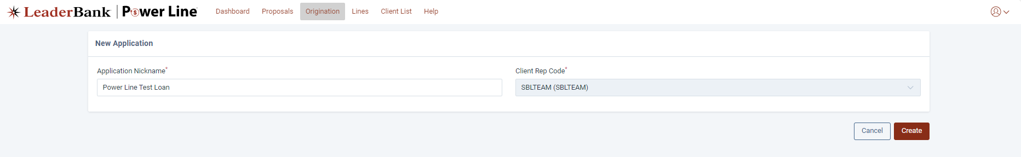
Creating the Application
INTERNAL USE ONLY
Once you click Start Application, enter the client’s name in Application Nickname.
  Note: Confirm that the Client Rep Code reflects your rep code set up at registration.
Click Create.

Slide 11
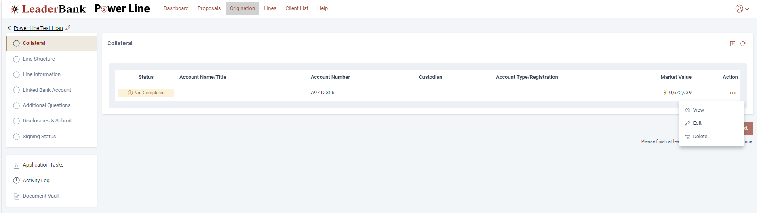
Creating the Application
INTERNAL USE ONLY
Within the Collateral page, click the three dots under Action and select Edit to begin the application process.

Slide 12
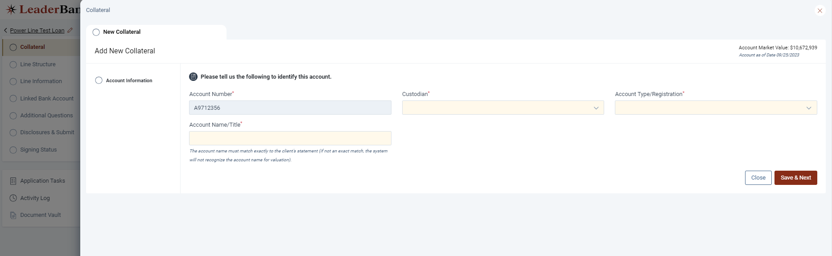
Creating the Application
INTERNAL USE ONLY
Select the proper Custodian of the investment assets (e.g., Fidelity, Schwab).
Select the correct Account Type/Registration of the pledged collateral account (individual, joint, trust).
Type the Account Name/Title of the collateral account.
  Important Note: This must match the Account Name/Title on the monthly investment account statement.

Slide 13
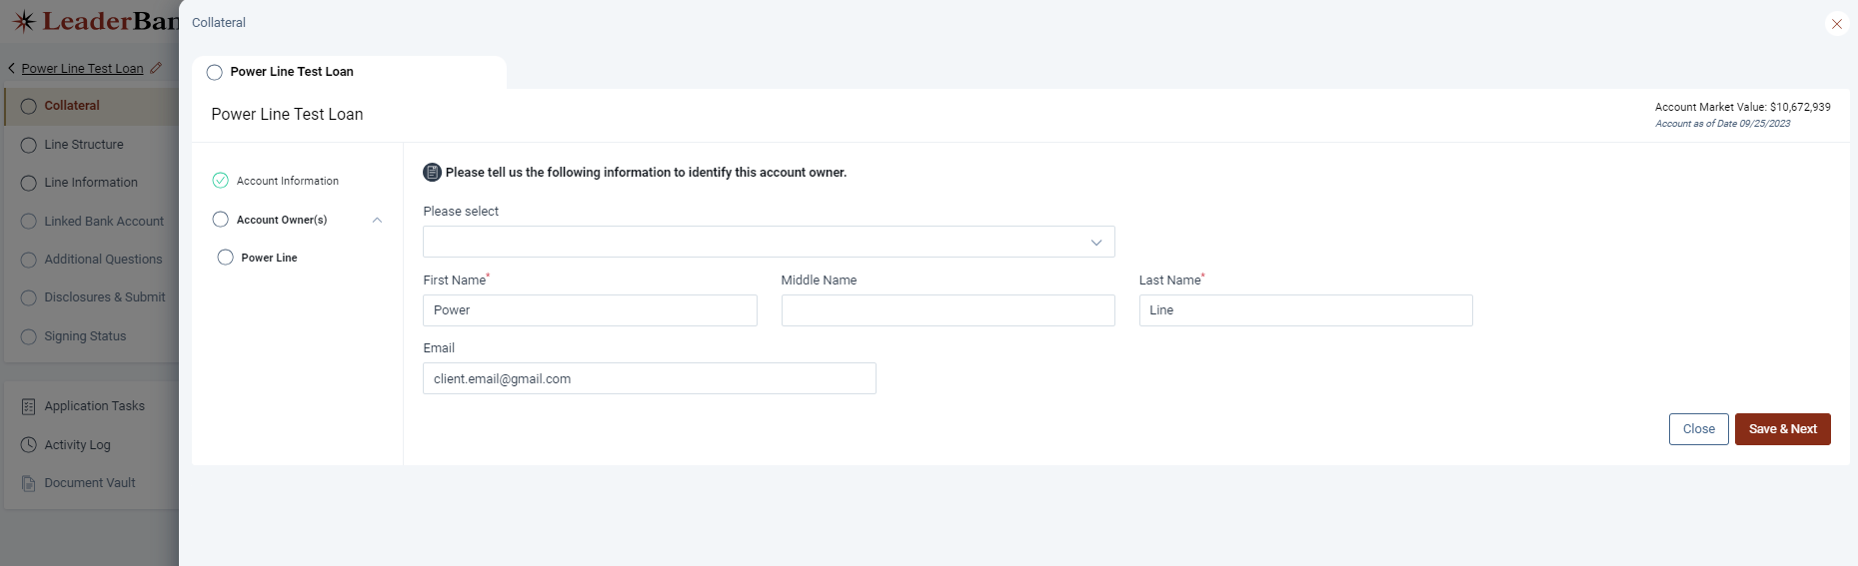
Creating the Application
INTERNAL USE ONLY
Enter the client’s First Name, Last Name, and Email Address.
Click Save & Next.

Slide 14
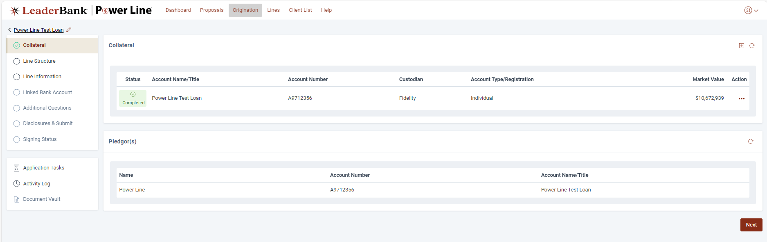
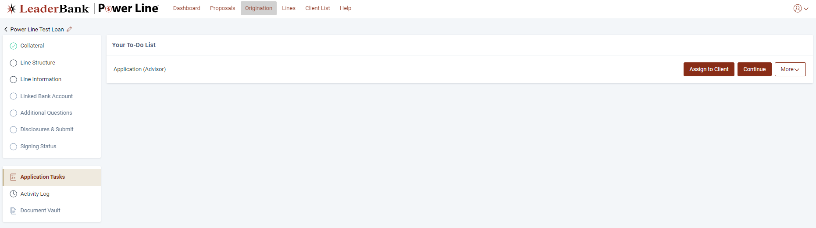
Creating the Application
INTERNAL USE ONLY
Once the Collateral page is Completed you may:
  Continue to assist the client with filling out the rest of the application, or
  Assign the application to the client by clicking Application Tasks > Assign to Client.
    Assign to Client will email them a Registration link to create login credentials, finalize the application, and sign the loan documents.
{
(a)
(b)

Slide 15
Finishing/Submitting the Application
INTERNAL USE ONLY

Slide 16
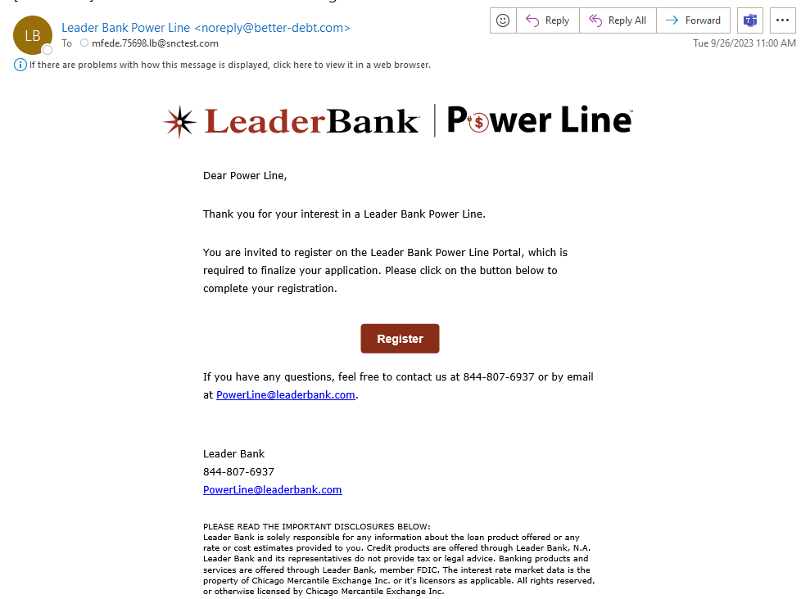
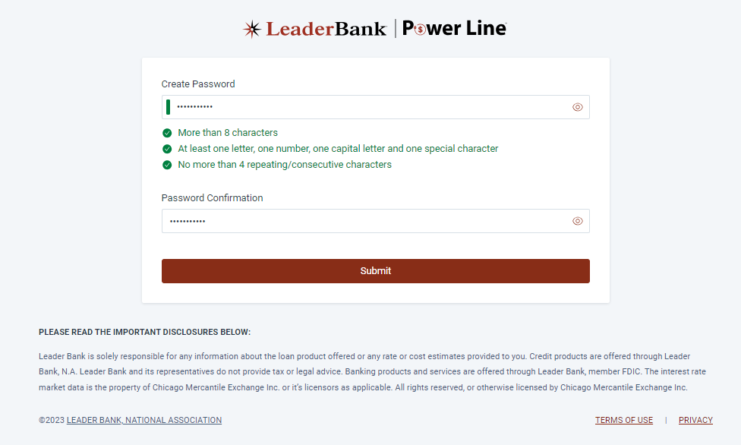
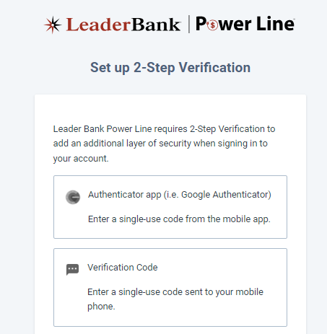
Finishing the Application
INTERNAL USE ONLY
Client will receive an email and click the Register button.
Client will be prompted to Create Password, then select a 2-Step Verification method.
  Note: their email address is the username.

Slide 17
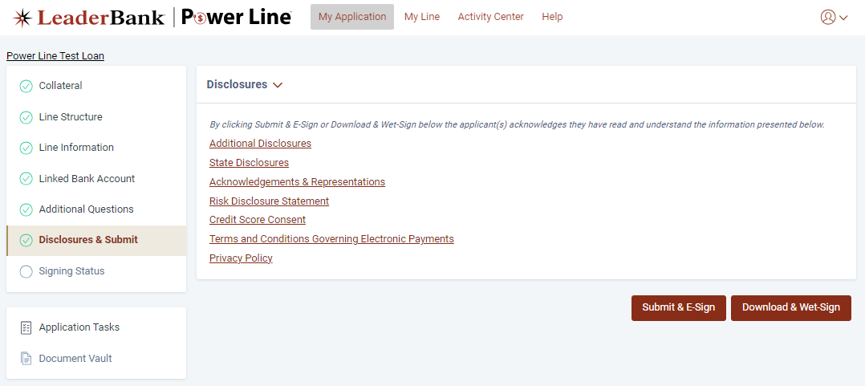
Finishing the Application
INTERNAL USE ONLY
Client will finish filling out the application and confirm all information is correct, then click Submit & E-Sign.
  Individual applicants, or primary applicants of joint applications, will be routed directly to DocuSign.
  Any joint applicants will receive an email from DocuSign to sign their loan documents.
Once DocuSign is completed by all applicants, the application is submitted and automatically moves into Underwriting.
{

Slide 18
Application Approved
INTERNAL USE ONLY

Slide 19
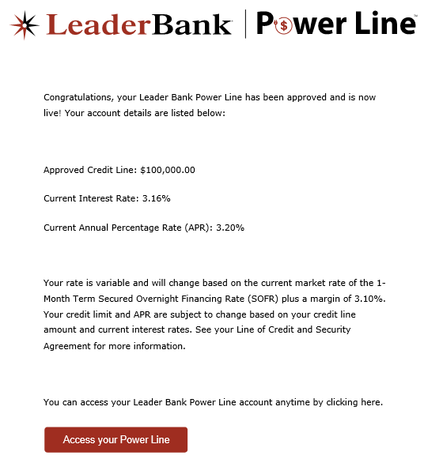
Application Approved
INTERNAL USE ONLY
Applications are typically reviewed and approved by Leader Bank in 1-2 business days.
The custodian (e.g., Fidelity, Schwab) then counter-signs the loan documents and sends Leader Bank the collateral positions.
Leader Bank activates the credit line, and the client receives an email that the Line is Live.
  Note: The Advisor is copied on this approval email as well for visibility.
Client can click the Access your Power Line button to log in and view their available credit, request a draw online, etc.

Slide 20
Considerations & Disclosures
INTERNAL USE ONLY
The Leader Bank Power Line™ is currently available to financial advisors using Fidelity Institutional for clearing and custody services. Securities-based lines of credit carry certain risks that should be carefully considered to ensure this product is right for your clients:
A reduction in the market value of pledged collateral may trigger a maintenance call, which could require the pledge of additional eligible collateral, the repayment of borrowed funds, or the potential sale of pledged securities requested at the Bank’s discretion. Such sales may carry adverse tax or other consequences.
Leader Bank may modify the collateral requirements at any time without prior notice.
The Leader Bank Power Line™ is an uncommitted demand facility, which means the Bank may require full or partial repayment at any time or elect not to advance funds.
Leader Bank Power LineTM proceeds may not be used to purchase securities or to repay a margin loan that was used to purchase securities. Leader Bank, N.A. cannot provide tax advice concerning the legal, investment or tax consequences of a given transaction. Please consult with your financial or tax advisor about your particular circumstances before making any investment or financial decisions. To ensure compliance with requirements under Treasury Department Circular 230, we inform you that the contents of this publication are not intended or written to be used, and may not be used, for the purpose of (i) avoiding U.S. federal tax penalties or (ii) promoting, marketing, or recommending to another party any matter addressed herein. Each taxpayer should seek advice based on the taxpayer’s particular circumstances from an independent tax adviser.
Monthly billed interest may be paid directly or capitalized into the credit line. Capitalizing interest means that any billed interest not paid by the due date will be automatically paid by drawing on the Leader Bank Power LineTM, adding to the outstanding principal balance. Borrowers may choose to pay interest without capitalizing their payments and can prepay their line balance at any time without penalty.
Banking products and services are offered through Leader Bank, N.A., Member FDIC.
The interest rate market data is the property of Chicago Mercantile Exchange Inc. or its licensors as applicable. All rights reserved, or otherwise licensed by Chicago Mercantile Exchange Inc.

